Slide 1
UNIT III
PART II. COVER LETTER

Slide 2
What is a Cover Letter?
A cover letter is a document which highlights the skills one possesses that are most relevant and important to the specific post you are applying to.
It introduces your resumé (CV) and shows your passion for the position.

Slide 3
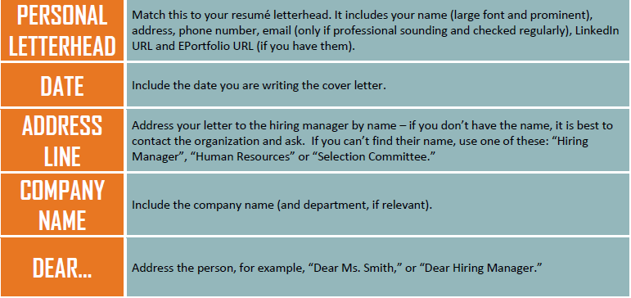
Structure and content of cover letter
Part I. The Set up

Slide 4
The set up: Example

Slide 5
Part II. The Content
1. Introduction

Slide 6
Introduction: Example

Slide 7
2. Body

Slide 8
Body: Example

Slide 9
3. Conclusion

Slide 10
Conclusion: Example

