Slide 1
Data Analysis in Interpretive Research: An Overview of Analysis Historical Development and its Main Constraints
Dr. Betka Rezig Nadia

Slide 2
Contents
Introduction
Interpretive Research Benefits and Challenges
History of Research and Data Analysis
Rationalism and Analysis : An example
Definition of Data Analysis
Challenges in Data Analysis in Interpretive Research
Developing a Consistent Analysis in Interpretive Research
Conclusion

Slide 3
Introduction
Data Analysis constitutes one of the major steps in academic research; a phase that carries researchers' deep view to their research findings and in- context implementation of their discipline knowledge to reach a grounded theory. Nontheless the nature of interpretive research presents a set of challenges as far as data analysis is concerned since it is qualified as subjective and based on biased data collection.

Slide 4
Interpretive Research
The term interpretive research is used interchangebly with the term Qualitative research but in fact there are differences between the two terms, IR is based on the assumption that the social reality is not singular or objective, but it is rather shaped by human experience and social contexts by considering the subjective interpretations of its varied participants
Social reseachers try to interpret reality through a sense making process rather than a hypothesis testing process when they implement statistics in their investigations they try only to add some precision to the the findings

Slide 5
Benefits and Challenges of Interpretive Research
There are many positive aspects of IR such as :
It is well suited to explore hidden easons behind the complex and multifaceted social processes ex : in politics
It is very helpful i theory building
It extremely helpful to study context specific events or processes
Example of the interperetive research benfits is the agency theory which is a theory in employer-employed rrelationship as far as payment is concerned
Interpretive research faces the following problems :
It is consumes much time in data collection because too little data lead to premature assumptions
It requires well trained researchers ho are capable of seeing and interpreting complex social phenomena without injecting their biases and precoceptions.
Interperetive research results do not lend themselves to repetition or generalization

Slide 6
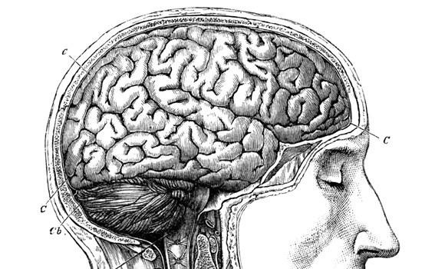
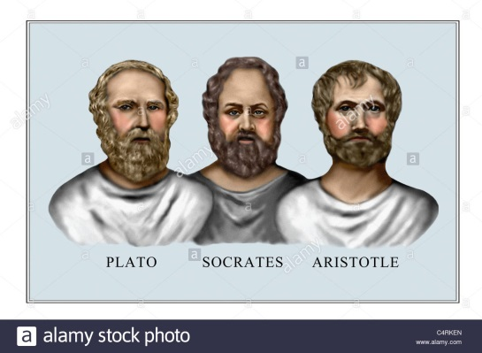
Rationalism
In the 3rd Century, Plato, Aristotle and Socrates established the first principles of analysis, they believed that
‘The fundamental nature of being and the world can be understood more accurately through the process of logical reasoning called Rationalism. Aristotle, in his book, Metaphysics, suggested that the criterion of truth is not sensory, it is intellectual for that reason, his laws were called the laws of non contradiction which gained unlimited support and analysis as a skill became the only means investigation.

Slide 7
Rationalism and Modern Research
Example: The « Agency Theory » in the private sector of buisiness:
The employer The active employed
Needs active workers Can do better than the
other workers
Needs continuous progress Seeks more consideration
Payes equally all workers Is obliged to be less active
He is not satisfied He is no longer active
The Solution:
Payment is relative to efforts and success to achieve progress and satisfy active workers. The commission

Slide 8
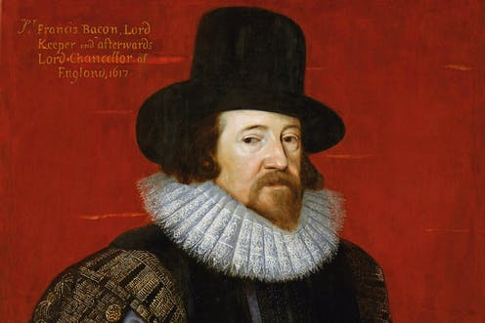
Empericism
Francis Bacon , In the 16th century the British philosopher (1561-1626) suggested that knowledge can be derived from observation in the real world, experimentation and Empericism emerged as a branch of philosophy

Slide 9
Empericism and Data Analysis
As a theory of knowledge, empiricism upholds the view that experience is the only source of knowledge, or that senses alone can provide us with knowledge. In other words, Perception of observable data are sufficient to reveal all needed explanations .
Two negative aspects appeared:
Researchers’ interpetations and analysis have no real significance, and, empericism cannot meet the demands of enquiries in the fields of epistemology and metaphysics because of its inherent limitations.

Slide 10
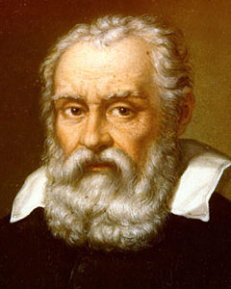
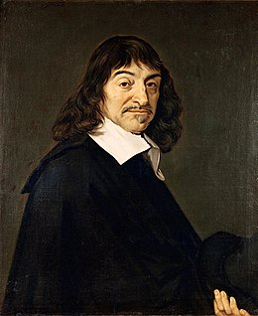
Rationalism Vs Empericism
The Middle Ages witnessed a clash between Rationalism and Empericism, Rene Descarte the French philosopher sided with rationalism, Galileo Galilei and Issac Newton fused their ideas into natural philosophy and their contributions were based on the principle that the laws of nature are mathematical. (Astronomy)

Slide 11
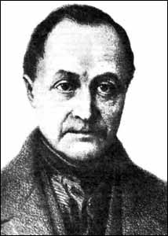
The Birth of Sociology
E. Kant
Emmanuel Kant, the German philosopher, tried to solve the clash between Empericism and Rationalism, a new view was born German Idealism
French philosopher, Auguste Compte(1798-1875) founded the discipline of sociology that blended rationalism and empericism into a doctrine called positivism which means that theory and observation have dependance on each others. Positivism was the foundation of social research that is called now : Qualitative research.
Analysis regained its importance to combine statistics and the interpretation of qualitative data together in one study which is far from being a clear mission

Slide 12
Data Analysis in Social Sciences
Definition
Qualitative analysis is the analysis of qualitative data, unlike the quantitative analysis which is statistics driven and largely independant of the researcher, qualitative data analysis is heavily dependant on the researcher’s analytic and integrative skills and personal knowledge of the social context where the data are collected. The focus in qualitative analysis more or less on ‘sense making’ in understanding a phenomenon rather than predicting or explaining.

Slide 13
Types of Analysis
The Grounded theory : one of the techniques of analyzing data devloped by Glazer and Strauss 1967 It is an inductive technique to intetrpret recorded data about a social phenomenon to build an analysis ; data are grouped in a system of codes and categories and their relationships are clearely screened.
Content analysis : a systematic analysis of the content of a book (as example) what, to whom, why, to what extent and with what effect, by selection of information.
Hermeunetics analysis : a special type of analysis where the researcher tries to interpret the subjective meaning of a given information

Slide 14
Steps in Developping Data Analysis in Interpretive Research
Step 1
Identify precisely your unit of analysis
The unit of analysis is the major entity that you are analyzing in your study. Who, what ………………….
Step 2
Decide about the way you will analyze it
your time frame and factors in relation . Ex: do we analyze the analysis unit’s development, drawback……..
Step 3
Select the data you will use in the analysis
Step 4
Map the relationships between these data to develop a logical connection to make sense and convince the reader
Step 5
Draw a thought line to follow along your data analysis to be able to move from one point to
another point without contraiction
Leave the most important arguments to the end of your analysis to give a strong effect.

Slide 15
Conclusion
Throughout time, research aimed basically at developping theories that help us solve problems, understand phenomena, control them or predict their evolution with non, total or partial involvement from the part of the researcher. Data analysis remains as a pillar in this process; it carries every aspect of the process either explcit or hidden, the researcher’s skills, vision, way of thinking and knowledge and most importantly, his contribution.

