Slide 1
UNIT III
Academic correspondence

Slide 2
Objectives
By the end of this unit, students will be able to:
Write personal statement (motivation letter) and cover letter
Express reasons of application
Write about their academic capacities
Write about their contributions

Slide 3
Personal statement: Overview
Many graduate programs require some sort of written statement as part of the application.
Personal statements are ways for graduate admissions committees (usually made up of program faculty) to learn more about you as an applicant.
The admission committee wants to know not only what interests you about the program, but also what you will contribute to their program in terms of research, seminar discussions, conferences and other collaborative opportunities.

Slide 4
Types of personal statements
Personal statements
Comprehensive
Response to a prompt
1. Comprehensive personal statement may not require any word count or guidelines. This is an example: “Write a personal statement describing your experiences and goals.”
2. Response to a specific prompt: Often, the prompt includes several questions such as, “Explain why this program is the best fit for you” or “Tell us about an accomplishment that is important to you.”

Slide 5
Samples of personal statements prompts

Slide 7
Writing the personal statement: get started
Accomplishments
Personal accomplishments: talents and attributes that make you special
Academic accomplishments : achievements, awards and honors
Experiences
Community experiences: extracurricular activities (volunteering, memberships)
Professional experience: work experience and affiliation

Slide 8
Storytelling
How does the story explain your personality traits?
How does the story show you as an individual?
Passion
What does the story tell the readers about your passion and dreams?
Study and research
Does the story explain the reason of application?
In what way does the story explain your study and research interests?
Does the story express how you see yourself as the most fitting candidate?
Personality

Slide 9
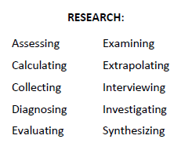
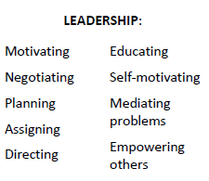
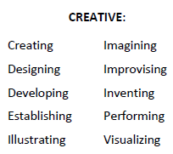
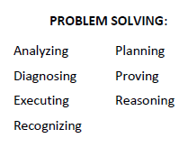
List of skills and traits

Slide 11
Structure and content of the personal statement
Paragraph 1. reasons for your choice
What course would you like to study?
Why are you interested in studying this course?
Why do you find this field interesting?
Is there anything in particular that has inspired you?
What are your future aims and ambitions – do you have a particular career in mind?

Slide 12
Paragraph 2. work experience/voluntary work
What skills have you gained from part-time/work experience?
What tasks did your job role involve and what did you learn?
How do you feel your work experience can benefit you?
Have you been involved in any voluntary work or projects in your local community?
Have you had any positions of responsibilities?

Slide 13
Paragraph 3. school/college experience
What have you learnt from your current studies? How do you feel they will help you progress onto further education?
Is there a particular project you enjoyed, excelled at or really inspired you?
What skills do you feel you have developed during the course of your studies?
Have you balanced your academic life with aspects of your social life?
How would you describe your college experience?

Slide 14
Paragraph 4. extracurricular involvement
Are you involved in any sports teams? Any clubs or societies?
Have you recently participated in any events?
What form of responsibility do you hold within the team/club/society?
Have you been rewarded with any medals/certificates/awards?
What types of skills do you feel you have gained?

Slide 15
Paragraph 5. interests
What are your hobbies and interests?
How would you describe yourself as a person? What are your strengths?
Do you have a valuable or exciting experience you would like to tell the admission staff to know about? For example – have you been travelling? Have you learnt about different cultures and backgrounds?

Slide 16
Paragraph 6. Concluding statement
What aspect of university are you looking forward to?
Are there any clubs/societies you really want to join? Why?
If you are planning to defer your entry (i.e. take a gap year) say what you plan to do and how you feel it will benefit you.
What career path would you like to go into and why?
What can you offer to the university?

