Slide 1
Where to Look for Sources of Information?
Mohamed Khider University of Biskra
Faculty of Letters and Languages
Department of English
Level: L2
Group: 04/05
Teacher: Ms. Ghennai
2021/2022

Slide 2
Where to Look for Sources of Information?
The Library
The Internet

Slide 3
The Library
Assignment
Visit your university/ faculty library.
Report the following:
1- the services provided.
2- the sources of information offered.
3- the method(s) sources are accessed and consulted.

Slide 4
The Internet
Using Search Engines.
People use concepts in the form of key words. Not all information in the search results will be useful; you need to skim read the short description of each result. As you may have hundreds (or even thousands) of results, it would probably be sufficient to skim through the first two or three pages of results.
Use Boolean Search to get more relevant results.

Slide 5
Boolean Search
A type of search that allows users to combine keywords with operators.
Boolean Operator | Use
AND | Results include all keywords linked with AND
OR | Results include either keyword or all of them.
Minus - | Excludes a keyword from your search
Brackets () | Group multiple search strings and set priorities
Quotation marks ” “ | Search for an exact phrase

Slide 6
Useful Internet Sites
Google Scholar
A freely accessible web search engine which provides a simple way to broadly search for scholarly literature across a wide variety of disciplines and sources.
Academic Databases
Collections of scholarly information that is commonly used for research and writing. They include access to academic journals.
e.g. ASJP ( Algerian Scientific Journal Platform/ multidisciplinary) JSTOR ( multidisciplinary) and ERIC (education sciences)
Social Networking Websites for Academics
Check Academia.edu / Researchgate.net

Slide 7
Important Remarks
If your university library does not subscribe to academic databases or quality academic journals, open-access publications can be useful.
There is no quality control of the information you find on the internet. Google Scholar contains academic-type documents (such as articles and conference papers), but the quality can vary enormously. If the publisher is a quality academic journal or an official organization (national or international), the document may well be useful for your research project.

Slide 8
Evaluating the appropriateness of websites
Anybody can add to information on websites, blogs, social media pages without having actual knowledge of the topic. To check whether information is genuine or not, check the authors providing the information and the references and bibliography given by them.
Use the URL ( Uniform Resource Locator) to check whether the website is of an institution, a private institution or a private website.
Some websites may have a promotional purpose and cannot be used for academic work.

Slide 9
Some websites of national and international institutions may contain documents that can be good sources for information.
Most journals have websites on the internet. Some of them have open access policy. This means that you can read and download the articles from the website without having to pay. Articles in subscription journals can only be downloaded if the university provides access or by paying.

Slide 10
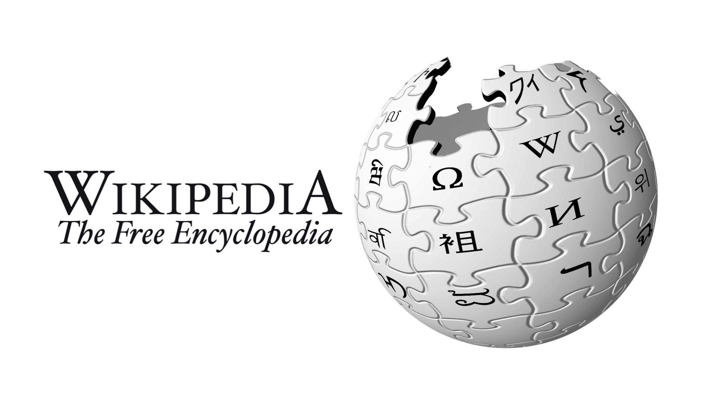
Evaluating Wikipedia
Task2: Answer the following questions.
What is Wikipedia?
If you have used Wikipedia during your studies, what sort of information did you search for? How did you use this information in your courses or assignments?
Look at the list of references of some articles or books. Did any of these authors cite Wikipedia in their references?
When might Wikipedia be useful? When should we not use Wikipedia?

