Slide 1
Faculty of Economic Sciences, Commerce and Management Sciences Deprt. of Management Module: English Level: M2. SM Academic year: 2021/2022
Lecture
Communication

Slide 2
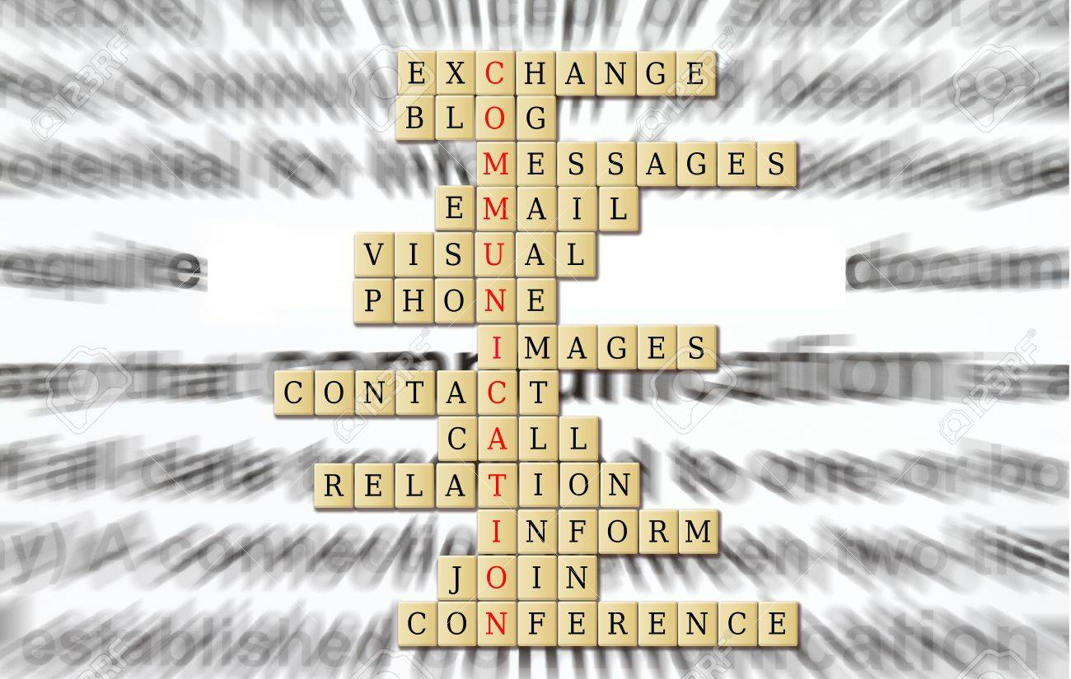

Slide 3
What is communication?
It is a process of exchanging:
Information
Ideas and thoughts
Emotion
Through:
Speech
Signals
Writing
Behaviour

Slide 4
Process of Communication
Sender: the one who sends a message (information,idea, or feeling)
Encoding: the process of turning thoughts into a message (talking for example) and is done by the sender.
Channel: the transportation tool or method used in sending the message.
Receiver: the person who is getting or receiving the message.
Decoding: is the process of understanding the message. It is done by the receiver.
Feedback: the receiver gives a response or an answer to the sender.

Slide 5
Types of Communication
The types of communication are based on the channel used in sending the message. There are two types:
Verbal communication
Non-verbal communication

Slide 6
Verbal Communication
It refers to communication in which the message is transformed verbally. This means that it is done by word or a piece of writing.
Verbal Communication is divided into:
Oral Communication: the message is spoken for example: face-to-face
conversations, speech, telephonic
conversation, video…etc
Written Communication: the message is written. For example: email, letter, report, memo etc. Written Communication is most common form used in business.

Slide 7
Non-Verbal Communication
Nonverbal communication is the sending or receiving of messages without spoken words, for example: gesture, body language, posture, and facial expressions.
Nonverbal communication is about
the body language of the speaker.

Slide 8
Barriers of Communication
Barriers of communication are the problems that prevent or block the exchanging of messages. This results in the breakdown of communication. The barriers are:
Physical barriers
Emotional barriers
Cultural barriers
Language barriers

