Slide 1
Lecture 10: Reporting results and data visualization
MOUSTAFA AMRATE
moustafa.amrate@univ-biskra.dz
Department of English
University of Biskra

Slide 2
Outline
The concept of data visualization
Forms of quantitative data visualization in Applied Linguistics
APA guidelines for data reporting and data visualization
Examples of data visualization

Slide 3
DATA VISUALIZATION

Slide 4
The concept of data visualization
Data visualization is a process that involves converting raw data into graphical representations that highlight key trends and patterns in the results.

Slide 5
The concept of data visualization
The process of data visualization is as important in reporting data as descriptive and advanced statistics (Larson-Hall & Plonsky, 2015).

Slide 6
Forms of data visualization
Quantitative data can be visualized through tables, charts, graphs, infographics or geospatial figures.

Slide 7
APA guidelines for data visualization
In Applied Linguistics, data visualization follows the APA formatting style.

Slide 8
APA guidelines for data visualization

Slide 9
APA guidelines for data visualization

Slide 10
Charts
Charts are graphical representations that summarize datasets in a concise and intuitive way. Charts can take the form of line charts, pie charts, or bar charts.

Slide 11
Graphs
Graphs, like charts, provide graphic visualization of data. Unlike charts, however, graphs focus on raw data and visualize trends over time and relationships between variables.

Slide 12
Line charts
A line chart visualizes data through a series of points or markers in relation to specific x and y axises. Line charts are well known for connecting markers with a straight line.

Slide 13
Line charts

Slide 14
Pie charts
A pie chart is a circular visual representation often using percentages to illustrate proportions of particular variables in a whole dataset.

Slide 15
Pie charts

Slide 16
Bar charts
A bar chart is a chart that represents categorical data (nominal or ordinal) through bars that differ in height depending on the value they visualize.

Slide 17
Bar charts

Slide 18
Bar charts

Slide 19
Bar charts

Slide 20
Histograms
A histogram is a type of a bar charts that plot the frequency of numerical data. Although the terms bar charts and histograms are sometimes used interchangeably, the chart types are different. While bar charts visualize categorical data, histograms visualize numerical data showing the distribution.

Slide 21
Histograms

Slide 22
Histograms

Slide 23
Boxplots
Boxplots are used to visually summarize the descriptive statistics of one or more groups of participants. This summary includes minimum and maxim values through the whiskers, the spread of data around the mean through the lower and upper quartiles (the box), and the media with the median line.

Slide 24
Boxplots

Slide 25
Boxplots

Slide 26
Scatter plots
Scatter plots are diagrams that visualize the relationship between two (or more) variables through dots plotted in relation to horizontal and vertical axes.

Slide 27
Scatter plots

Slide 28
Geospatial graphs
Geospatial refers to graphs visualizing statistics on geographical maps. The following example of a geospatial reports the number of Berber speakers in different regions of Algeria.

Slide 29
Geospatial graphs

Slide 30
Infographics
Infographics are a visualization tool to represent the data in a creative and visually appealing way.

Slide 31
Infographics

Slide 32
Data visualization tools

Slide 33
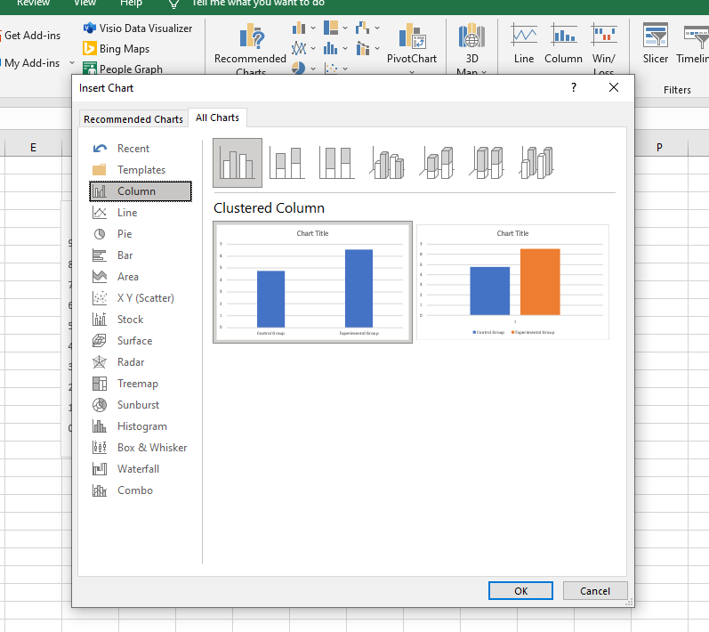
Microsoft excel
Microsoft excel provides an easy way to visualize data through the insert chart function.

Slide 34
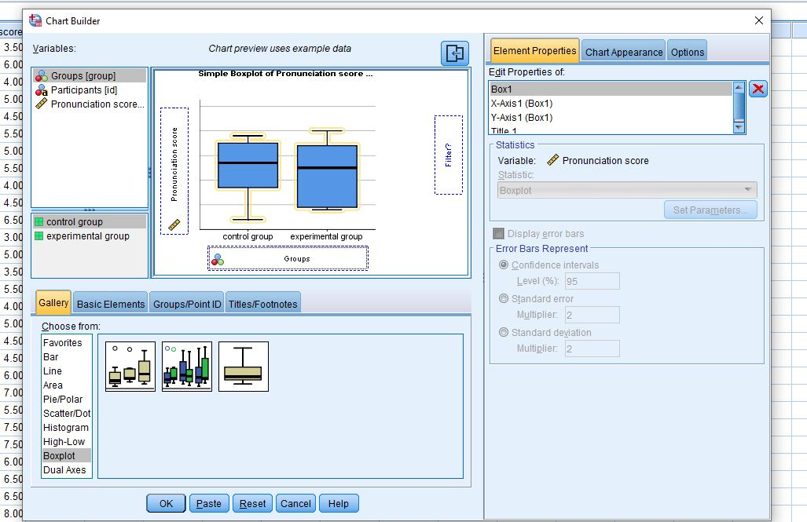
IBM SPSS
The software package IBM SPSS has a chart builder function.

Slide 35
RStudio
Along with the ggplot2 package, RStudio offers creative, visually appealing, and flexible data visualization.

Slide 36
Line charts

Slide 37
Bar charts

Slide 38
Box plots

Slide 39
Scatter plots

Slide 40
THANK YOU!
moustafa.amrate@univ-biskra.dz
@MoustafaAmrate
Moustafa-Amrate

