Slide 2
CUSTOMER RELATIONSHIP MANAGEMENT CRM

Slide 3
Brief Contents
INTRODUCTION
THE NORDIC APPROACH
THE NORTH-AMERICAN APPROACH
DISCISSION
THE ANGLO-AUSTRALIA APPROACH

Slide 4
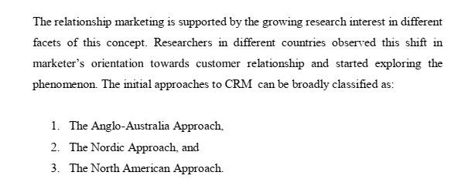
SCHOOLS OF THOUGHT ON CRM

Slide 5
SCHOOLS OF THOUGHT ON CRM
The ANGLO-AUSTRALIAN APPROACH

Slide 6
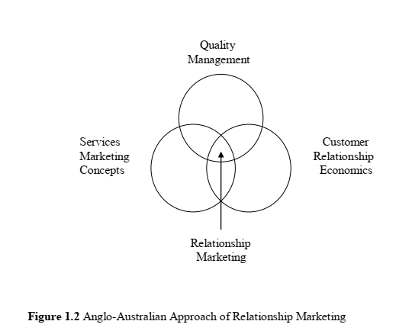
SCHOOLS OF THOUGHT ON CRM

Slide 7
SCHOOLS OF THOUGHT ON CRM
The NORDIC APPROACH

Slide 8
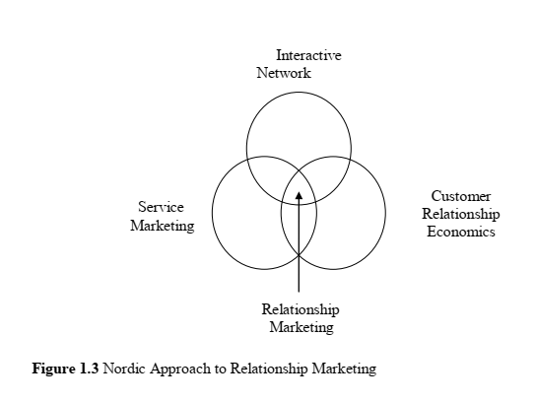
SCHOOLS OF THOUGHT ON CRM

Slide 9
SCHOOLS OF THOUGHT ON CRM
The NORTH-AMERICAN APPROACH

Slide 10
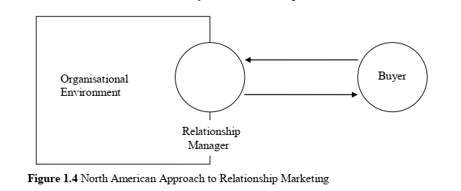
SCHOOLS OF THOUGHT ON CRM

