Slide 1
Chapter 6
International Training and Development

Slide 2
Chapter Objectives
Define and contrast between training and development
Explore how the international assignment is a vehicle for both training and development, as reflected in the reasons why international assignments continue to play a strategic role in international business operations.
Examine the role of training in preparing and supporting personnel on international assignments.
We examine the following issues:

Slide 3
Chapter Objectives (cont.)
The role of training in supporting expatriate adjustment and on-assignment performance
Components of effective pre-departure training programs such as cultural awareness, preliminary visits and language skills. Relocation assistance and training for trainers are also addressed
Effectiveness of pre-departure training
Developmental aspect of international assignments and its relation to international career paths
Training and developing international management teams
Trends in international training and development

Slide 4
Training and Development
Training aims to improve employees’ current work skills and behavior
Development aims to increase abilities in relation to some future positions or jobs.

Slide 5
International Assignments as a Training and Development Tool
Expatriates are trainers
Expatriates show how systems and procedures work, ensure adoption, and monitor performance of HCNs
International assignments are a form of job rotation to gain a broader perspective – management development, and to assist in developing a pool of capable global operators.

Slide 6
Figure 6-1
International training and development

Slide 7
Pre-departure Training Programs
U.S. MNCs were found reluctant to provide pre-departure training
U.S. firms 32%
European firms 69%
Japan 57%
Primary reason:
Top managers saw it as not necessary or effective
No time
GMA-GRS 2002 International Survey :
64% firms provided at least a 1-day training
76% made it optional
Most firms include family:
Whole family 33%
Spouse 29%
Employee only 2%
None 36%

Slide 8
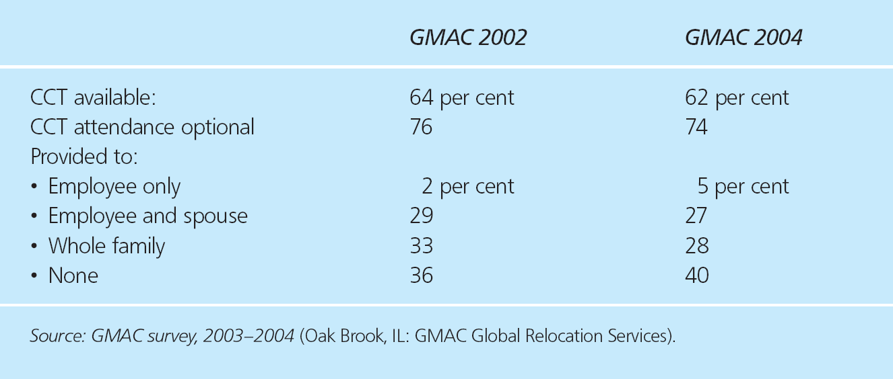
Table 6-1
Availability of cross-cultural training in MNEs

Slide 9
Components of Effective Pre-departure Training
Cultural awareness programs
Preliminary visits
Language training
Practical assistance
Training for the training role
TCN and HCN expatriate training
Non-traditional assignments and training

Slide 10
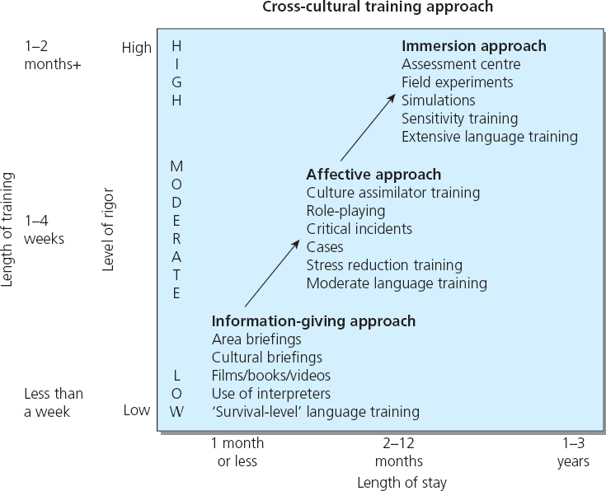
Figure 6-2
The Mendenhall, Dunbar and Oddou cross-cultural training model

Slide 11
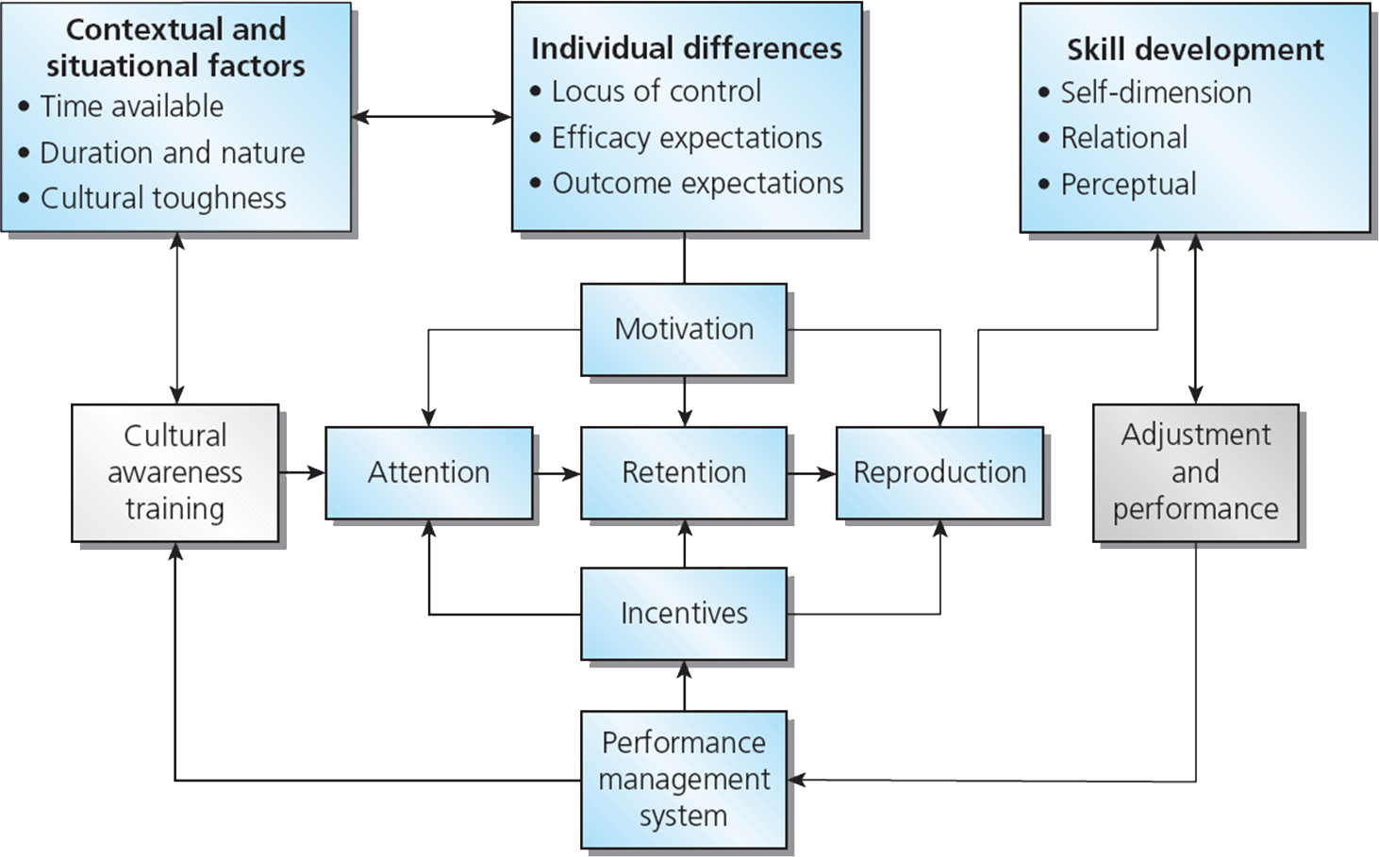
Figure 6-3
Cultural awareness training and assignment performance

Slide 12
Language Training
The role of English as the language of world business
Host country-language skills and adjustment
Knowledge of the corporate language

Slide 13
The Impact of Language on Power

Slide 14
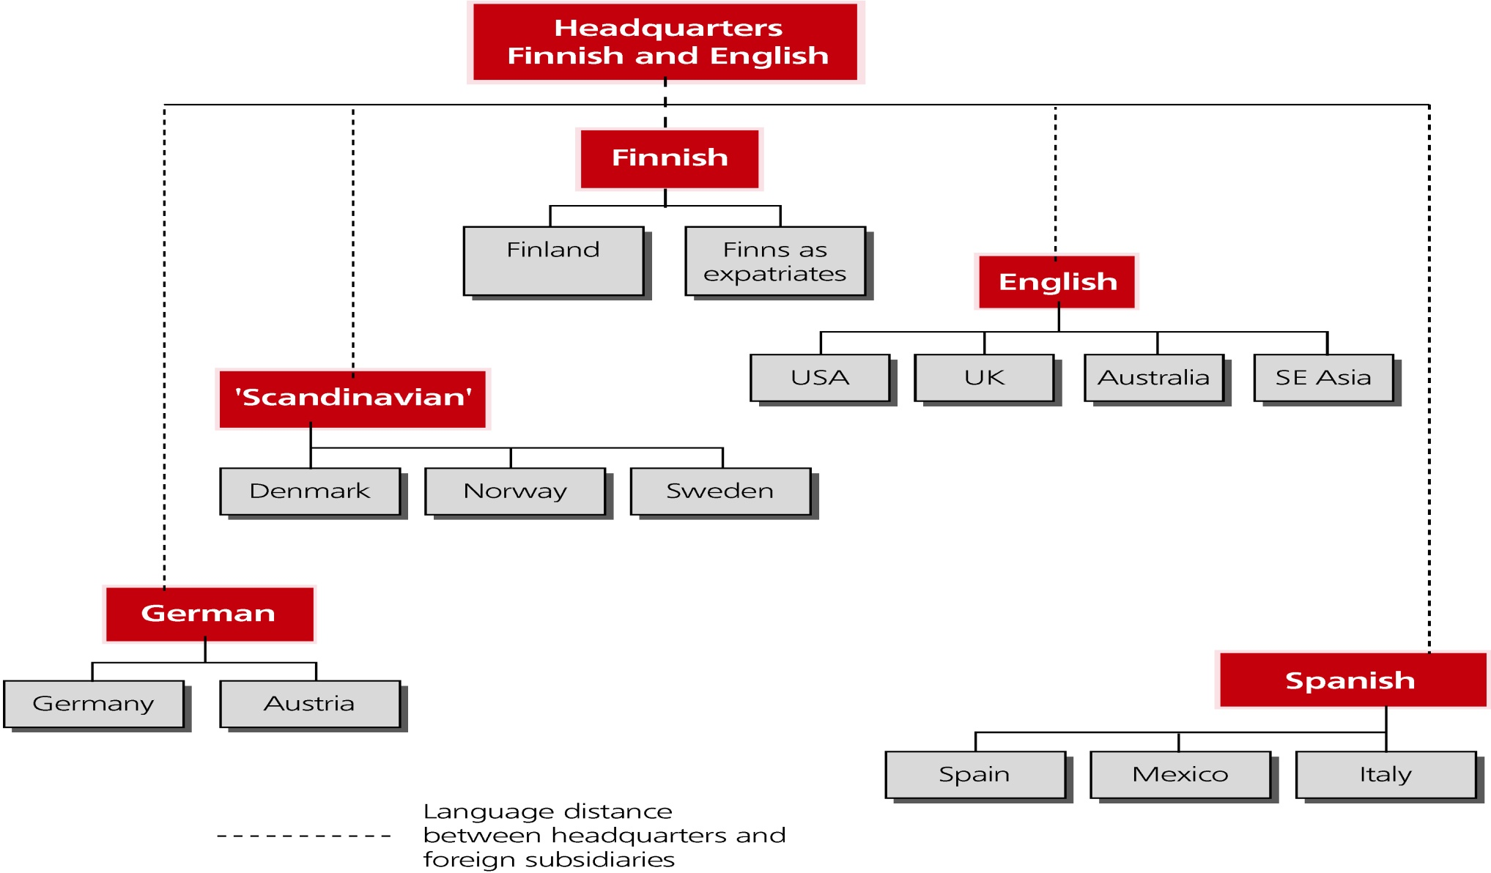
Shadow Structure Based on Language

Slide 15
Practical Assistance
Information that assists relocation
Assistance in finding suitable accommodation and schooling
Further language training
Makes an important contribution to adaptation of expatriate and accompanying family members to the host location

Slide 16
Table 6-2
Perceived value of cross-cultural preparation of expatriates

Slide 17
Effectiveness of Pre-departure Training
Limited data on how effective such training is and what components are considered most essential:
Use of mixture of methods makes evaluation of which method is most effective difficult to isolate
Large diversity of cultures involved
What works for one may not work for another
Complex jobs in multiple cultural contexts
Integrated cross-cultural training exhibited cultural proficiency earlier and appeared to have greater job satisfaction than those with lesser training.

Slide 18
Developing Staff through International Assignments
Management Development
Individuals gain international experience which assists career progression
Multinationals gain through having a pool of experienced operators on which to draw for future international assignments

Slide 19
Developing Staff through International Assignments
Organizational Development
Accumulating a stock of knowledge, skills and abilities
Developing a global mindset
Expatriates as agents of direct control and socialization in the transfer of knowledge and competence.

Slide 20
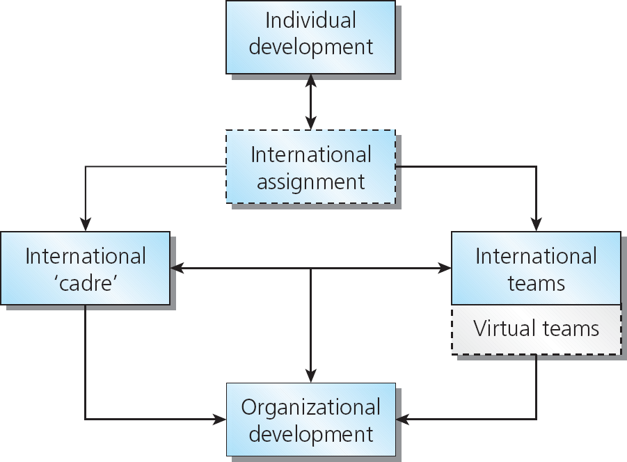
Developing international teams through international assignments
Figure 6-4

Slide 21
How international teams benefit the multinational
Fosters innovation, organizational learning and transfer of knowledge
Assists breaking down of functional and national boundaries
Encourages diverse inputs
Assists in developing broader perspectives
Develops shared values

Slide 22
Cross-cultural Training
GMAC 2005 Survey:
60% provided training for the entire family
30% for expatriates and spouses
10% for employees alone
20% made training mandatory
73% companies reported great or high value of training
29% used CD or web-based cross-cultural training programs
62% report great or high value of CD or web-based training programs as alternatives

Slide 23
Trends in internationals training and development
Convergence from globalization
Divergence towards localization of training and development
Non-government organizations
The rise of China
To address global, comparative, and local contexts for effective training and development programs

Slide 24
Chapter Summary
This chapter has concentrated on the issues relating to training and developing expatriates for international assignments. In the process, we have discussed:
The role of expatriate training in supporting adjustment and on-assignment performance.
The components of effective pre-departure training programs such as cultural awareness, preliminary visits, language skills, relocation assistance and training for trainers.
(cont.)

Slide 25
Chapter Summary (cont.)
How cultural awareness training appears to assist in adjustment and performance and therefore should be made available to all categories of staff selected for overseas postings, regardless of duration and location.
The need for language training for the host country and in the relevant corporate language.
The impact that an international assignment may have on an individual’s career.
(cont.)

Slide 26
Chapter Summary (cont.)
The international assignment as an important way of training international operators and developing the international ‘cadre’. In this sense, an international assignment is both training (gaining international experience and competence) and managerial and organizational development.
How international assignments are connected to the creation of international teams.
Trends in international training and development.

Slide 27
Discussion Questions
What are some of the challenges faced in training expatriate managers?
Assume you are the HR director for a small company that has begun to use international assignments. You are considering using an external consulting firm to provide pre-departure training for employees, as you do not have the resources to provide this ‘in-house’. What components will you need covered? How will you measure the effectiveness of the pre-departure training program provided by this external consultant?
How does an international assignment assist in developing a ‘cadre’ of international operators? Why is it necessary to have such a ‘cadre’?
Why do some MNEs appear reluctant to provide basic pre-departure training?

