Slide 1
Lesson 3: Searching for Reliable Sources of Information
UMKB- Department of English L2Research Methodology
Teacher: Ms. Ghennai
2022/2023

Slide 2
Where to Look for Sources of Information?
The Library
The Internet

Slide 3
The Library
You are going on a field visit with your teacher and classmates to your faculty’s Library. Write a report about your visit. Mention the following information.
1- The layout and the facilities of the library
Study areas
Catalogues
Sources
Web-based sources
Membership activation and renewal
2- What I need to know as a borrower/ attender
Number of books.
Loan period.
Renewing the loans
Fines
Regulations and code of conduct
Support from the staff

Slide 4
The Internet
Search Engines
Google Scholar
Academic Databases
Social Networking websites for Academics

Slide 5
Search Engines
People use concepts in the form of key words. Not all information in the search results will be useful; you need to skim read the short description of each result. As you may have hundreds (or even thousands) of results, it would probably be sufficient to skim through the first two or three pages of results.
Use Boolean Search to get more relevant results.

Slide 6
Google Scholar
A freely accessible web search engine which provides a simple way to broadly search for scholarly literature across a wide variety of disciplines and sources.
Academic Databases
Collections of scholarly information that is commonly used for research and writing. They include access to academic journals.
e.g. ASJP ( Algerian Scientific Journal Platform/ multidisciplinary) JSTOR ( multidisciplinary) and ERIC (education sciences)
Check: https://en.wikipedia.org/wiki/List_of_academic_databases_and_search_engines
Social Networking Websites for Academics
Check Academia.edu / Researchgate.net

Slide 7
Important Remarks
Most journals have websites on the internet. Some of them have open access policy. This means that you can read and download the articles from the website without having to pay. Articles in subscription journals can only be downloaded if the university provides access or by paying.
If your university library does not subscribe to academic databases or quality academic journals, open-access publications can be useful.
There is no quality control of the information you find on the internet. Google Scholar contains academic-type documents (such as articles and conference papers), but the quality can vary enormously. If the publisher is a quality academic journal or an official organization (national or international), the document may well be useful for your research project.

Slide 8
Evaluating websites
Anybody can add to information on websites, blogs, social media pages without having actual knowledge of the topic. To check whether information is genuine or not, check the authors providing the information and the references and bibliography given by them.
Use the URL ( Uniform Resource Locator) to check whether the website is of an institution, a private institution or a private website.
Some websites of national and international institutions may contain documents that can be good sources for information.
Some websites may have a promotional purpose and cannot be used for academic work.

Slide 9
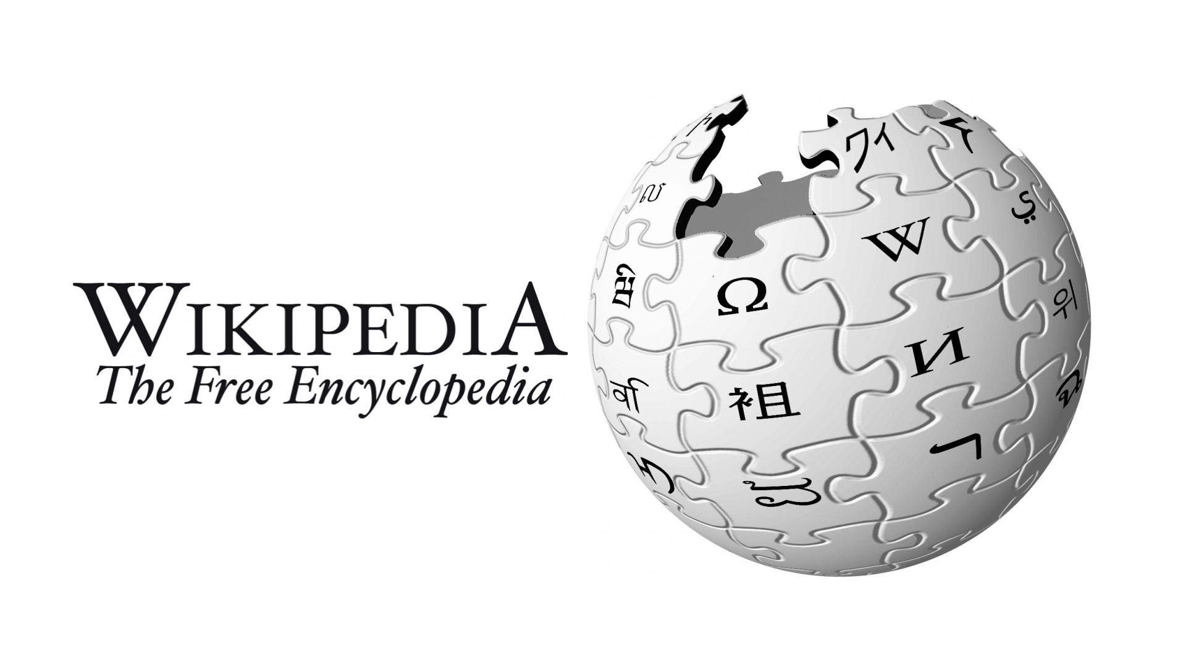
Evaluating Wikipedia
Task1: Answer the following questions.
What is Wikipedia?
If you have used Wikipedia during your studies, what sort of information did you search for? How did you use this information in your courses or assignments?
Look at the list of references of some articles or books. Did any of these authors cite Wikipedia in their references?
When might Wikipedia be useful? When should we not use Wikipedia?

