Slide 1
Faculty of Letters and Foreign Languages
Department of English Language
Course: Study skills
Level: First year LMD
Instructor: Dr. Chahira Nasri
Academic year: 2023/2024
Using library

Slide 2
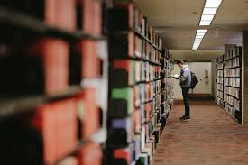

Slide 3
The outline
Introduction
Definitions
Objectives and purposes of using libraries
Types of libraries
Sources of information
Refernces

Slide 4
Introduction
Knowledge is the ingredient that propels development and success. It is the key to successful living and development of a nation. It is indispensible in any field of human endeavour as it determines its success or otherwise whether in formal education or in other informal ways. Generally, there are two ways of seeking for knowledge. The first way is seeking for knowledge in a formal way. This simply means seeking for formal education. Formal education is the knowledge one acquires in classroom setting or in an environment close to the classroom situation. Informal education is said to be received through daily activities, practice and experience. However, the library is indispensible in both ways of seeking for knowledge. The library can be of assistance to those in schools or colleges by providing information already written by others. The library can also be of assistance to those who are not necessarily in school to answer some of their questions. In this situation, the library serves as an organ or the process of studying or acquiring knowledge.

Slide 5
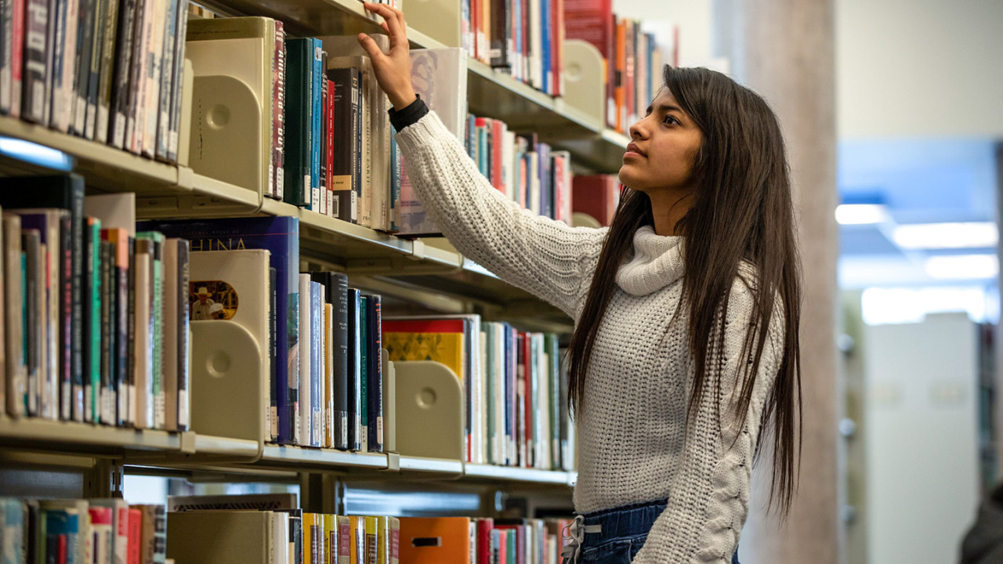

Slide 6
Definition of library
A library (derived from the Latin word liber meaning books) is a collection of written, printed, or other graphic and visual materials including films, photographs, phonographs, tapes, records video cassette, disc, microforms and computer programmes (software) organized and maintained for reading, study and interpreted to meet broad and varying need of people for information, knowledge, recreation and aesthetic enjoyment. In other words, A library is a collection of resources in a variety of formats that is organized by information professionals or other experts who provide convenient physical, digital, bibliographic, or intellectual access and offer targeted services and programs with the mission of educating, informing, or entertaining a variety of audiences (5) and the goal of stimulating individual learning and advancing society as a whole."

Slide 7
Objectives and purposes of the library
To ensure that its user’s needs are meet within the shortest possible time. This mean that, the usefulness of any library collection depend upon the ease and speed with which books and other library materials can be located and use when required. To this end, books are shelved according to some pre-determined classification and relation.

Slide 8
Libraries provide sitting facilities for readers who want to take note. Library staff are
also readily available to help users make efficient use of the library; attend to users’ problems and reshelf consulted books in their proper positions
Libraries provide sitting facilities for readers who want to take note. Library staff are
also readily available to help users make efficient use of the library; attend to users’ problems and reshelf consulted books in their proper positions
Libraries provide sitting facilities for readers who want to take note. Library staff are also readily available to help users make efficient use of the library; attend to users’ problems and reshelf consulted books in their proper positions. There are other staff who work behind the scene that the readers may not see.

Slide 9
To accelerate the possibility of the students studying individually on their own most of the time in order to enrich what has been taught.
On the other hand, the library meets the recreational needs of its users by providing materials to occupy their leisure times or to while always the times.
Another purpose of the library is to serve the needs of the business men who may require information on trade or commerce to promote their business.
Yet other purpose the library is to meet the research needs of its users such as in any academic library.

Slide 11
Types of libraries
Academic, Public, National, School, Special and Private Libraries
Academic
Public

Slide 12
Private
school
national

Slide 13
Academic Libraries
The Libraries in this category include libraries in institutions of higher learning such as the Universities, Polytechnics, Colleges of Education, and Colleges of Technology etc. These Libraries are mainly established for research, teaching and study purposes. They are meant to serves communities of their respective institutions.

Slide 14
School libraries
These are libraries in schools they include nursery, primary, secondary schools, teacher training colleges and technical schools. These are like academic libraries, but without any emphasis on research. This means, school libraries are established mainly for studies and learning. Also their book collections are mostly on the subjects taught in their respective schools. The services rendered by school libraries include reference services and lending

Slide 15
Synonyms and antonyms: dictionaries may present the words that have close or the same or the opposite meaning.
• The etymology of a word: this includes the origin of that word including its changes throughout the history. The etymology may also contain the derived words.
• The meaning of idiomatic expressions: dictionaries present the implied meaning of phrases and expressions that is not clear for beginners.
• The different registers of a word: such as formal, informal, slang…etc.

Slide 16
Private libraries
These refer to libraries that are established, by individuals for their private use. Some of these libraries are in particular area of interest of their owners, while others are on several or general discipline. Libraries in this category are not common because of their patrons.

Slide 17
National libraries
This is a statutory government establishment, responsible for collection and preserving the printed output of a country. National Libraries are maintained by Federal Government bodies, academic institutions and the entire citizens of the nations. National Library builds its collection from books and other materials submitted by publishers in the process of registering their copyright.

Slide 18
Public libraries
These are libraries that are established with the main aim of serving the general public─ adults, children, handicapped, literate and non-literate, etc, for this reason, the public libraries; collections cover all areas of knowledge. In other words, their collections try as much as possible to satisfy information needs of every profession and infact all activities in the society where the library is established.

Slide 19
SOURCES OF INFORMATION
Basically there are three main sources of information:
a. Primary sources
b. Secondary sources
c. Tertiary sources

Slide 20
References
Gürcü K.,E. & Demiral, H. (2009).the library use habits of student teachers . Procedia Social and Behavioral Sciences. N 1. 2233–2240
Lorver, T, R. (2015). Introduction to the use of library for schools, colleges, polytechnics and universities. Retrieved from https://www.researchgate.net/publication/342303750_INTRODUCTION_TO_THE_USE_OF_LIBRARY_FOR_SCHOOLS_COLLEGES_POLY
Retrieved from https://www.crk.umn.edu/library/primary-secondary-and-tertiary-sources december,2021.

