Slide 1
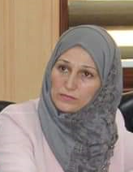
BUYERS, SELLERS AND THE MARKET
Dr.DJOUDI Hanane
Faculty of ECMS/ University of Biskra
November 13, 2023
REF: Business vocabulary in use

Slide 2
A

Slide 3
A

Slide 4
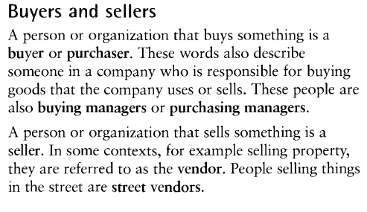
B

Slide 5
C

Slide 6
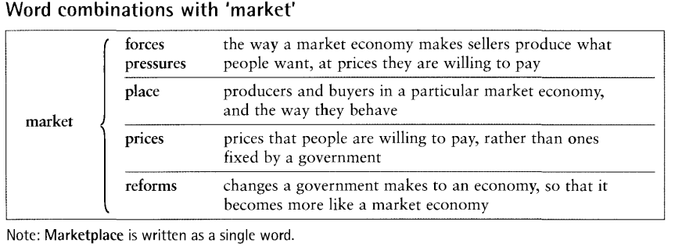
D

Slide 7
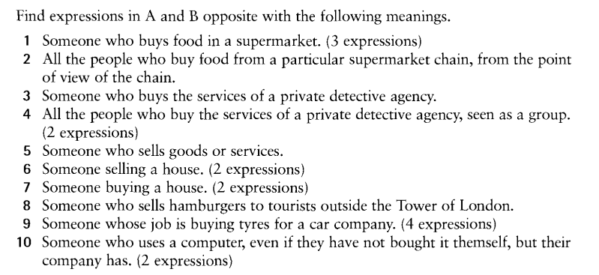
EX 1

Slide 8
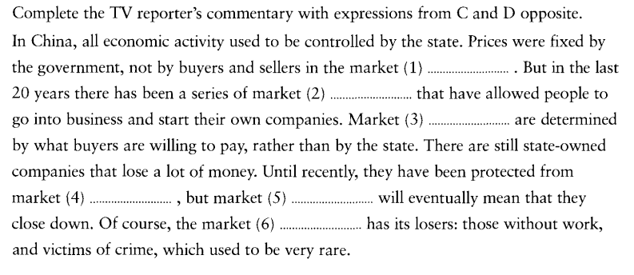
EX 2

Slide 9
Thanks

