Slide 1
MOHAMED KHEIDER UNIVERSITY FACULTY OF ECONOMICS, BUSINESS AND MANAGEMENT DEPARTMENT OF MANAGEMENT
Module: English
Level: 2nd Year Licence Students
Groups: All the Groups
Miss. BECHKI. N
Academic year: 2020-2021

Slide 2
Note: Dear students: as a result of the confinement measures imposed to curb the spread of the Covid 19 pandemic. You are kindly asked to watch the video and to download it with its lecture.
Thank you in advance

Slide 3
Inroduction to Management
Section Two: it consists of:
Importance of Management
Management and administration
*On the Basis of Function
*On the Basis of Usage

Slide 4
1/Definition of Management: According to some scholars the term of “management” defined as:

Slide 5
“ Art of getting things done through people.” Mary P. Follett (1868 –1933)

Slide 6
“A distinct process consisting of planning, organising, actuating and controlling; utilising in each both science and art, and followed in order to accomplish pre-determined objectives.” George R. Terry (1877-1955).

Slide 7
“A multipurpose organ that manage a business and manages Managers and manages Workers and work”.
(Peter F. Drucker 1909-2005).

Slide 8
“ An art of getting things done through and with the people in formally organized groups”. Harold koontz (1909-1984).

Slide 9
2/ Features of Management:
Management is an activity concerned with guiding human and physical resources such that organizational goals can be achieved. The highlighted features can be as:

Slide 10
2.1- Management is Goal-Oriented:
The success of any management activity is assessed by its achievement of the pre-determined goals or objective. For example, the goal of an enterprise is maximum consumer satisfaction by producing quality goods and at reasonable prices.

Slide 11
2.2. Management Integrates Human, Physical and Financial Resources:
In an organization, human beings work with non-human resources like machines, Materials…etc. Management integrates human efforts to those resources.

Slide 12
2.3. Management is Continuous:
Management is an ongoing process. It involves continuous handling of problems and issues. It is concerned with identifying the problem and taking appropriate steps to solve it.

Slide 13
2.4. Management is a Group Activity:
Management is very much less concerned with individual’s efforts. It is more concerned with groups. It involves the use of group effort to achieve pre-determined goal of management.

Slide 14
3/Levels of Management:
The levels of management can be classified in three main categories :

Slide 15
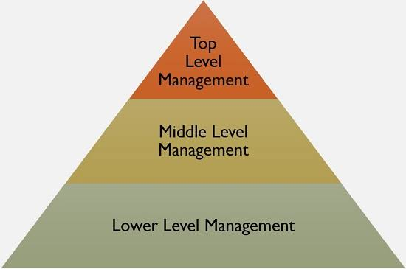

Slide 16
3.1. Top Level of Management:
The top management is the ultimate source of authority and it manages goals and policies for an enterprise. It consists of directors and managing director. Some of its roles can be like:
It controls and coordinates the activities of all the departments.
It provides guidance and direction.
It prepares strategic plans and policies for the enterprise.

Slide 17
3.2. Middle Level of Management
They are responsible to the top management for the functioning of their
department. They devote more time to organizational and directional functions. Their roles can be:
They execute the plans of the organization in accordance with the policies and directives of the top management.
They make plans for the sub-units of the organization.
They participate in employment and training of lower level management.
They interpret and explain policies from top level management to lower level.

Slide 18
3.3. Lower Level of Management :
It is also known as supervisory / operative level of management that consists of supervisors, foreman, section officers. They are concerned with direction and controlling function of management. This level characterized by:
They are responsible for the quality as well as quantity of production.
They are responsible for providing training to the workers.
They arrange necessary materials, machines, tools ...etc for getting the things done.
They are the image builders of the enterprise because they are in direct contact with the workers.

Slide 19
4/ Objectives of Management:
The essential objectives of management are:

Slide 20
4.1. Getting Maximum Results with Minimum Efforts:
It is basically concerned with thinking and utilizing human, material and financial resources in such a manner that would result in best combination. This combination results in reduction of various costs.

Slide 21
4.2. Increasing the Efficiency of factors of Production:
Through proper utilization of various factors of production .

Slide 22
4.3. Maximum Prosperity for Employer and Employees:
Management ensures smooth and coordinated functioning of the enterprise. This in turn helps in providing maximum benefits to the employee in the shape of good working condition, suitable wage system, incentive plans on the one hand and higher profits to the employer on the other hand.

Slide 23
4.4. Human betterment and Social Justice:
Management serves as a tool for betterment of the society. Through increased productivity and employment; hence, management ensures better standards of living for the society. It provides justice through its uniform policies.

