Slide 1
Lecture starting soon

Slide 2
STATISTICS Quantitative Data Analysis in Applied Linguistics
LECTURE 4:
INTRODUCTION TO DESCRIPTIVE STATISTICS
Moustafa Amrate
Department of English, University of Biskra
moustafa.amrate@univ-biskra.dz

Slide 3
House keeping

Slide 4
Continuous assessment and TD mark

Slide 5
The final exam

Slide 6
Branches of statistics
Descriptive statistics
Inferential statistics

Slide 7
“Descriptive statistics can help to provide a simple summary or overview of the data, thus allowing researchers to gain a better overall understanding of the data set”
(Mackey & Gass, 2005, p. 292)

Slide 8
This lecture will present an overview of three different types of descriptive statistics:
Measures of frequency
Measures of central tendency
Measures of variability or dispersion

Slide 9
1) Measures of frequency
Measures of frequency are used to indicate how often a particular behavior or phenomenon occurs.
For example, in second language studies, researchers might be interested in tallying how often learners make errors in forming the past tense, or how often they engage in a particular classroom behavior.

Slide 10
Visualizing measures of frequency
This is usually done through a table format where the researcher presents frequencies and percentages.

Slide 11
The following table, for example, presents the frequency of phonemic pronunciation errors made by beginner EFL students in a spontaneous speech task.
Visualizing measures of frequency
Participants |  | Vowel errors | Consonant errors | Totals
Student 1 |  | 17 | 3 | 20
Student 2 |  | 15 | 8 | 23
Student 3 |  | 25 | 9 | 34
Student 4 |  | 18 | 6 | 24
Student 5 |  | 14 | 2 | 16
Totals (%) |  | -- (--.--%) | 28 (--.--%) | ---- (----%)

Slide 12
The following table, for example, presents the frequency of phonemic pronunciation errors made by beginner EFL students in a spontaneous speech task.
Visualizing measures of frequency
Participants |  | Vowel errors | Consonant errors | Totals
Student 1 |  | 17 | 3 | 20
Student 2 |  | 15 | 8 | 23
Student 3 |  | 25 | 9 | 34
Student 4 |  | 18 | 6 | 24
Student 5 |  | 14 | 2 | 16
Totals (%) |  | 89 (76.07%) | 28 (23.93%) | 117 (100%)

Slide 13
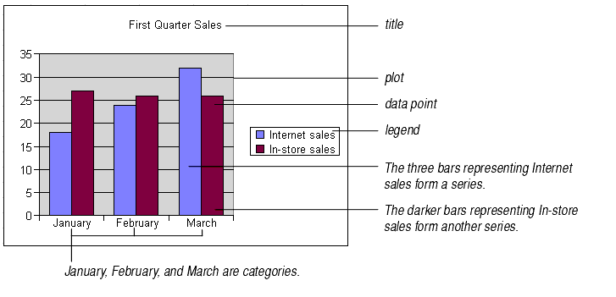
Visualizing measures of frequency
Measures of frequency can also be visualized through pie charts, bar graphs, and line charts.

Slide 14
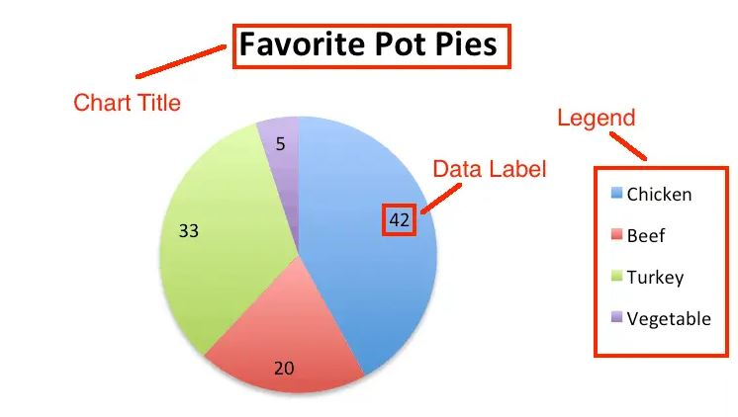
Visualizing measures of frequency
Measures of frequency can also be visualized through pie charts, bar graphs, and line charts.

Slide 15
Demonstration

Slide 16
2) Measures of central tendency
Second language researchers often use one or more measures of central tendency to provide precise quantitative information about the typical behavior of learners with respect to a particular phenomenon. There are three commonly used measures of central tendency, namely: 1) the mode, 2) the median, and 3) the mean.

Slide 17
A) The mode:
The most frequent score obtained by a particular group of learners.
For example, if the ESL proficiency test scores recorded for a group of students were 92, 78, 92, 74, 89, and 80, the mode would be ----??

Slide 18
A) The mode:
The most frequent score obtained by a particular group of learners.
For example, if the ESL proficiency test scores recorded for a group of students were 92, 78, 92, 74, 89, and 80, the mode would be 92 because two students in this sample obtained that score.

Slide 19
B) The median:
The score at the center of the distribution—that is, the score that splits the group in half.
For example, in our series of ESL proficiency test scores (92, 78, 92, 74, 89, and 80), the median is ----??

Slide 20
B) The median:
The score at the center of the distribution—that is, the score that splits the group in half.
For example, in our series of ESL proficiency test scores (92, 78, 92, 74, 89, and 80), we would find the median by first ordering the scores (74, 78, 80, 89, 92, 92) and then finding the score at the center. Since we have an even number of scores in this case (i.e., six), we would take the midpoint between the two middle scores (80 and 89), or 84.5.

Slide 21
C) The mean (average):
Derived from adding up all the numbers (Sum) and dividing by the total number of observations (e.g., participants). The following table presents the formulas needed for calculating the mean.

Slide 22
For our scores (92, 78, 92, 74, 89, and 80), the mean would be ----??

Slide 23
For our scores (92, 78, 92, 74, 89, and 80), the mean would be the sum of all scores divided by the number of observations, or (505 /6 =) 84.17.
It should be kept in mind that even though the mean is commonly used, it is sensitive to extreme scores especially if the number of participants is small.

Slide 24
 | FORMULA | EXPLANATION
Population mean (μ) | $$μ=\frac{\left(Σ xi\right)}{N}$$ | $$Population Mean = \frac{Sum}{Population size}$$
Sample mean (x̄) | $$x̄=\frac{\left(Σ xi\right)}{n}$$ | $$Sample Mean = \frac{Sum}{Sample size}$$

Slide 25
Demonstration

Slide 26
ANY QUESTIONS?

Slide 27
3) Measures of spread (dispersion):
“Measures of dispersion describe variability of the numeral data away from the central tendency” (Phakiti, 2010, p. 44) .
“Measures of dispersion [particularly standard deviation] can serve as a quality control for measures of central tendency; the smaller the standard deviation, the better the mean captures the behavior of the sample.” (Mackey & Gass, 2015, p. 303)1.

Slide 28
3) Measures of spread (dispersion):
In statistics, there are two main measures of dispersion, the variance and standard deviation.

Slide 29
A) The variance:
The variance is a measure of how far a set of numbers is spread out from their average value. The more spread the data, the larger the variance is in relation to the mean.
It is calculated by dividing the sum of squared deviations from the mean by the population or sample size.

Slide 30
A) The variance:
The mean

Slide 31
Variance formula
 | FORMULA | EXPLANATION
Population variance (σ2) | $$σ^{2}=\frac{Σ \left(xi− μ\right)² }{N}$$ | $$Population Vriance = \frac{Sum of {\left(observation value−population mean\right)}^{Squared}}{Population size}$$
Sample variance (S²) | $$S²=\frac{Σ \left(xi− x̄\right)² }{n−1}$$ | $$Sample Vriance = \frac{Sum of {\left(observation value−sample mean\right)}^{Squared}}{Sample size−1}$$

Slide 32
B) The Standard deviation (SD):
The standard deviation “is the average point from the mean which indicates on average how much the individual scores spread around the mean.” (Phakiti, 2010, p. 44).
The standard deviation is “high if the sample is heterogeneous and contains extreme scores, whereas [it is] low in a homogeneous sample with all the scores clustered around the mean.” (Dörnyei, 2007, p. 214)

Slide 33
B) The Standard deviation (SD):
$σ$/ S

Slide 34
Standard deviation (SD) formula
 | FORMULA | EXPLANATION
Population standard deviation (σ) | $$σ=\sqrt{\frac{Σ \left(xi− μ\right)² }{N}}$$ | $$Population SD = \sqrt{\frac{Sum of {\left(observation value−population mean\right)}^{Squared}}{Population size}}$$
Sample standard deviation (S) | $$S=\sqrt{\frac{Σ \left(xi− x̄\right)² }{n−1}}$$ | $$Sample SD = \sqrt{\frac{Sum of {\left(observation value−sample mean\right)}^{Squared}}{Sample size−1}}$$

Slide 35
Demonstration

Slide 36
ANY QUESTIONS?

Slide 37
Thank you for attending!
Q& A

