Slide 1
Lecture starting soon

Slide 2
STATISTICS Quantitative Data Analysis in Applied Linguistics
LECTURE 8:
Correlation
Moustafa Amrate
Department of English, University of Biskra
moustafa.amrate@univ-biskra.dz

Slide 3
Deadline:
December 16th, 2023

Slide 4
Types of advanced tests
Types of advanced tests
Difference
Relationship

Slide 5
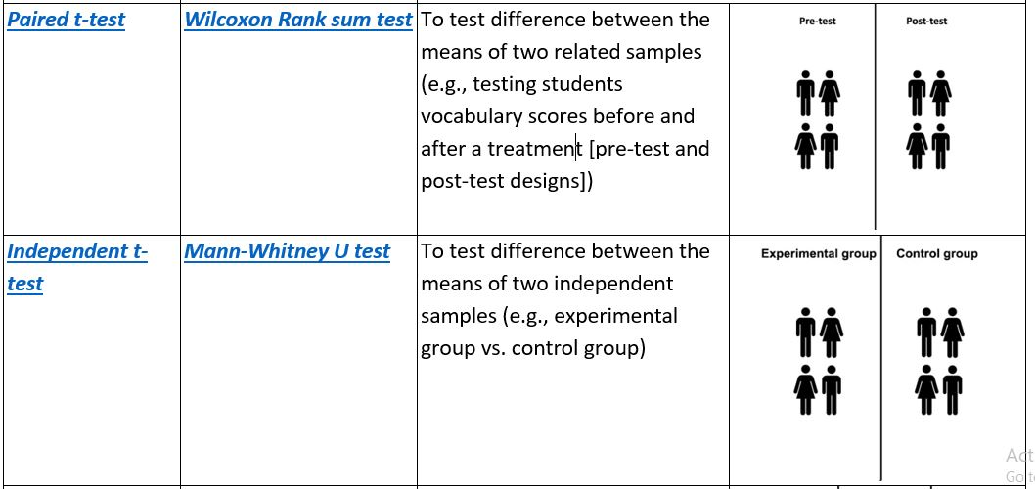
Classification of inferential statistical tests

Slide 6
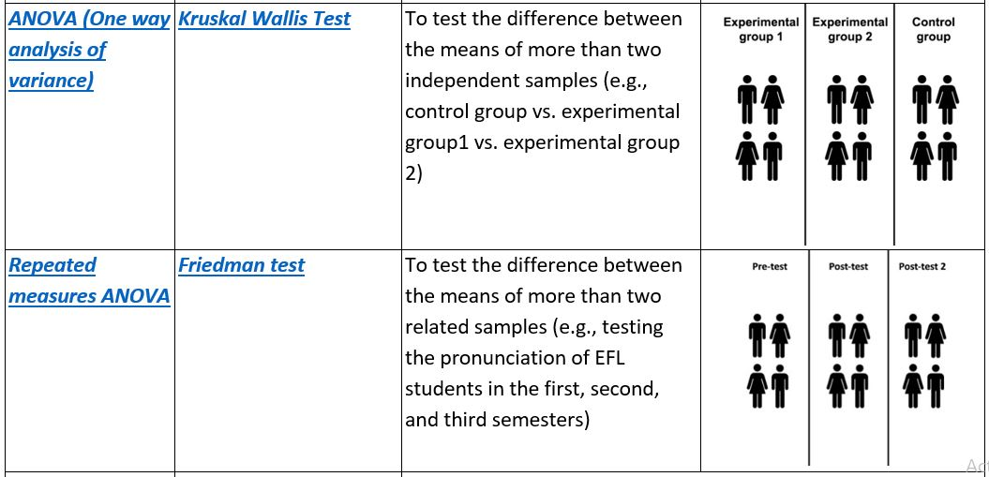
Classification of inferential statistical tests

Slide 7
Classification of inferential statistical tests

Slide 8
The concept of correlation
Correlation refers to statistical tests that investigate the degree to which two or more variables are linked to each other.
For example, a correlational study in Applied Linguistics would look at the relationship between the number of years living abroad and ESL/ EFL learners’ pronunciation accuracy.

Slide 9
The concept of correlation
“The statistical procedure to achieve [this purpose] is called ‘correlation analysis’ and it allows us to look at two variables and evaluate the strength and direction of their relationship”
(Dörnyei, 2007, p. 223)

Slide 10
Correlation ≠ causation
“Correlation research attempts to determine the relationship between or among variables; it does not determine causation”
(Mackey & Gass, 2015, p. 284)

Slide 11
Correlation ≠ causation
In other words, the fact that two variables are linearly linked to each other does not mean that one is causing the other.
Correlation does not always mean causation
For example, just because British people spend more money in shops during the winter, it does not mean that the cold temperature is causing people in the UK to spend more money. It just happened that the winter season coincides with the British holiday season, a period that is known for increased spending.

Slide 12
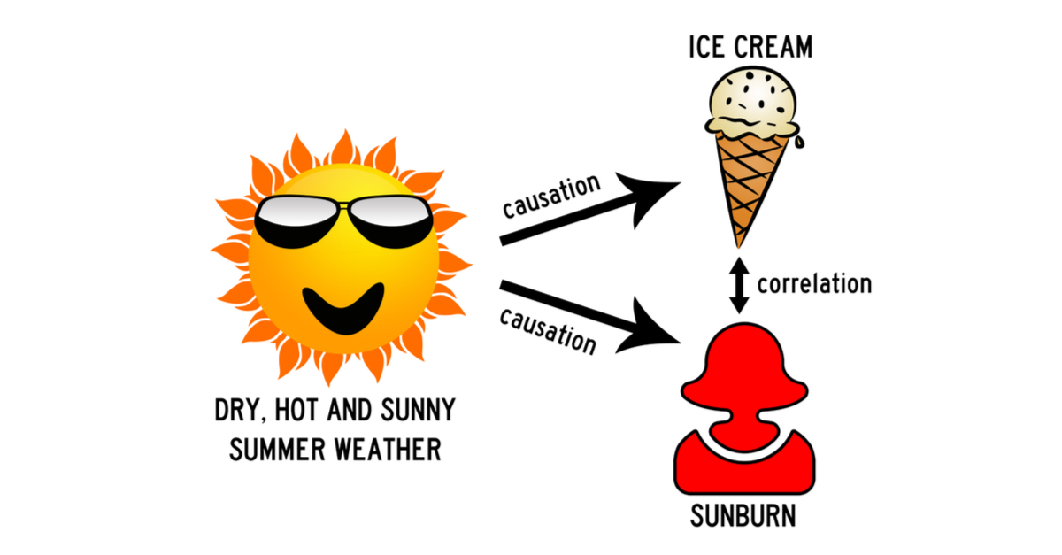
Example

Slide 13
Detecting a correlation in descriptive statistics
Generally, correlations can be detected or noticed when summarizing and describing data. For example, the table below reports the percentage of public library members in relation to their social class.
Percentage of public library members by their social class origin
PUBLIC LIBRARY MEMBERSHIP | SOCIAL CLASS STATUS
 | Middle class | Working class
Member | 86% | 37%
Non-member | 14% | 63%
Total | 100% | 100%
(Adapted from Cohen, Manion, & Morrison, 2007, p. 529)
Cohen, L., Manion, L., & Morrison, K. (2002). Research methods in education. Routledge.

Slide 14
Detecting a correlation in descriptive statistics
Generally, correlations can be detected or noticed when summarizing and describing data. For example, the table below reports the percentage of public library members in relation to their social class.
Percentage of public library members by their social class origin
PUBLIC LIBRARY MEMBERSHIP | SOCIAL CLASS STATUS
 | Middle class | Working class
Member | 86% | 37%
Non-member | 14% | 63%
Total | 100% | 100%
(Adapted from Cohen, Manion, & Morrison, 2007, p. 529)
Cohen, L., Manion, L., & Morrison, K. (2002). Research methods in education. Routledge.

Slide 15
Detecting a correlation in descriptive statistics
Generally, correlations can be detected or noticed when summarizing and describing data. For example, the table below reports the percentage of public library members in relation to their social class.
Percentage of public library members by their social class origin
PUBLIC LIBRARY MEMBERSHIP | SOCIAL CLASS STATUS
 | Middle class | Working class
Member | 86% | 37%
Non-member | 14% | 63%
Total | 100% | 100%
(Adapted from Cohen, Manion, & Morrison, 2007, p. 529)
Cohen, L., Manion, L., & Morrison, K. (2002). Research methods in education. Routledge.

Slide 16
Detecting a correlation in inferential statistics
Parametric correlation test
PEARSON CORRELATION
Numerical data
Non-parametric correlation test
SPEARMAN'S CORRELATION
Categorical data
Random sampling
Normal distribution of data
Homogeneous variances
Non-random sampling
Non-normal distribution of data
Heterogeneous variances

Slide 17
Correlational tests are designed to answer the following questions:
1) Is there a relationship between two (or more) variables?
2) What is the direction of the relationship?
3) What is the strength of the relationship?

Slide 18
Interpreting correlation test results
1. The direction of a correlation
A correlation can either be positive or negative.
Positive correlations are prefaced with a plus sign (+) to indicate the positive nature of the relationship.
On the other hand, a negative correlation (-) is to be found when an increase in one variable is accompanied by a decrease in the other variable.

Slide 19
Interpreting correlation test results
2. The strength of a correlation
Correlation tests can give us:
No correlation,
Low correlation,
Medium correlation,
Strong correlation,
Perfect correction.
However, “perfect correlations of +1.00 or -1.00 [or even 0.00] are rarely found and most coefficients of correlation in social research are around +0.50 or less”.
(Cohen, Manion, & Morrison, 2007, p. 530)

Slide 20
2. The strength of a correlation

Slide 21
Pearson correlation (r)
“Pearson product-moment correlation is the standard type, computed between two continuous variables. When we talk about ‘correlation’ in general, this is what we usually mean. The Pearson product-moment correlation coefficient is symbolized by the lower-case letter ‘r’”
(Dornyei, 2007, p.224)

Slide 22
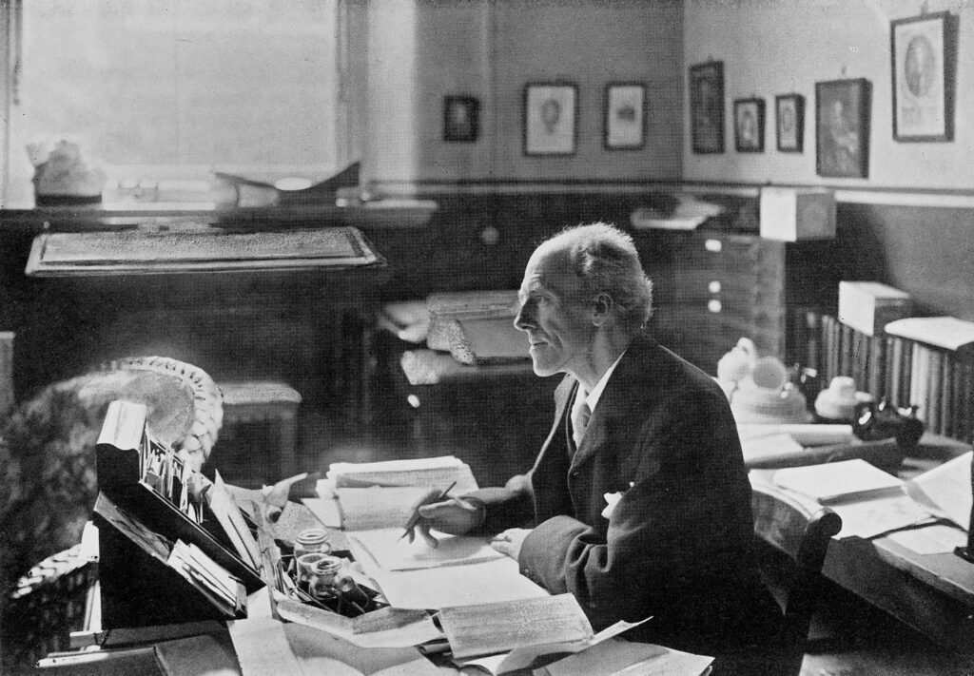
Karl Pearson (1857 - 1936)

Slide 23
Pearson correlation

Slide 24
Pearson correlation
Participants | Language learning experience | (xi - x̄) | (xi - x̄)^2 | Gramatical errors | (yi - ȳ) | (yi - ȳ)^2 | (xi - x̄) (yi - ȳ)
student 1 | 9 years |  |  | 37 errors
student 2 | 12 |  |  | 8
student 3 | 7 |  |  | 56
student 4 | 10 |  |  | 22
student 5 | 8 |  |  | 35
student 6 | 11 |  |  | 24
student 7 | 9 |  |  | 32
student 8 | 8 |  |  | 41

Slide 25
Pearson correlation
عدد سنوات تعلم لغة أجنبية
الأخطاء اللغوية
Participants | Language learning experience (x) | (xi - x̄) | (xi - x̄)^2 | Gramatical errors (y) | (yi - ȳ) | (yi - ȳ)^2 | (xi - x̄) (yi - ȳ)
student 1 | 9 |  |  | 37
student 2 | 12 |  |  | 8
student 3 | 7 |  |  | 56
student 4 | 10 |  |  | 22
student 5 | 8 |  |  | 35
student 6 | 11 |  |  | 24
student 7 | 9 |  |  | 32
student 8 | 8 |  |  | 41
مجموع قيم x
مجموع قيم y
معدل قيم x
معدل قيم y

Slide 26
Pearson correlation
عدد سنوات تعلم لغة أجنبية
الأخطاء اللغوية
Participants | Language learning experience | (xi - x̄) | (xi - x̄)^2 | Gramatical errors | (yi - ȳ) | (yi - ȳ)^2 | (xi - x̄) (yi - ȳ)
student 1 | 9 |  |  | 37
student 2 | 12 |  |  | 8
student 3 | 7 |  |  | 56
student 4 | 10 |  |  | 22
student 5 | 8 |  |  | 35
student 6 | 11 |  |  | 24
student 7 | 9 |  |  | 32
student 8 | 8 |  |  | 41
مجموع قيم x
74
مجموع قيم y
255
معدل قيم x
9.25
معدل قيم y
31.88

Slide 27
Pearson correlation
عدد سنوات تعلم لغة أجنبية
الأخطاء اللغوية
Participants | Language learning experience | (xi - x̄) | (xi - x̄)^2 | Gramatical errors | (yi - ȳ) | (yi - ȳ)^2 | (xi - x̄) (yi - ȳ)
student 1 | 9 | -0.25 |  | 37 | 5.12
student 2 | 12 | 2.75 |  | 8 | -23.88
student 3 | 7 | -2.25 |  | 56 | 24.12
student 4 | 10 | 0.75 |  | 22 | -9.88
student 5 | 8 | -1.25 |  | 35 | 3.12
student 6 | 11 | 1.75 |  | 24 | -7.88
student 7 | 9 | -0.25 |  | 32 | 0.12
student 8 | 8 | -1.25 |  | 41 | 9.12
مجموع قيم x
74
مجموع قيم y
255
معدل قيم x
9.25
معدل قيم y
31.88

Slide 28
Pearson correlation
عدد سنوات تعلم لغة أجنبية
الأخطاء اللغوية
Participants | Language learning experience | (xi - x̄) | (xi - x̄)^2 | Gramatical errors | (yi - ȳ) | (yi - ȳ)^2 | (xi - x̄) (yi - ȳ)
student 1 | 9 | -0.25 |  | 37 | 5.12 |  | -1.28
student 2 | 12 | 2.75 |  | 8 | -23.88 |  | -65.67
student 3 | 7 | -2.25 |  | 56 | 24.12 |  | -54.27
student 4 | 10 | 0.75 |  | 22 | -9.88 |  | -7.41
student 5 | 8 | -1.25 |  | 35 | 3.12 |  | -3.90
student 6 | 11 | 1.75 |  | 24 | -7.88 |  | -13.79
student 7 | 9 | -0.25 |  | 32 | 0.12 |  | -0.03
student 8 | 8 | -1.25 |  | 41 | 9.12 |  | -11.40
مجموع قيم x
74
مجموع قيم y
255
-157.75
معدل قيم x
9.25
معدل قيم y
31.88

Slide 29
Pearson correlation
عدد سنوات تعلم لغة أجنبية
الأخطاء اللغوية
Participants | Language learning experience | (xi - x̄) | (xi - x̄)^2 | Gramatical errors | (yi - ȳ) | (yi - ȳ)^2 | (xi - x̄) (yi - ȳ)
student 1 | 9 | -0.25 | 0.06 | 37 | 5.12 | 26.21 | -1.28
student 2 | 12 | 2.75 | 7.56 | 8 | -23.88 | 570.25 | -65.67
student 3 | 7 | -2.25 | 5.06 | 56 | 24.12 | 581.77 | -54.27
student 4 | 10 | 0.75 | 0.56 | 22 | -9.88 | 97.61 | -7.41
student 5 | 8 | -1.25 | 1.56 | 35 | 3.12 | 9.73 | -3.90
student 6 | 11 | 1.75 | 3.06 | 24 | -7.88 | 62.09 | -13.79
student 7 | 9 | -0.25 | 0.06 | 32 | 0.12 | 0.01 | -0.03
student 8 | 8 | -1.25 | 1.56 | 41 | 9.12 | 83.17 | -11.40
مجموع قيم x
74
19.50
مجموع قيم y
255
1430.88
-157.75
معدل قيم x
9.25
معدل قيم y
31.88

Slide 30
Step 4
………
-157.75
Step 1
19.50
×
1430.88
………….
Step 2
…………..
………….
Step 3
…………

Slide 31
Step 4
-0.94
-157.75
Very high negative correlation
Step 1
19.50
×
1430.88
-157.75
Step 2
27902.16
-157.75
Step 3
167.04

Slide 33
Interpretation of Pearson correlation

Slide 34
The Spearman correlation (P)
The Spearman correlation is the non-parametric equivalent for the Pearson correlation. “As the name suggests, the correlation is based on the ranks of the data (in a rank order) rather than the actual [numerical] values”
(Dornyei, 2007, p. 230)
In other words, this test is used when the data of the variables being correlated do not meet the conditions for parametric tests

Slide 35
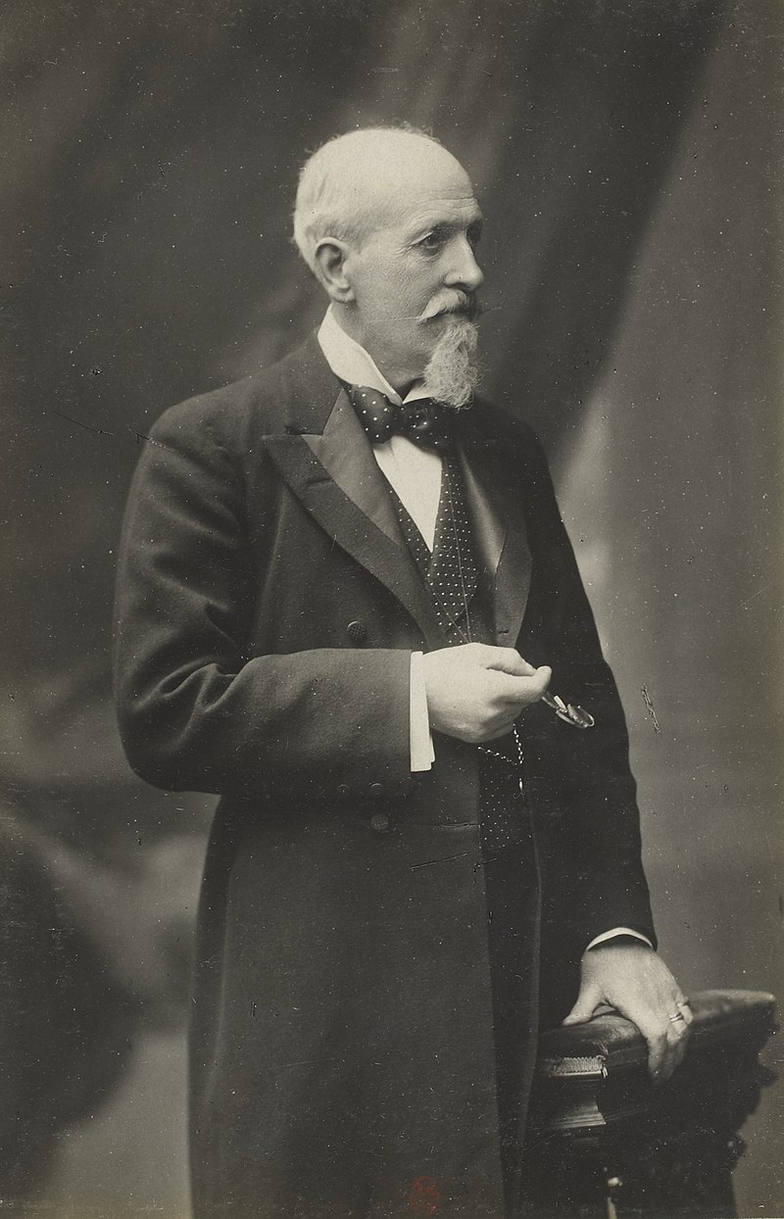
Charles Edward Spearman (1863 -1945)

Slide 36
The Spearman correlation

Slide 37
The Spearman correlation
Participants | Library use frequency | Rank | Grammatical errors | Rank | d
student 1 | 1 | 8 | 37 | 3 | 5 | 25
student 2 | 2 | 6 (6.5) | 8 | 8 | .. | ..
student 3 | 2 | 7 (6.5) | 56 | 1 | .. | ..
student 4 | 4 | 2 | 22 | 7
student 5 | 3 | 3 (4) | 35 | 4
student 6 | 3 | 4 (4) | 24 | 6
student 7 | 5 | 1 | 32 | 5
student 8 | 3 | 5 (4) | 41 | 2

Slide 38
The Spearman correlation
Participants | Library use | Rank | Gramatical errors | Rank | d
student 1 | 1 | 8 | 37 | 3 | 5 | 25
student 2 | 2 | 6.5 | 8 | 8 | .. | ..
student 3 | 2 | 6.5 | 56 | 1 | .. | ..
student 4 | 4 | 2 | 22 | 7 | .. | ..
student 5 | 3 | 4 | 35 | 4 | .. | ..
student 6 | 3 | 4 | 24 | 6 | .. | ..
student 7 | 5 | 1 | 32 | 5 | .. | ..
student 8 | 3 | 4 | 41 | 2 | .. | ..

Slide 39
The Spearman correlation
Participants | Library use | Rank | Gramatical errors | Rank | d
student 1 | 1 | 8 | 37 | 3 | 5 | 25
student 2 | 2 | 6.5 | 8 | 8 | -1.5 | 2.25
student 3 | 2 | 6.5 | 56 | 1 | 5.5 | 30.25
student 4 | 4 | 2 | 22 | 7 | -5 | 25
student 5 | 3 | 4 | 35 | 4 | 0 | 0
student 6 | 3 | 4 | 24 | 6 | -2 | 4
student 7 | 5 | 1 | 32 | 5 | -4 | 16
student 8 | 3 | 4 | 41 | 2 | 2 | 4
106.50

Slide 40
………
Step 4
Weak negative relationship
6 × 106.50
Step 1
8 (8² – 1)
……….
Step 2
…….
………
Step 3

Slide 41
- .27
Step 4
Weak negative relationship
6 × 106.50
Step 1
8 (8² – 1)
639
Step 2
504
1.27
Step 3

Slide 42
Spearman correlation interpretation

Slide 44
Thank you for attending!
Q& A

