Slide 1
University of Biskra
Architecture Department
Design theory
Introduction to Architectural Project
1st year of Architecture diploma
Teacher : Youcef Mokrane
2023-2024

Slide 2
Introduction
This course intends to introduce the Architecture discipline and project to 1st year students for architecture. It aims to present a set of introductory themes focused on :
Architecture discipline and profession (2-3 sessions)
Architecture in History (2 sessions)
Architectural drawing (3 sessions)
Graphical elements of Architecture (3-4 sessions)
Architectural composition (3 sessions).

Slide 3
Intended learning outcomes
At the end of the course, students will be able to :
Understand and explain introductory concepts of Architectural discipline ,Profession and History
Understand the logic of Graphical construction in Architecture.
Recognize, name and describe esthetical aspects of form arrangements and composition in Architecture.

Slide 4
So, …what do you think Architecture is ?
…

Slide 5
Artistical aspect;
Cultural;
Societal;
Structural and engineering aspect;
…

Slide 6
Please observe the following pictures and environments…

Slide 11
Architecture as a Shelter

Slide 12
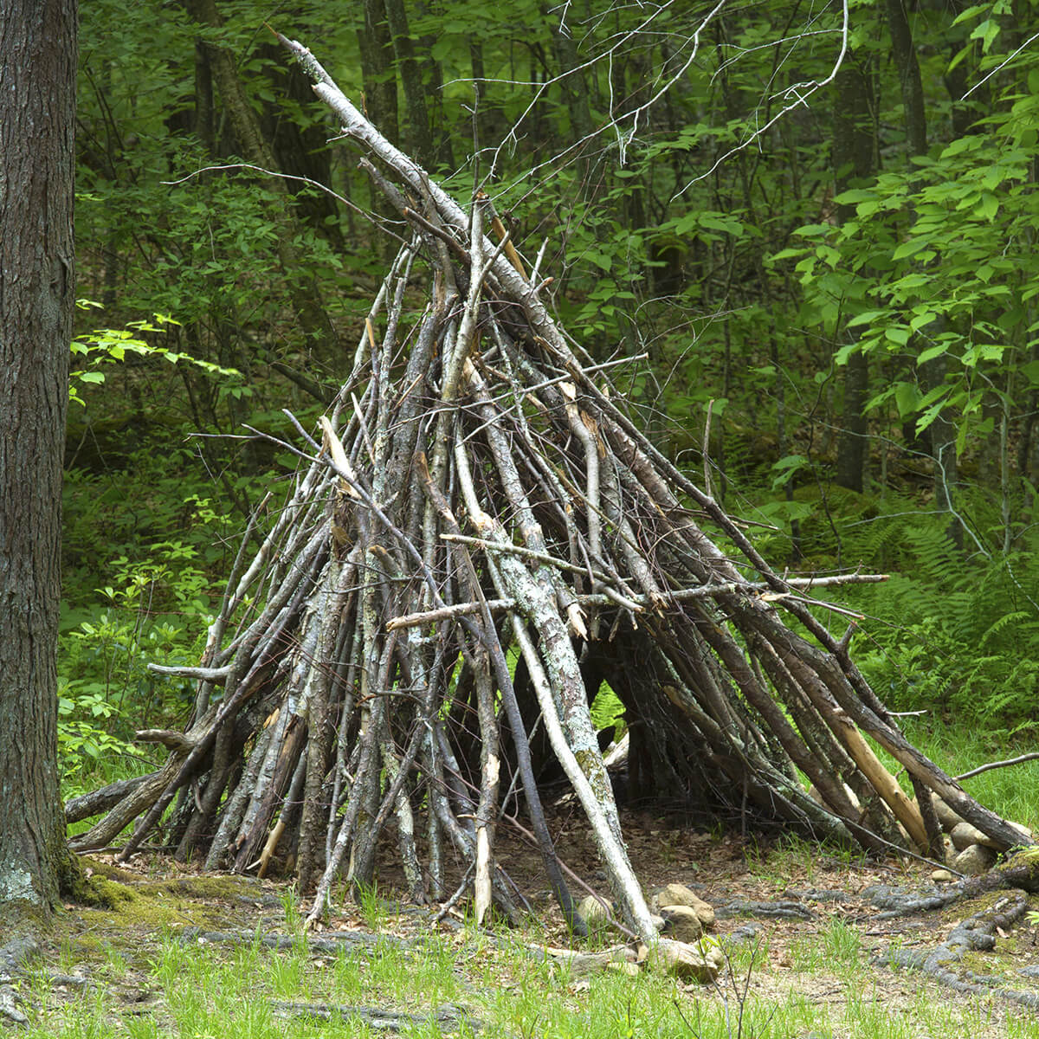

Slide 13
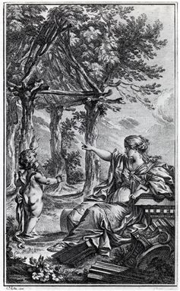

Slide 14
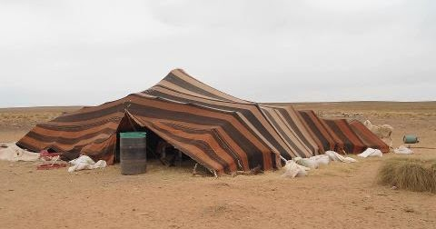

Slide 15
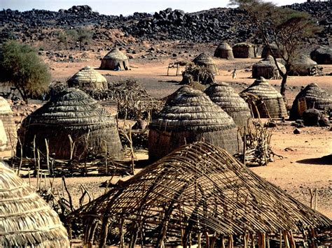

Slide 16
Architecture as an Environment of life

Slide 17
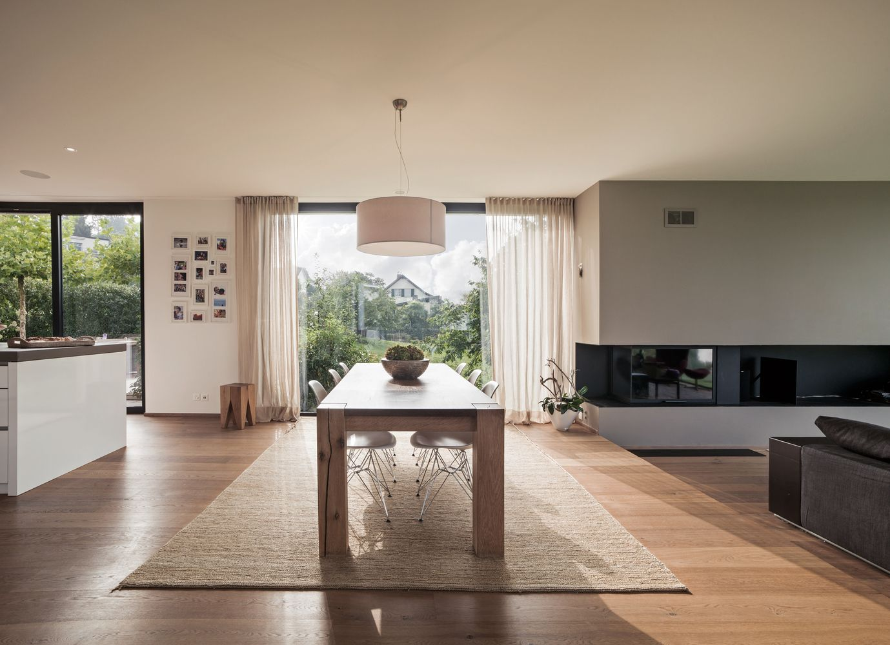

Slide 18
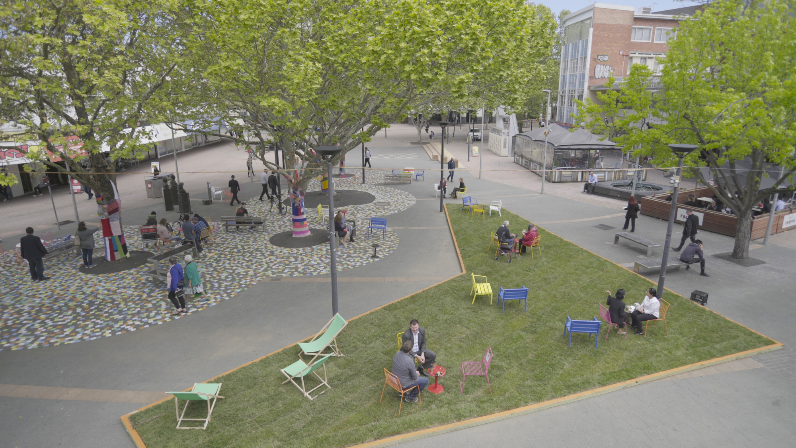

Slide 19
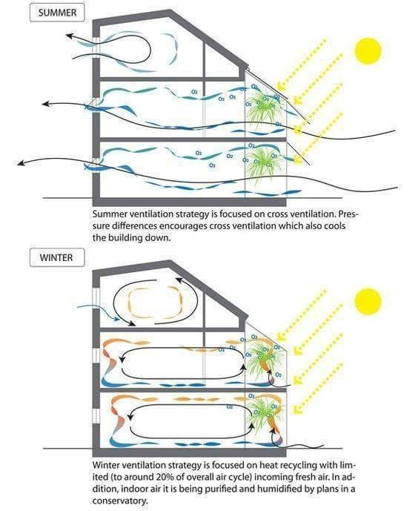

Slide 20
Architecture as an Mission

Slide 21
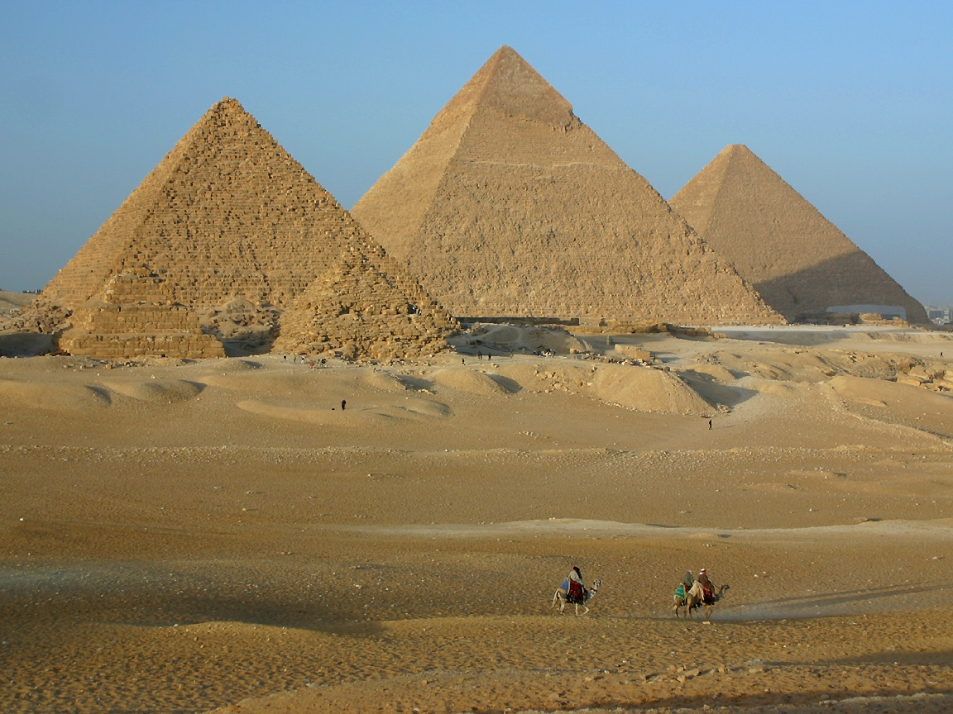

Slide 22
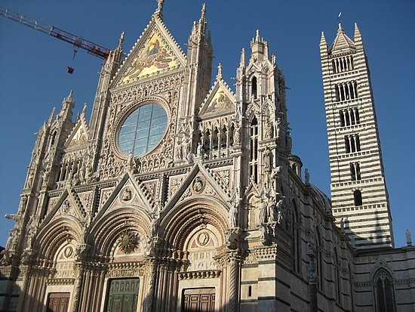

Slide 23
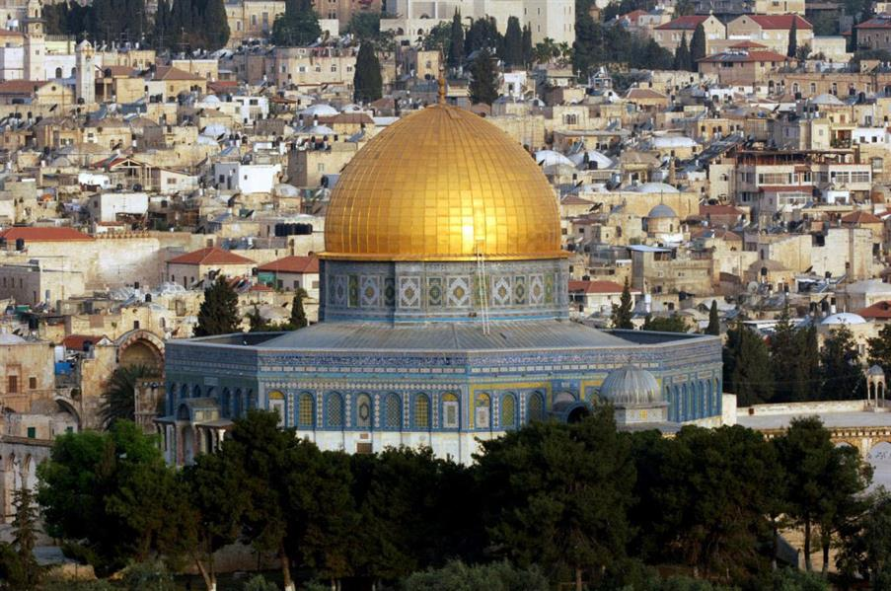

Slide 24
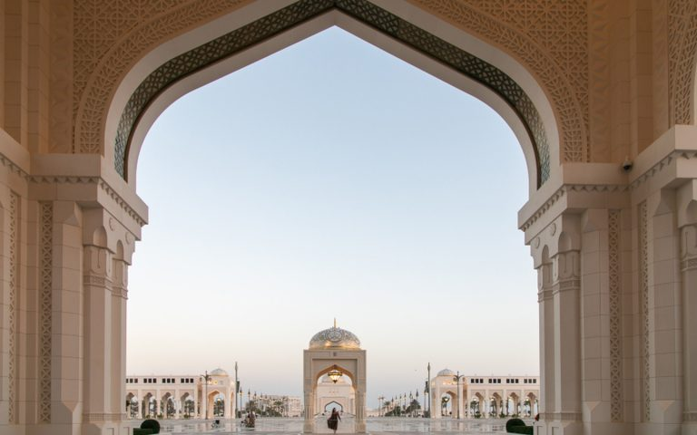

Slide 25
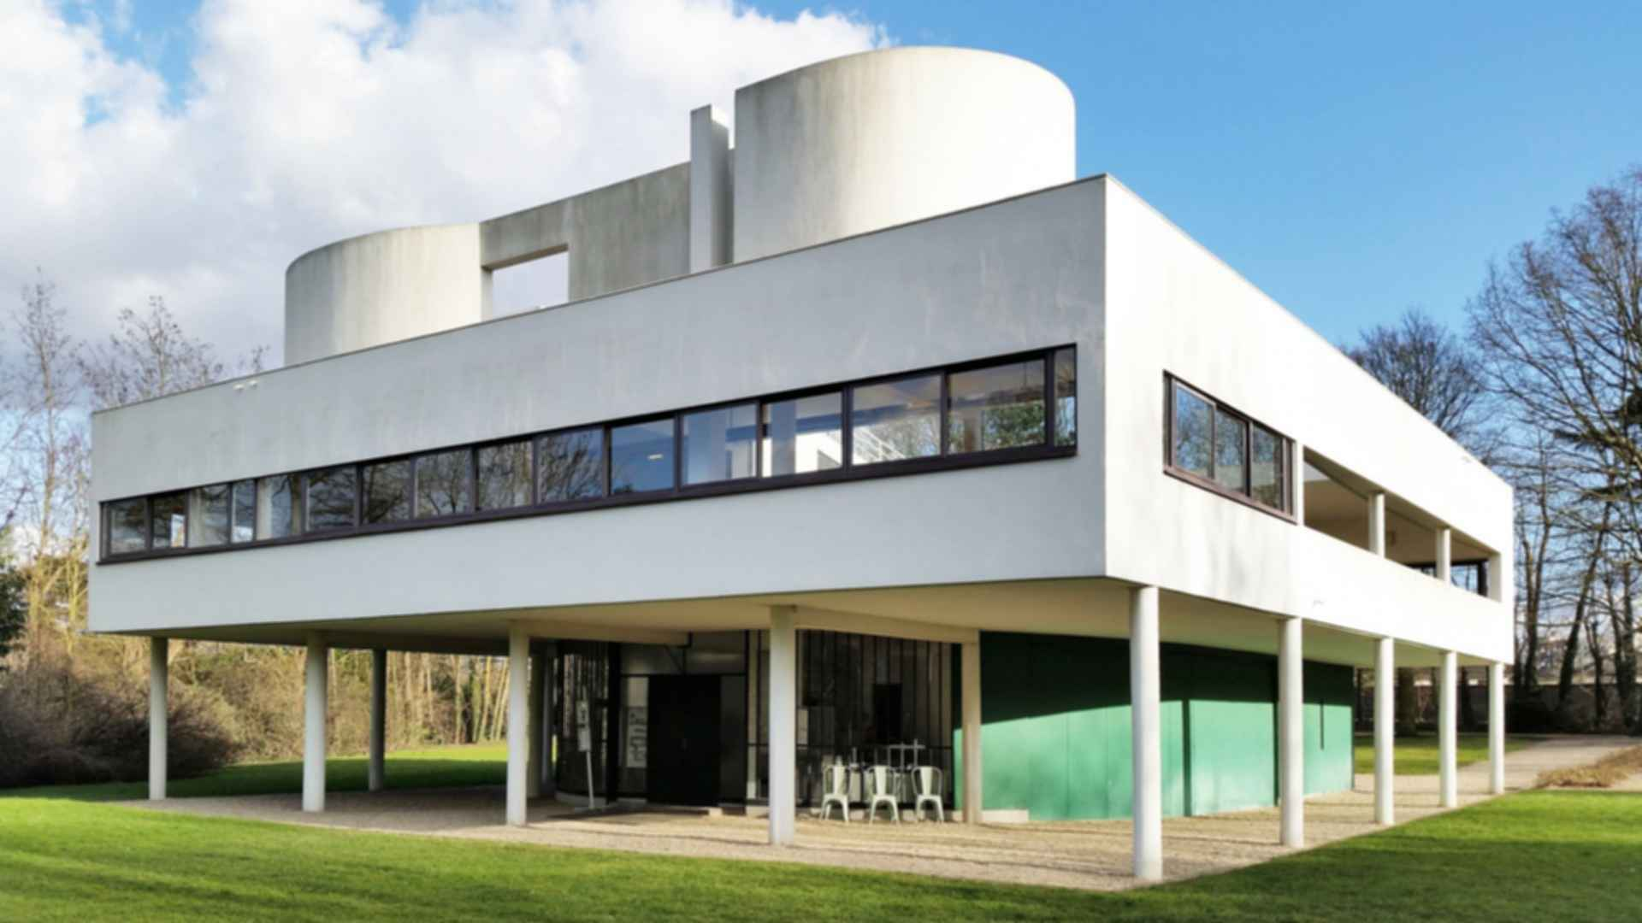
Le Corbusier – La villa Savoye.

Slide 26
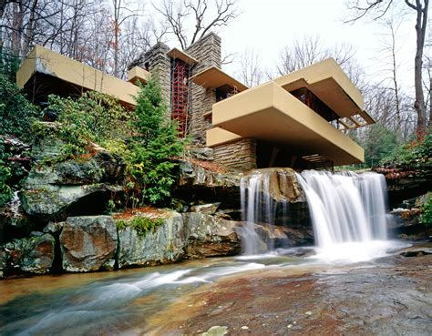
Franck Lloyd Wright – Falling Water. USA.

Slide 27
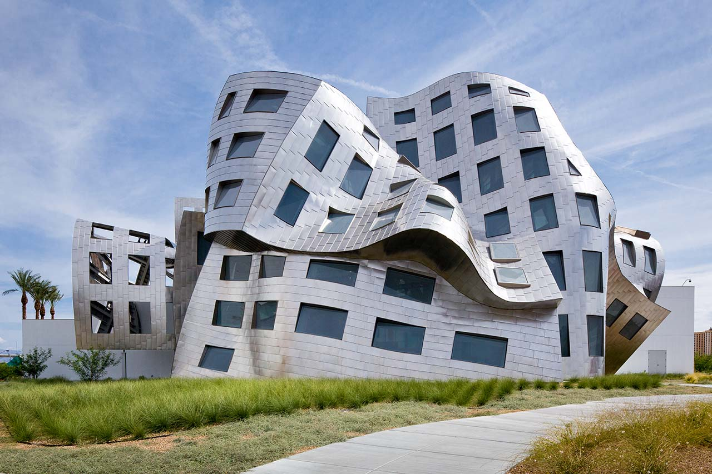

Slide 28
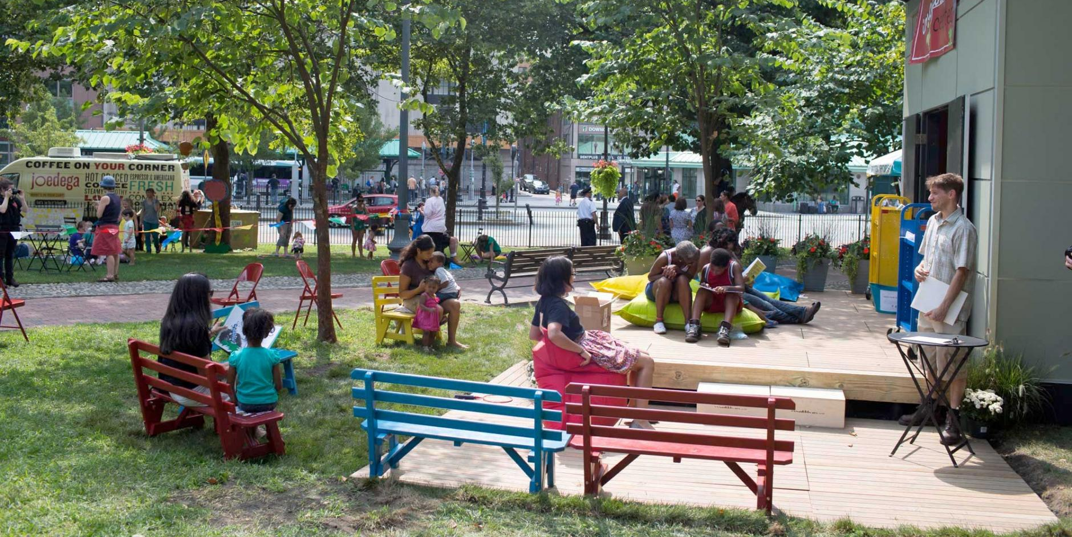
Architecture as a Place

Slide 29
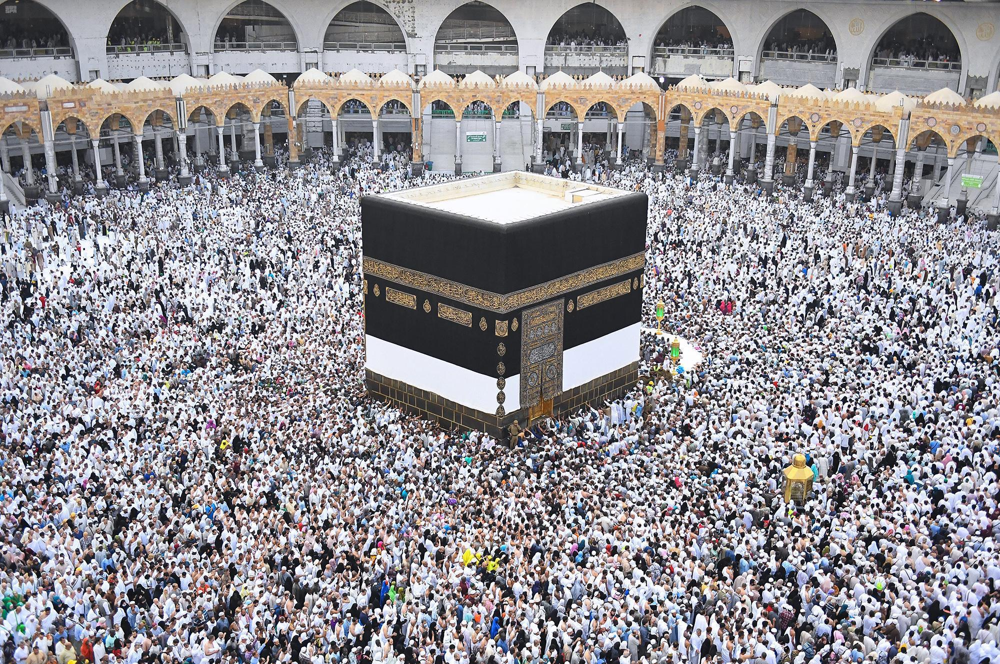

Slide 30
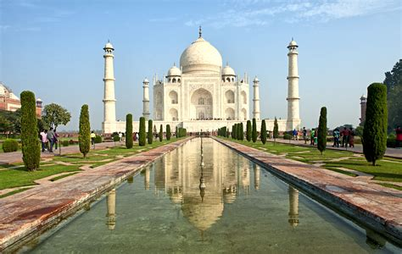

Slide 31
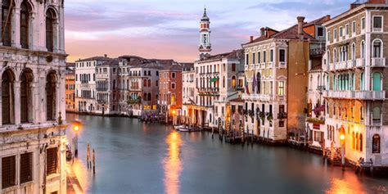

Slide 32
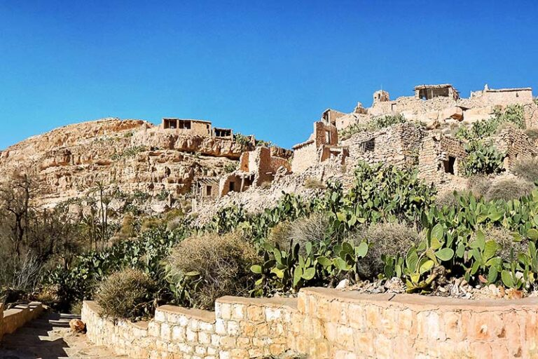

Slide 33
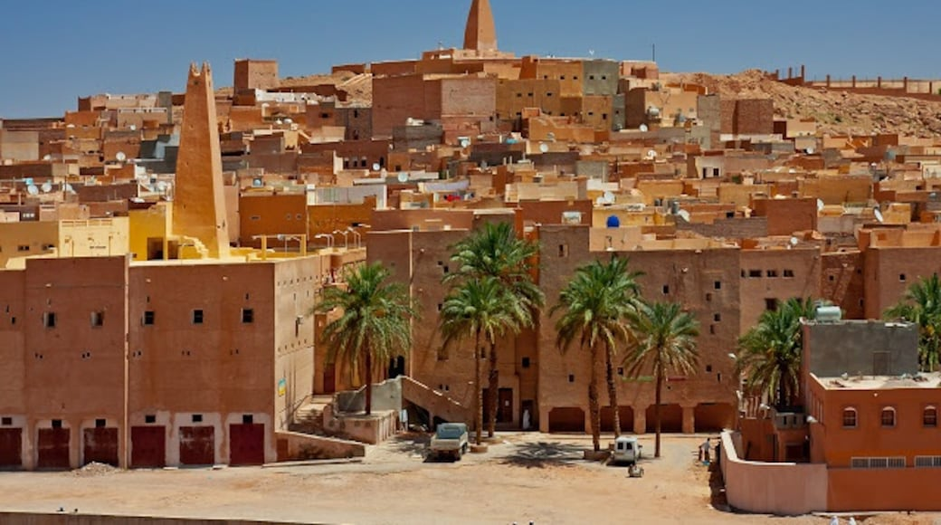

Slide 34
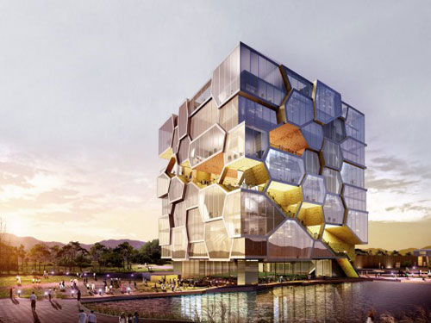
Well-known defintions of Architecture
Art or Science …?
The art of building- Art de bâtir (Dictionnaire Larousse) ;
The art and science of designing and erecting buildings (Stanford dictionnary).

Slide 35
As as Science …
According to Vitruvius (Roman antiquity), architecture is a science that is acquired through practice and theory. Architects must have a broad knowledge of geometry, drawing, history, mathematics and optics.
Triad of Vitruvius :
Firmitas,
Utilitas,
Venustas.

Slide 36
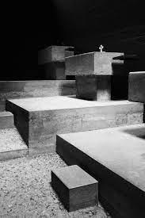
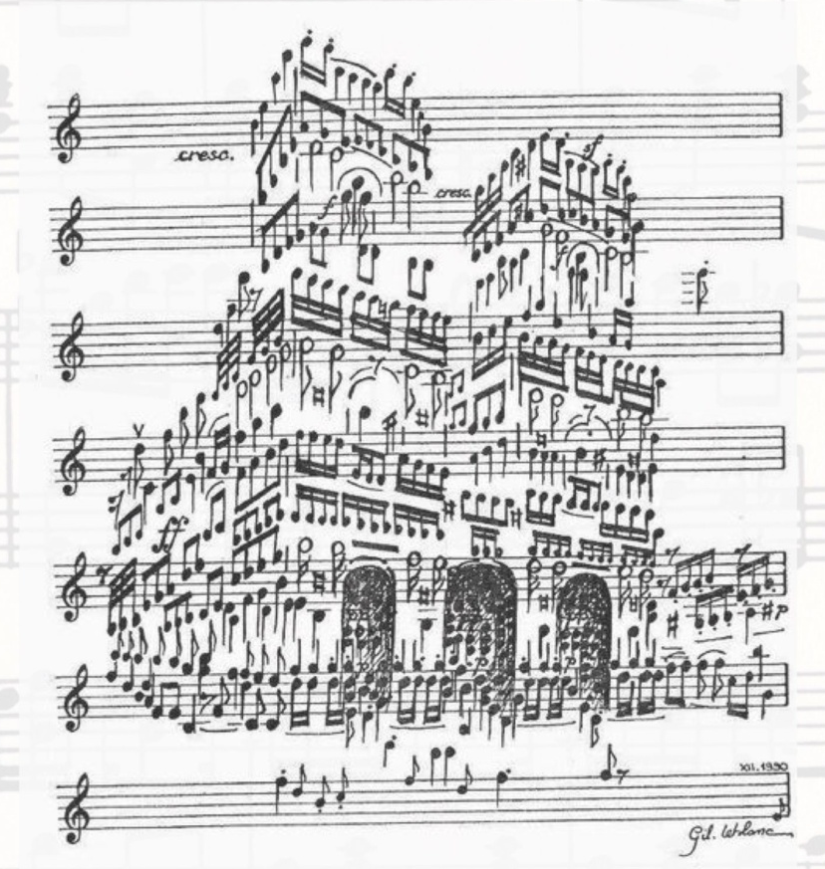
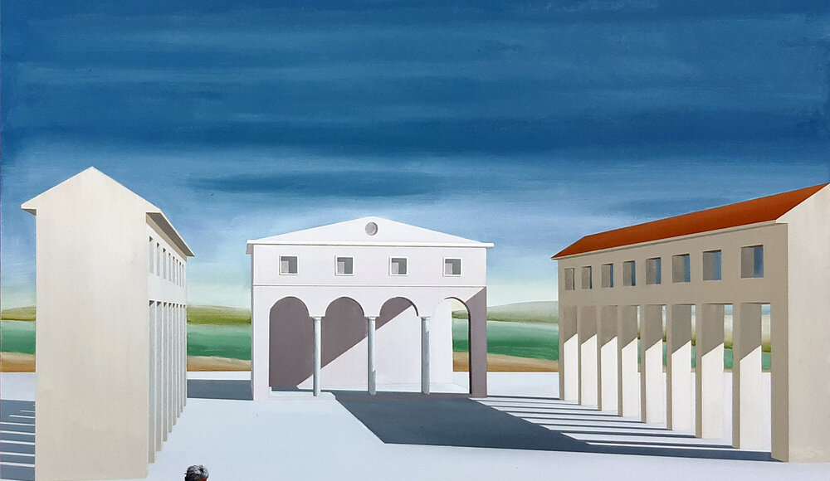
As an Art …
JohannWolfgang von Goethe citation (1749-1832) :
Architecture is a frozen music.
Definition of Le Corbusier (1886-1965)
Architecture is the skilful, correct and magnificent interplay of volumes assembled under light.
L’architecture est le jeu savant, correct et magnific des volumes assemblés sous la lumière.

Slide 37
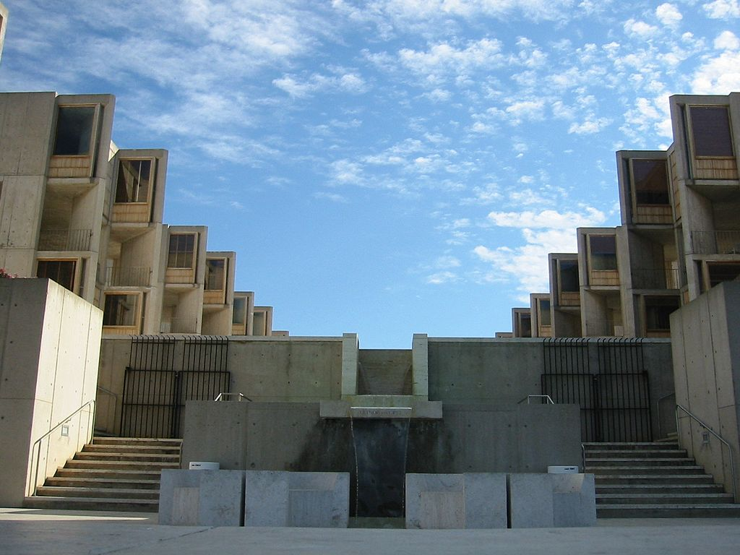
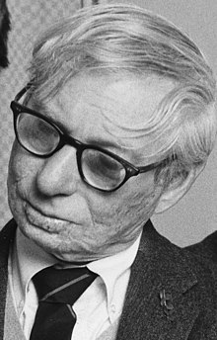
As both …
Definition of Louis Kahn (1901-1974) :
Architecture is a thoughtful making of space.

Slide 38
Architecture as a complex discipline
Based on :
Need
Safety
Expression
Triad of Vitruvius :
Firmitas,
Utilitas,
Venustas.

Slide 39
Architecture as a complex discipline
Architecture, a cultural product.
Architecture, a cultural product.
Architecture holds values of :
Social response;
Local and environmental Culture.
Art and expression.
These dimensions are expressed in characteristics such as :
form,
symbolism
or usage properties.

Slide 40
Architecture as a complex discipline
Styles, History, use and materials
We generally add a distinctive qualifier to the set by:
style :
An architectural style is a set of characteristics and features that make a building or structure notable or historically identifiable.
Function/use :
In architecture, function is the purpose or program of a building, as opposed to its form. This can refer to the literal purpose of a building, such as a school or factory, or to more intangible functionalities, such as the way a building makes its occupants feel.
Historical period :(Antiquity, middle age, renaissance, modernity, post-modernity, etc.)
Used materials
etc.
Military architecture, Housing Architecture; Islamic architecture, modern architecture, wooden or concrete architecture, etc.

Slide 41
The Architect and his role?
Or, Architecture as a discipline

Slide 42
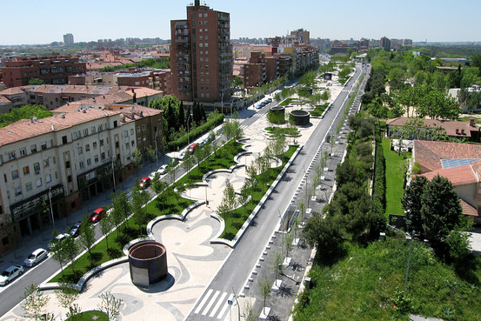
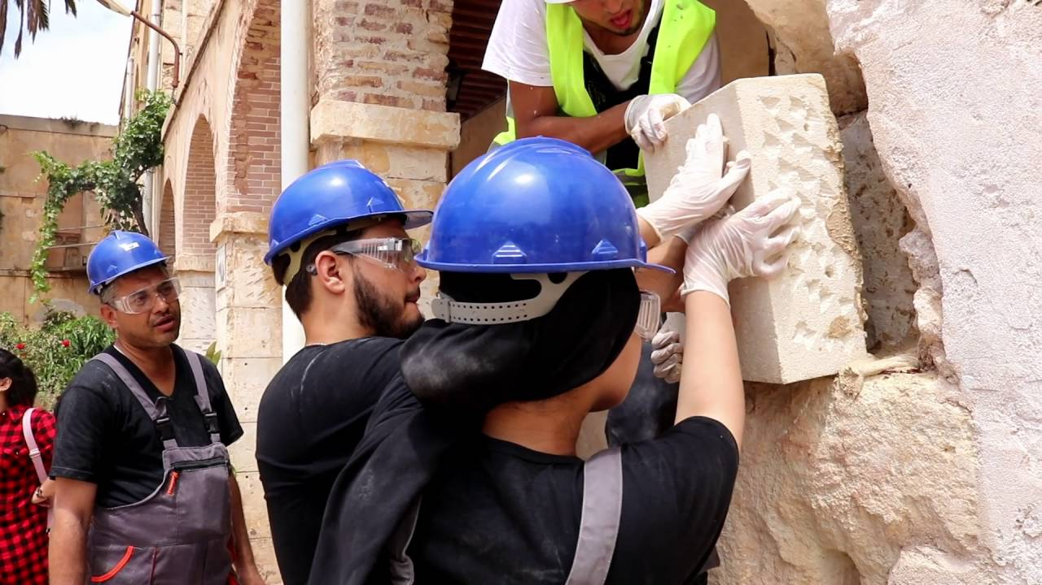
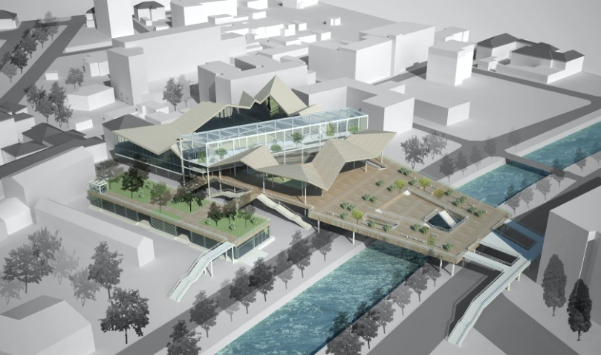
Fields of Architect’s intervention
The architect's vocation is to take part in all aspects of spatial planning, and more particularly in the act of building.
Architects work on :
the construction of new environments,
Renovation-rehabilitation-restauration of existant environments,
Adaptation- modification, requalification to new purposes for existant environments.
NB. Common built environments can be public or private buildings for residential, professional, industrial or commercial use, urban or rural landscapes, public open spaces or even urban environments (urban design).

Slide 43
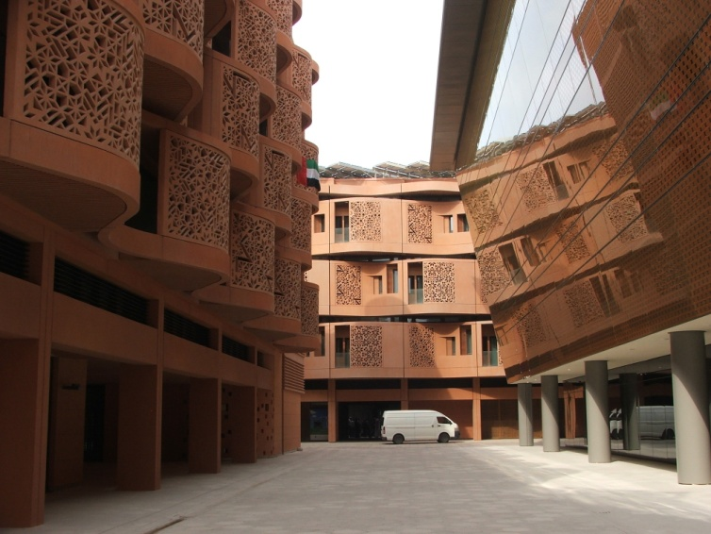
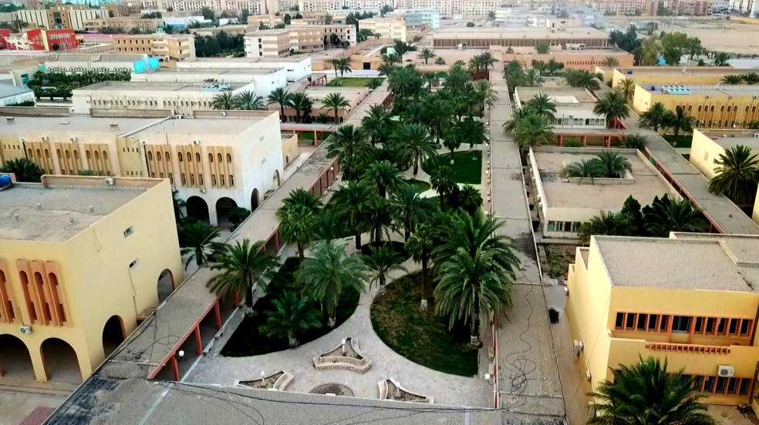
Fields of Architect’s intervention
Fields of intervention of the Architect:
Design of institutional, commercial and industrial buildings.
Various civil structures, such as bridges, monuments, works of art, etc.
Town and country planning.

Slide 44
Architect’s mission
In Algeria, architects are used by :
- private individuals because building or renovating is one of the most important decisions in their lives and those of their families.
- Institutionnal actors :
Administratives, local consillors.
Economical agents : (Retailers, manufacturers, developpers, etc.)

Slide 45
Architect’s mission
As well designing up architectural projects, architects are qualified to intervene at all stages of a project, from design to completion:
- Choice of site - Architectural design - Building expertise - economic evaluation of buildings.

Slide 46
Architect’s mission
The architect's assistance is required to design up the architectural project for which a building permission “ رخصة بناء” is sought.
Architects are also asked to deliver permissions of demolition and permissions of subdivision (land lots).
The architect responds to the expectations of each user while ensuring that the collective interest is respected.
Architect ensures also several other missions like financial expertise on buildings and administrative procedures like call of tenders (avis d’appel d’offre), etc.

Slide 47
Building projects : Actors, responsibilities and intellectual property
The act of construction brings together three main actors: :
The architect (Project manager/maître d’oeuvre) is commissioned by the
client (Project owner- maître d’ouvrage) to design the architectural project.
The project is then built by the Building Contractor/Entrepreneur.
The architect (project manager) is the artistic creator owner of the work of art. He holds the intellectual property of the project as a work of art.

Slide 48
Building projects – Actors, responsibilities and intellectual property
Mission statement:
designing plans and directing the creation of architectural works on behalf of the client, in accordance with guidelines known as specifications :
This project contains : plans and written documents to define the layout of the buildings, their composition, their organization and the expression of their volume, as well as the choice of materials and colours.
Architect ensures also the supervision of the building site (suivi de chantier).
Architect holds the civil liabiability of the building (la responsabilité civile).

Slide 49
Building requirements
Architect’s work satisfaction is a factor of:
- Quality
- Performance
- Economy
He guarantees the customer:
Quality of design and building,
The best balance Quality/cost including significant savings.

Slide 50
Course summary
Introduction to architecture :
Architecture as shelter, as living environments, as a mission and as a place.
Defintions of architecture : Art and/or Science.
Explore of definitions of dictionnaries, architects and theoritians : Vitruvius, Le Corbusier, Luis Kahn, Goethe.
Architecture as a complex discipline : Environment, society, aethetics.
Missions of Architect (Architect as a Profession).

Slide 51
Quizz – Q1
Respond to the following questions :
Classify the following words in accordance with Architecture meanings below :
Hostile natural environment
Impressive façade!
We have to find place to settle down!
Your kitchen is so functionnal space
I like to work in this office
I love this Heritage building
This corner reminds me great childhood sovenirs.
Architecture meanings :
As shelter ……………
As living environment …………….
As a mission ………………..
As a Place …………………

Slide 52
Quizz – Q2
Among these personnalities who defined Architecture in relation to music ?
Le Corbusier
Franck Lloyd Wright
JohannWolfgang von Goethe
Vitruvius.
What was the definition of Architecture by LeCorbusier ?
………………………………………………………………………………………………………………………………………………………………………………………………………………………………………………………………………………………

Slide 53
Quizz – Q3
Is architecture an art or a Science ? Explain.
………………………………………………………………………………………………………………………………………………………………………………………………………………………………………………………………………………………

Slide 54
Quizz – Q4
What are the three stackholders of any building act ?
Project M………..
…………..
……………
Who holds the civil reliability in the building act ?
……………………………………………………………………………………..

Slide 55
Quizz – Q5
What are the three stackholders of any building act ?
Project M………..
…………..
……………
Who holds the civil reliability in the building act ?
……………………………………………………………………………………..

