Slide 1
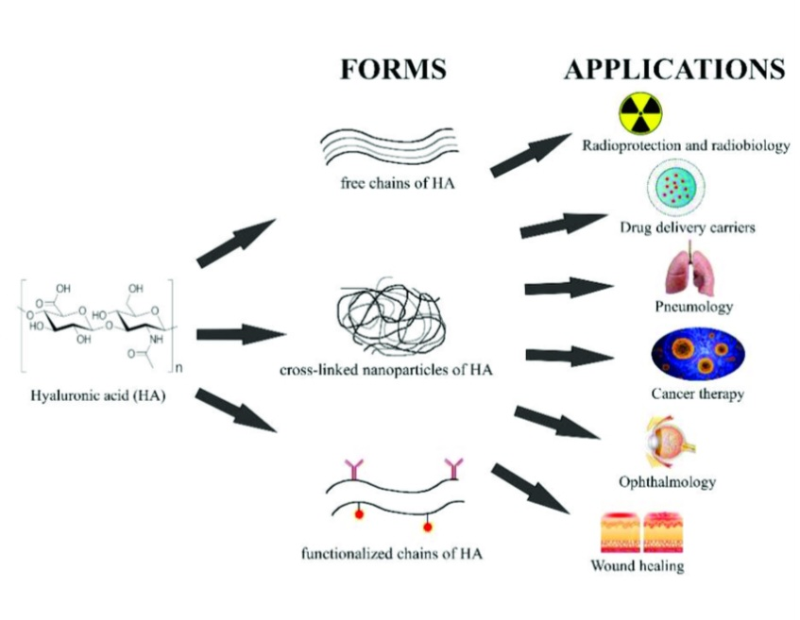
By : Zerguine Hafssa

Slide 2
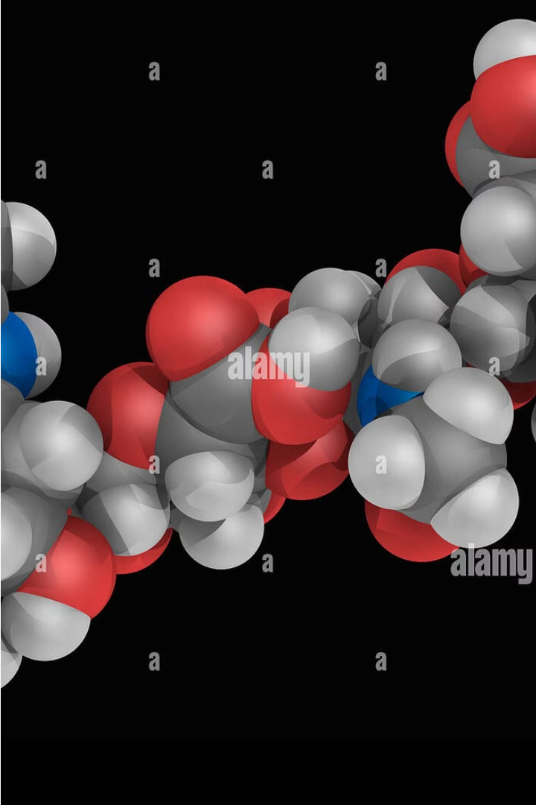
Hyaluronic Acid: The Powerhouse Molecule
Hyaluronic acid is a naturally occurring polysaccharide found throughout the body, particularly in the skin, joints, and connective tissues. It is known for its remarkable ability to hold water, making it a powerful humectant and an essential component in maintaining skin hydration and joint lubrication.

Slide 3
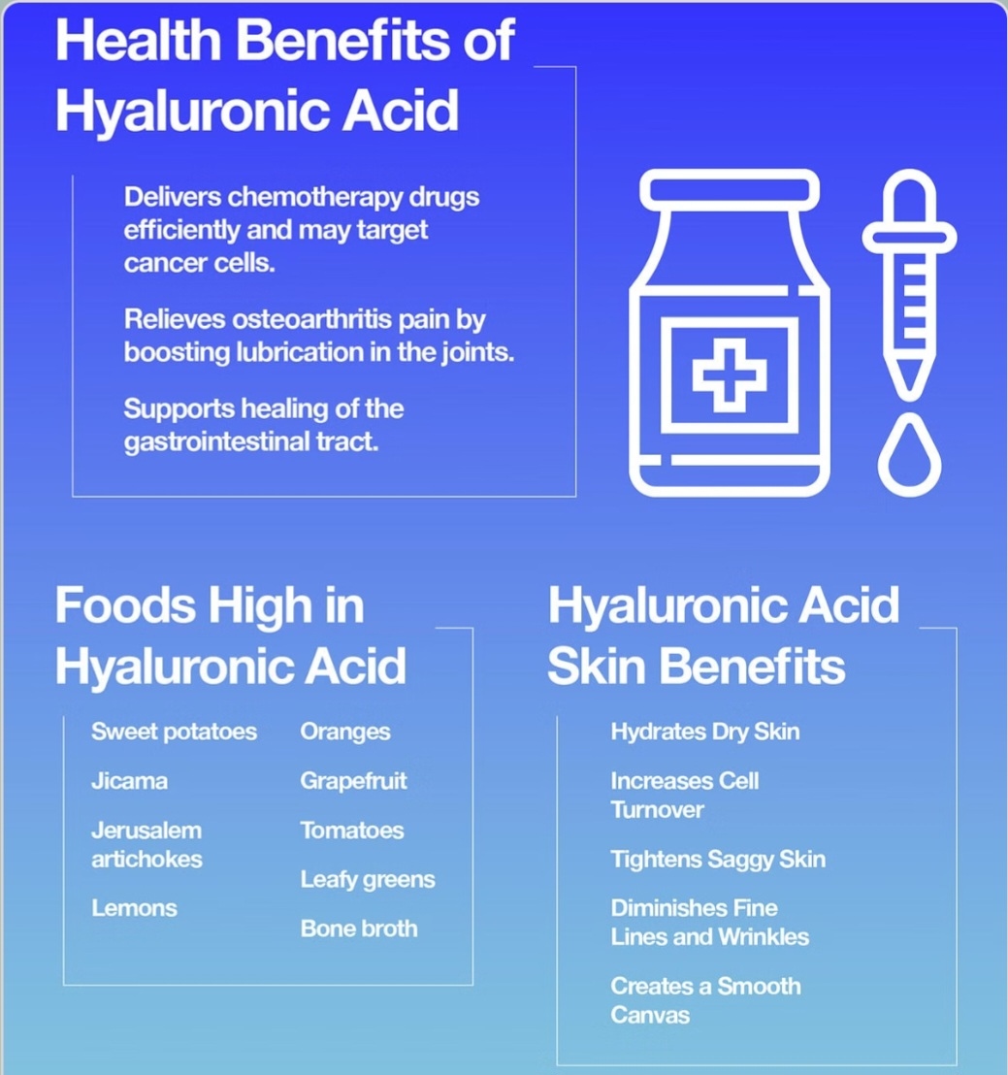
Benefits of Hyaluronic Acid
1
Skin Hydration
Hyaluronic acid is a powerful humectant, drawing moisture into the skin and keeping it plump and youthful.
2
Joint Health
It lubricates and cushions the joints, reducing friction and helping to maintain mobility and flexibility.
3
Wound Healing
Hyaluronic acid promotes the formation of new tissues and cells, accelerating the healing process.

Slide 4
How Hyaluronic Acid Works
Water Retention
Cell Signaling
Antioxidant Properties
Hyaluronic acid has an exceptional ability to hold water, up to 1,000 times its own weight.
It plays a crucial role in cell signaling, influencing cell proliferation, migration, and differentiation.
Hyaluronic acid has potent antioxidant properties, helping to protect against free radical damage.

Slide 5
Sources of Hyaluronic Acid
Human Body
Microbial Fermentation
Hyaluronic acid is naturally produced by the body, primarily in the skin, joints, and connective tissues.
Commercially available hyaluronic acid is often produced through microbial fermentation of Streptococcus bacteria.
Plant-based Sources
Some plants, such as rooster comb and certain types of bacteria, can also produce hyaluronic acid.

Slide 6
Hyaluronic Acid in Skincare
Hydration
Anti-Aging
Skin Barrier
Hyaluronic acid's humectant properties help to deeply hydrate the skin, plumping and smoothing the appearance.
By supporting collagen production and reducing the appearance of fine lines and wrinkles, hyaluronic acid can help maintain a youthful complexion.
Hyaluronic acid helps to strengthen the skin's natural barrier, protecting it from environmental stressors.

Slide 7
Hyaluronic Acid Supplements
Oral Supplements
Topical Serums
Injectable Fillers
Hyaluronic acid can be taken as a dietary supplement, providing systemic benefits for the skin, joints, and overall health.
Hyaluronic acid serums and creams can be applied directly to the skin, providing targeted hydration and anti-aging benefits.
Medical-grade hyaluronic acid is used in injectable fillers to temporarily plump and smooth wrinkles and fine lines.

Slide 8
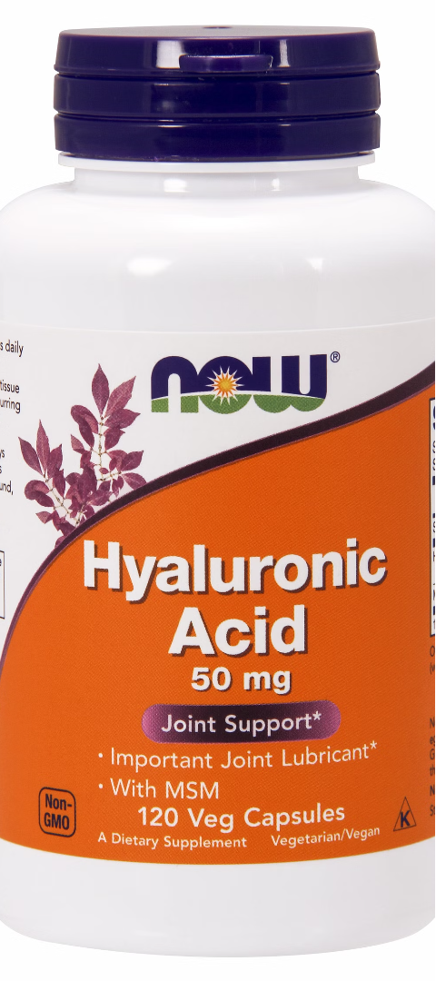
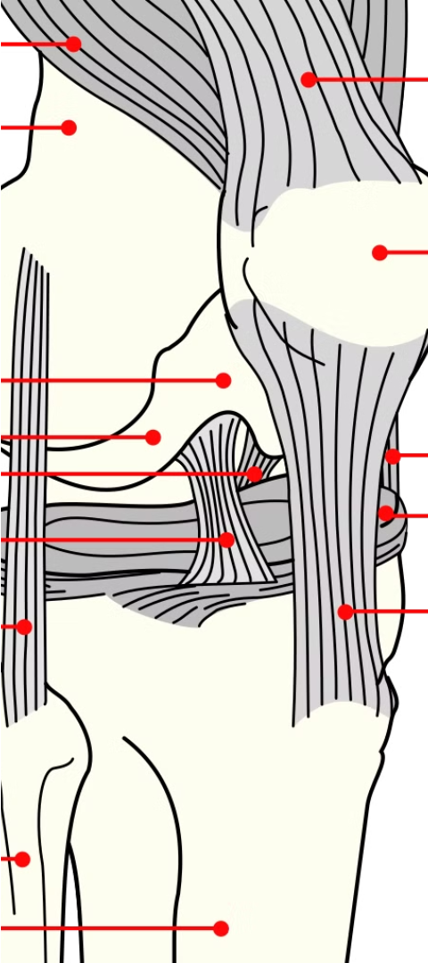
Hyaluronic Acid for Joint Health
1
Lubrication
Hyaluronic acid is a key component of the synovial fluid that lubricates and cushions the joints, reducing friction and wear.
2
Cartilage Protection
It helps to maintain the integrity of cartilage, preventing damage and supporting joint function.
3
Pain Reduction
Hyaluronic acid injections can help alleviate joint pain and improve mobility in conditions like osteoarthritis.
4
Shock Absorption
It helps cushion the joints, absorbing impact and protecting the underlying bone and cartilage.
5
Osteoarthritis Relief
Hyaluronic acid injections can help alleviate the pain and stiffness associated with osteoarthritis.

Slide 9
Potential Side Effects of Hyaluronic Acid
Topical Application
Generally well-tolerated, with rare instances of skin irritation or allergic reaction.
Oral Supplements
Typically safe, but high doses may cause mild gastrointestinal discomfort.
Injectable Fillers
Injection-site reactions, such as swelling, bruising, or infection, are possible but uncommon.

Slide 10
Frequently Asked Questions about Hyaluronic Acid
Can I use hyaluronic acid every day?
Does hyaluronic acid help with wrinkles?
Can hyaluronic acid be taken long-term?
Yes, hyaluronic acid can be safely used daily as part of a skincare routine or as a dietary supplement.
Yes, hyaluronic acid can help reduce the appearance of fine lines and wrinkles by improving skin hydration and plumpness.
Yes, hyaluronic acid can be taken long-term without any major safety concerns, as it is a naturally occurring substance in the body.

Slide 11
THANK YOU
FOR YOUR ATTENTION

