Slide 1
Faculty of Letters and Foreign Languages
Department of English Language
Course: Study skills
Level: First year LMD
Instructor: Dr. Chahira Nasri
Academic year: 2023/2024
Using dictionary

Slide 2
The outline
Introduction
Definitions
Types of dictionary
The importance of dictionary
Criteria of good dictionary
Refernces

Slide 3
Introduction
Vocabulary is a fundamental part of learning any language. Therefore, FLLs and SLLs always need to nurture it to be able to act correctly. Nonetheless, learners may come across different unfamiliar structures during learning. Thus, they tend to use different strategies to learn those new words such as ignoring words, asking others for help or inferring using a context. Sometimes, learners may find the meaning of a compound word through breaking it down into small parts. But most of the time, students do not find the desirable results from their guesses. After these exhausting possibilities, students need to choose other ways to decipher meaning such as using dictionary.

Slide 4
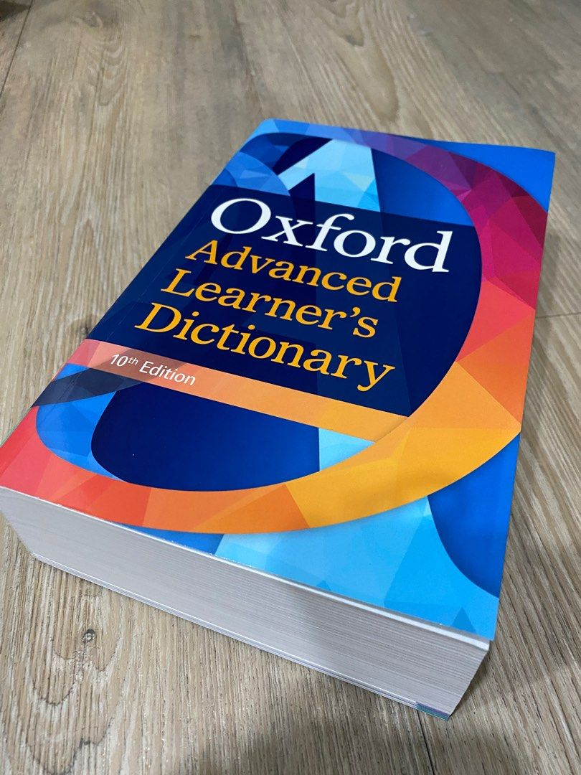

Slide 5
Definition of dictionary
Tarp (2009,p. 29) states that dictionary is a handy tool which is, or should be, designed to satisfy certain human needs. Dictionaries are ways for autonomous learning. The dictionary is a device or a strategy which enables language learners to check their own knowledge, and to eliminate weaknesses in spelling, The traditional way in paper dictionary has explained words with words, using either a definition (typically in the language of the headword) or an equivalent (typically in another language).

Slide 6
Types of Dictionary

Slide 7
2.1.Bilingual dictionary
This kind of dictionary has two different languages and it follows the alphabetical order. It focuses on providing explanations with helpful examples to vague words in a clear and simple way. Wei (2007) said that learners of English are likely to use a bilingual dictionary to look out equivalents in their L1. However, the bilingual dictionary has negative points. Among its disadvantages, learners are likely to rely on translation rather than definitions (Baxter, 1980; Nation, 2001).

Slide 8
2.2.Monolingual dictionary
It uses only one language. A monolingual dictionary put the emphasis on providing
deep explanations based on vocabulary function in context i.e. it gives definitions which are commonly used in conversation (Albus et al., 2005, pp. 246-248).

Slide 9
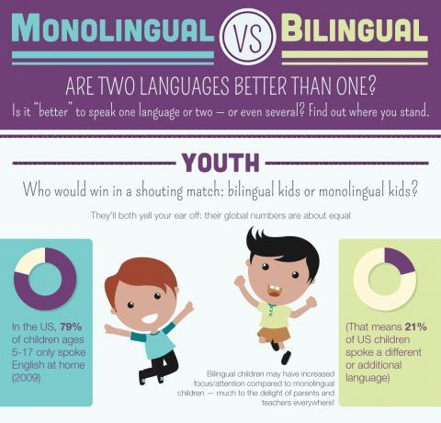

Slide 10
3.The importance and purposes of using dictionary
• Pronunciation rules: this means how a word sounds correctly in speaking.
• Division of words into syllables: how many syllables there are in a word including the stress.
• The correct spelling: language users can check the correct written by from using dictionary.
• The grammatical class of a word: learners can determine the function of a word in particular sentence .i.e. is it a noun, a verb, an adverb…etc.

Slide 11
Synonyms and antonyms: dictionaries may present the words that have close or the same or the opposite meaning.
• The etymology of a word: this includes the origin of that word including its changes throughout the history. The etymology may also contain the derived words.
• The meaning of idiomatic expressions: dictionaries present the implied meaning of phrases and expressions that is not clear for beginners.
• The different registers of a word: such as formal, informal, slang…etc.

Slide 12
4. Criteria of good dictionary
Information about the usefulness of words.
*Contexts for the words
*Helpful etymology
*Definition that relate to word parts
*Keywords
*Underlying concepts
*The format of entries
*Computer use

Slide 13
References
AlBulushy, Z. (2012). Paper Dictionary or Electronic One. Retrieved from http://www.developing teacher.com. December, 2021.
Albus, D., Thurlow, M., Liu, K., & Bielinski, J. (2005). Reading test performance of English-Language learners using an English Dictionary. The Journal of Educational Research, 98(4), 245-256.
Baxter, J. (1980). The dictionary and vocabulary behavior: A single word or ahandful?TESOL Quarterly, XIV (3), 325-336.
Gu, P. Y. (n. d.). Learning strategies for vocabulary development. Reflections on English Languge Teaching, 9 (2), 105-118.
Huang, S., & Eslami, Z. (2013). The use of dictionary and contextual guessing strategies for vocabulary learning by advanced English-Language learner. English Language and Literature Studies: Canadian Center of Science and Education, 3(3), 1-7.
Rohmatillah, B. (2016).dictionary usage in English Language learning. English Education: Jurnal Tadris Bahasa Inggris. Vol 9 (1), 2016, 186-197.
Nation, ISP. 1989. Dictionaries and Language Learning. In: Learners’ dictionaries State of the Art M.L. Tickoo (Ed), RELC Anthology Series 23.
Nation, ISP. (2000). Learning Vocabulary in Another Language. Cambridge: Cambridge University Press.UK.

