Slide 1
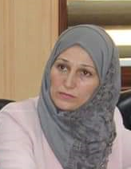
ENTREPRENEURIAL ECOSYSTEM Daniel Isenberg model
Dr.DJOUDI Hanane
Faculty of ECMS/ University of Biskra
April, 2023
REF: Guide for mapping the entrepreneurial ecosystem, GIZ 2018

Slide 2
Background
* Entrepreneurship is a catalyst of economic growth and national competitiveness .
* Policymakers and academics believe in the value of entrepreneurship to the society and economic growth.
* Formulating entrepreneurship policies is critical to entrepreneurship development and the well being of society.
* There is a real need to adopt a holistic approach to this phenomenon to generate high levels of dynamism, innovation, effectiveness and allow for the creation of conductive atmosphere,
النظام البيئي لريادة الأعمال Entrepreneurship ecosystem

Slide 3
Background
* Industrial economy ------knowledge based economy
*Structure and production part -------Service part
*Big companies--------Small companies
* Small companies------New companies
النظام البيئي لريادة الأعمال Entrepreneurship ecosystem

Slide 4
EE Model
Isenberg emphasises that every entrepreneurial ecosystem is unique as it develops under ideosyncratic circumstances.
According to him, the entrepreneurial ecosystem is defined as a product of three elements:
1. the surrounding environment, more precisely the business environment and investment climate,
2. its interacting actors, and
3. the evolving culture and attitudes.
النظام البيئي لريادة الأعمال Entrepreneurship ecosystem

Slide 5
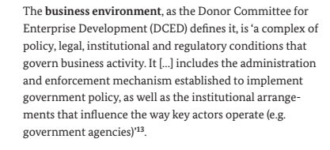
Business environment
النظام البيئي لريادة الأعمال Entrepreneurship ecosystem

Slide 6
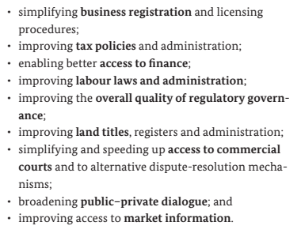
Functional areas of Business environment
النظام البيئي لريادة الأعمال Entrepreneurship ecosystem

Slide 7
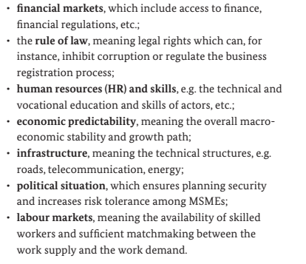
Investment climate
النظام البيئي لريادة الأعمال Entrepreneurship ecosystem

Slide 8
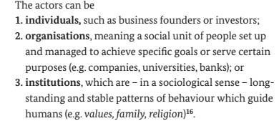
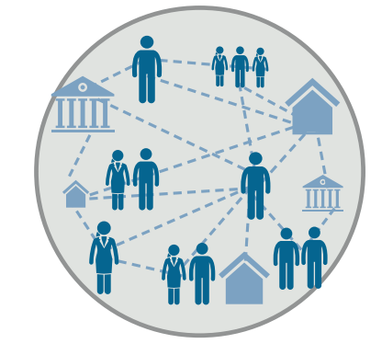
Interacting actors
النظام البيئي لريادة الأعمال Entrepreneurship ecosystem

Slide 9
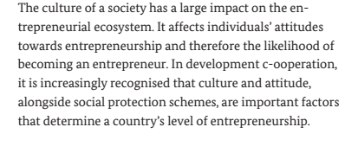
Entrepreneurial culture and attitude
النظام البيئي لريادة الأعمال Entrepreneurship ecosystem

