Slide 1
Basic Concepts of Crystallography

Slide 2
UNIT CELL
In 3D space the unit cells are replicated by three noncoplanar translation vectors a₁, a₂, a₃ and the latter are typically used as the axes of coordinate system
In this case the unit cell is a parallelepiped that is defined by length of vectors a₁, a₂, a₃ and angles between them.

Slide 3
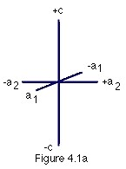
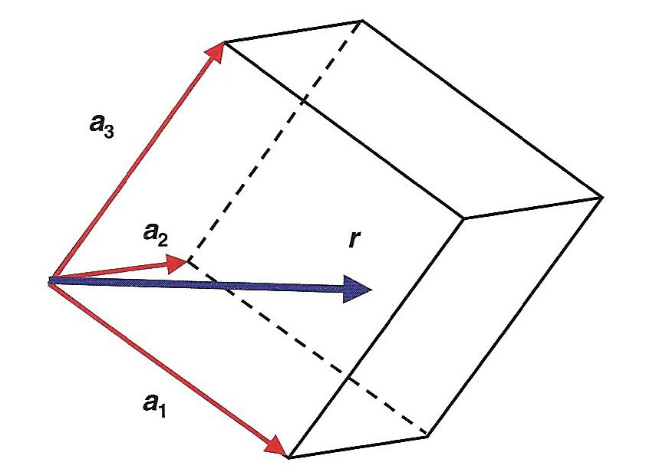
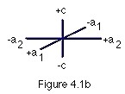
The volume of the parallelepiped is Given by the mixed scalar-vector product of translation vectors:
Any point, r, within a unit cell is defined by three fractional coordinates, x, y, z:

Slide 4
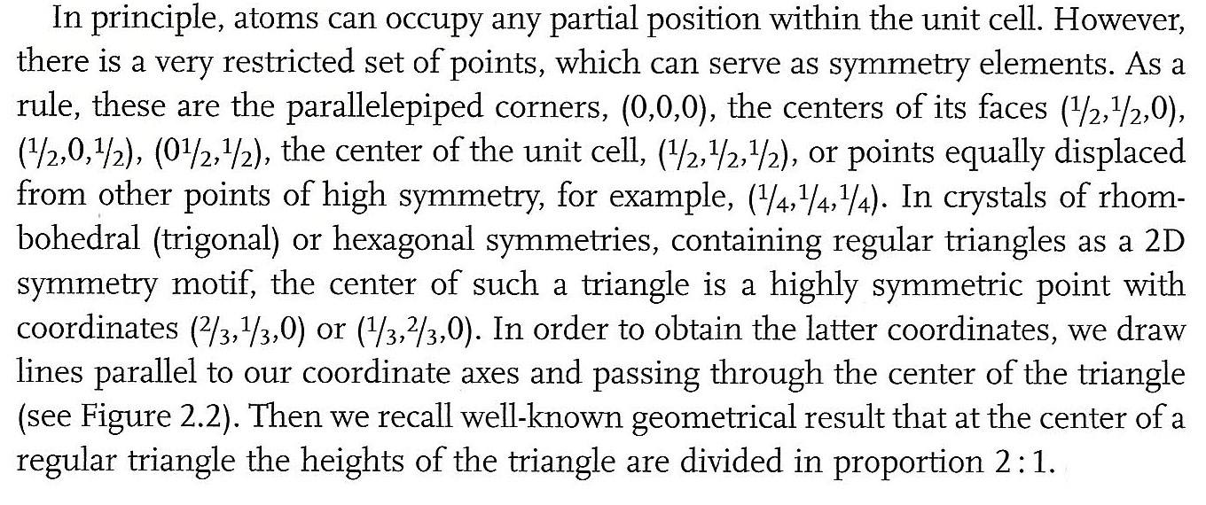
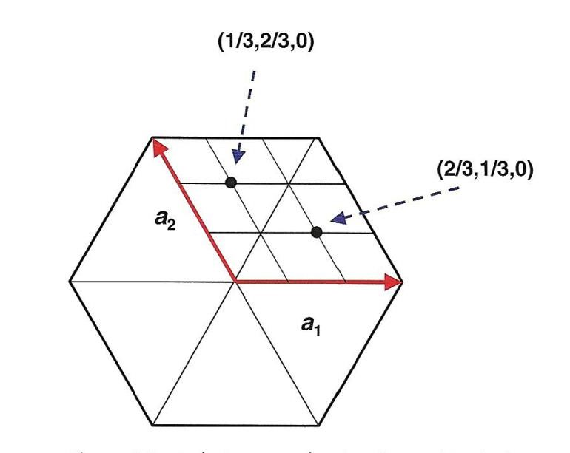

Slide 5
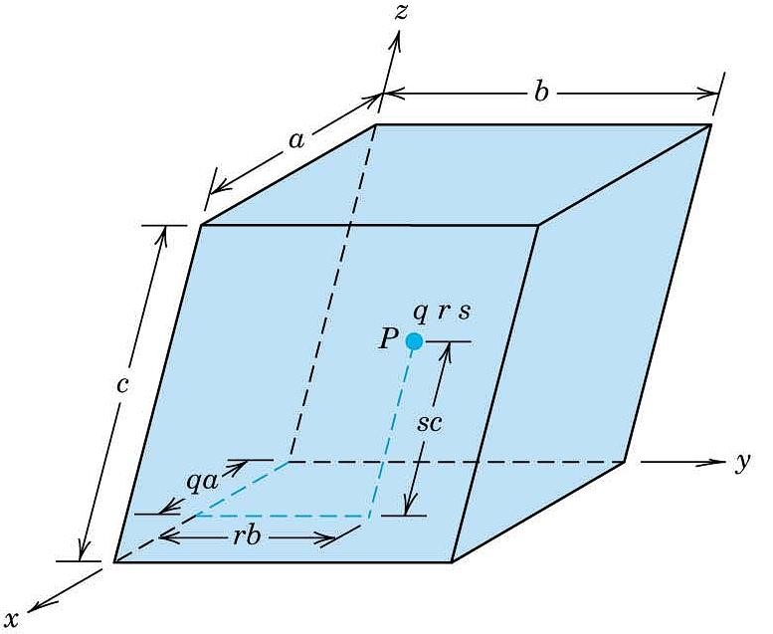
Point Coordinates
The position of any point (e.g. P)
within the unit cell can be defined
in terms of
generalized coordinates
(
e.g. q, r, s) which are
fractional
multiples
of the unit cell
edge length
(
a, b, c respectively):
(
q
r
s)

Slide 6
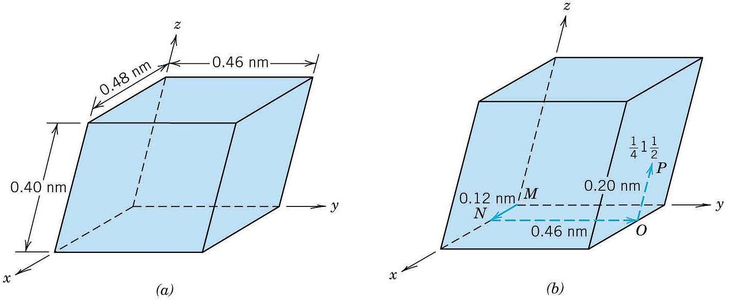
Point Coordinates
Problem: Locate the point with coordinates ¼ ,1, ½
a =0.48 nm b =0.46 nm c =0.40nm |  | P: q r s = P: ¼ 1 ½ qa = ¼ 0.48 nm = 0.12 nm rb =0.46 nm sc = ½ 0.40nm = 0.20 nm

Slide 7
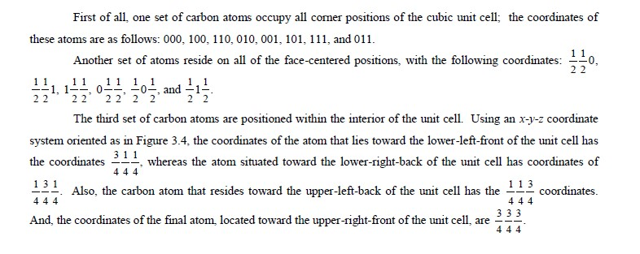
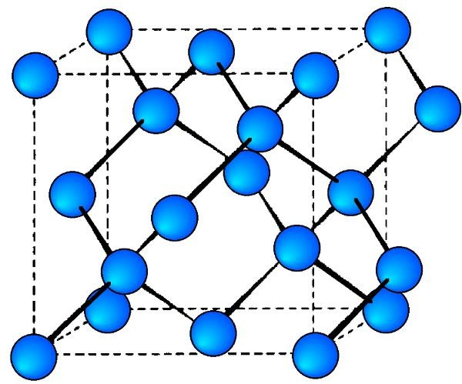
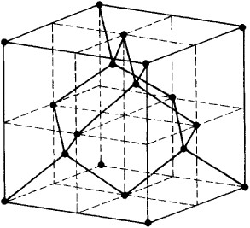

Slide 8
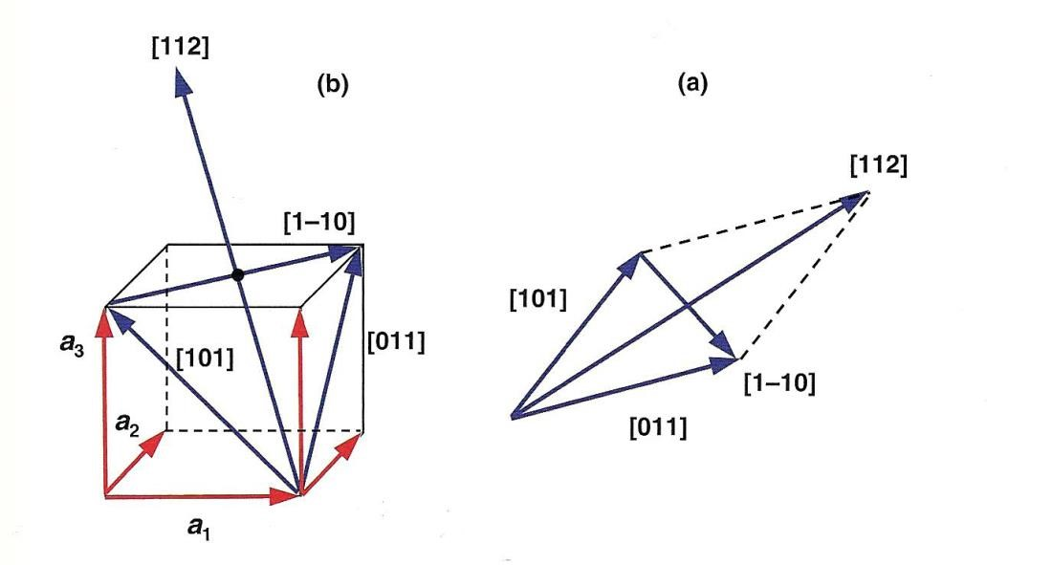
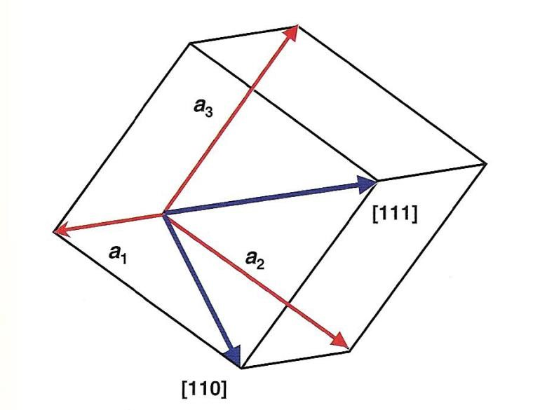
are associated with certain crystallographic
directions. The latter also designated by vector,
r
:

Slide 9
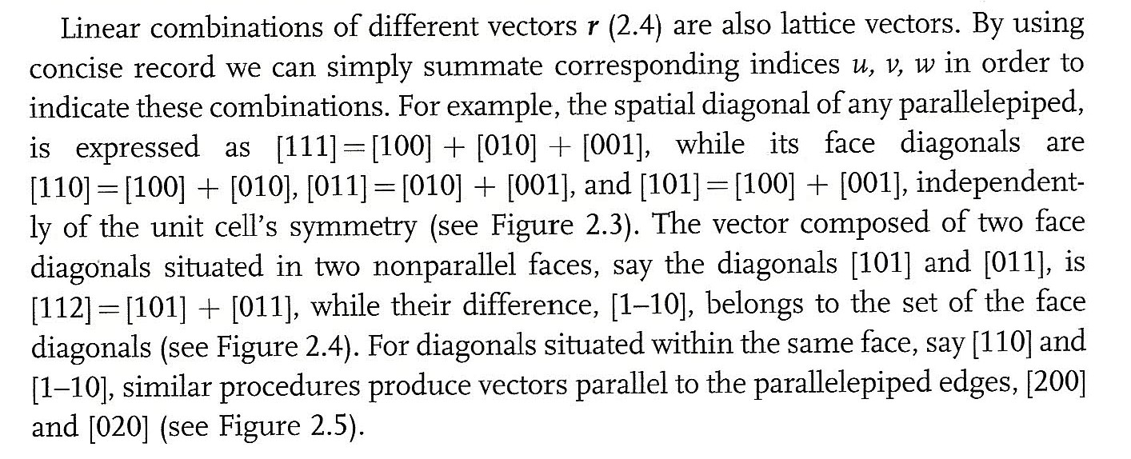
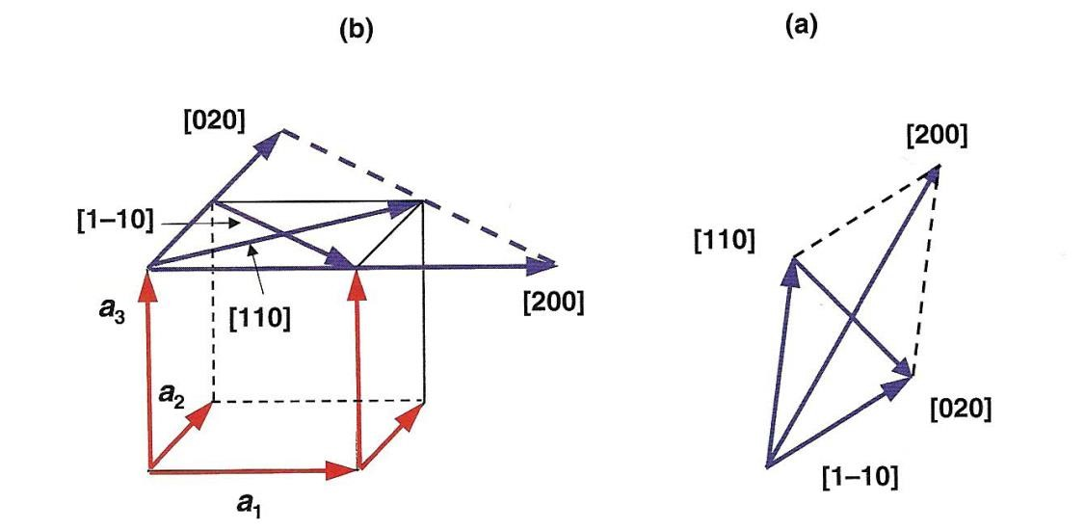
Indexing Crystallographic Directions

Slide 10
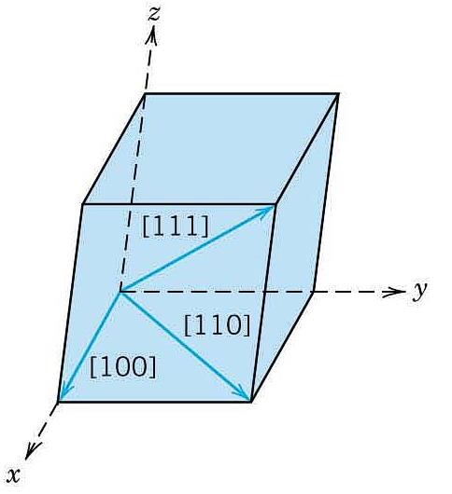
Crystallographic Directions
is a vector connecting the coordinate origin and a specific point of a unit cell. In crystallography such vector is defined by three directional indices [u n w]
A vector of desired length is positioned that it pass through the origin of the coordinate system. Translate it through a crystal lattice if needed!!
The length of the vector projection on each axis are determined again in terms of unit cell dimensions (a, b, c)
Obtained three numbers are multiplied or divided by a common factor to reduce them to integer values (e.g. u n and w)
Notation in square bracket [u n w] defines the desired crystallographic direction

Slide 11
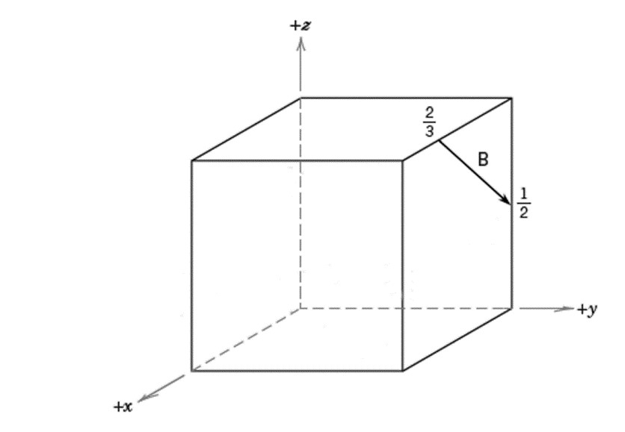
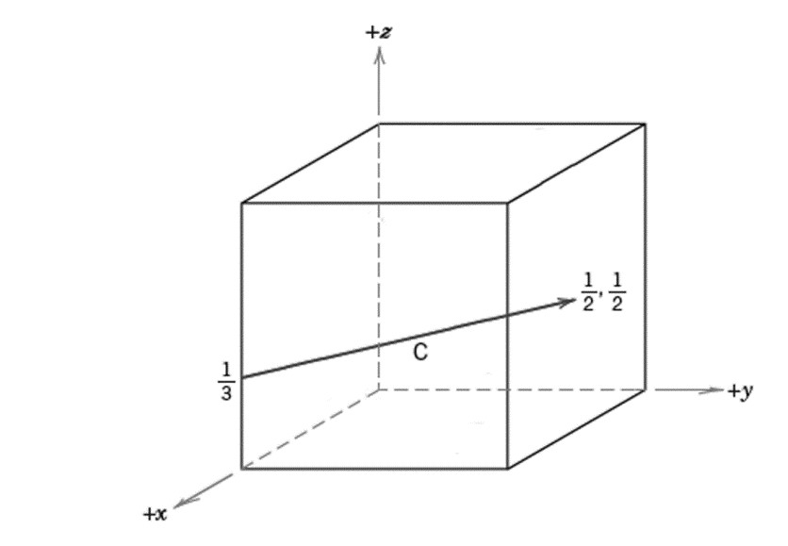
Indexing Crystallographic Directions
Or
𝑥
2
−
𝑥
1
𝑢
=
𝑛
𝑎
𝑦
2
−
𝑦
1
𝑣
=
𝑛
𝑏
𝑧
2
−
𝑧
1
𝑤
=
𝑛
𝑐

Slide 12
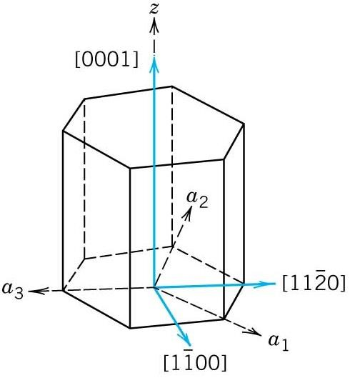
Crystallographic Directions: Hexagonal Crystals
It is convenient to use a four- axis (Miller-Bravais) coordinate system: a₁,a₂,a₃ axes lay in one basal plain and located at 120 to each other, while the z axis is perpendicular to the basal plane. Same rules determine in this case four indices [u n s w]:
by convention the first three pertain to projections in a₁, a₂, z axes
[u` n` w`] → [u n s w] conversion:
where n is a factor required to reduce indices

Slide 13
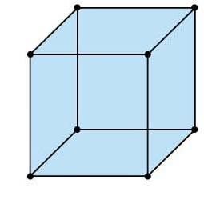
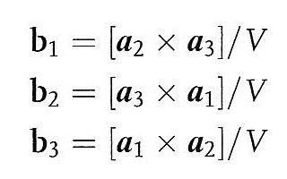
Reciprocal and Real Spaces
.
a3
Using equations:
.
a2
a1
.

Slide 14
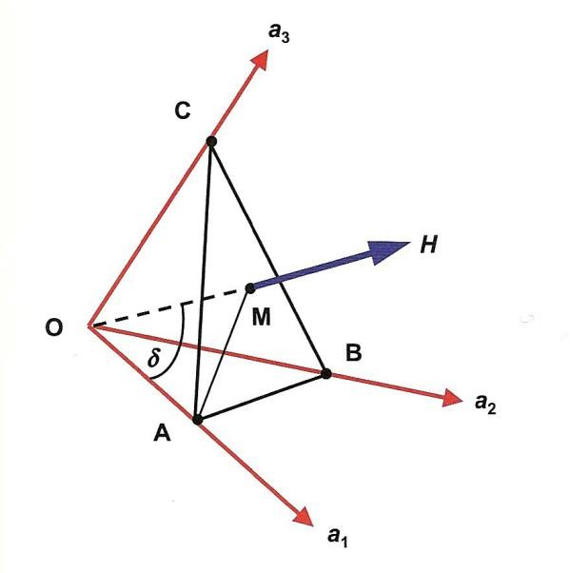
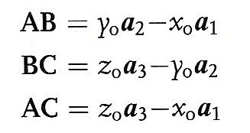
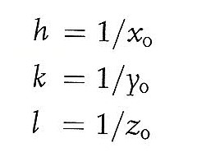
Reciprocal and Real Spaces
By using equations:
It can be shown that scalar products of vector
H
and
AB,BC,AC
equal:
H
=
k∙y
-
h∙x
∙AB
_{o}
_{o}
=
H
∙BC
l
∙z
-
k∙y
=
_{o}
_{o}
H
∙AC
l
∙z
-
h∙x
_{o}
_{o}
=
=
=0
The scalar products
H
∙AB
H
∙BC
H
∙AC

Slide 15
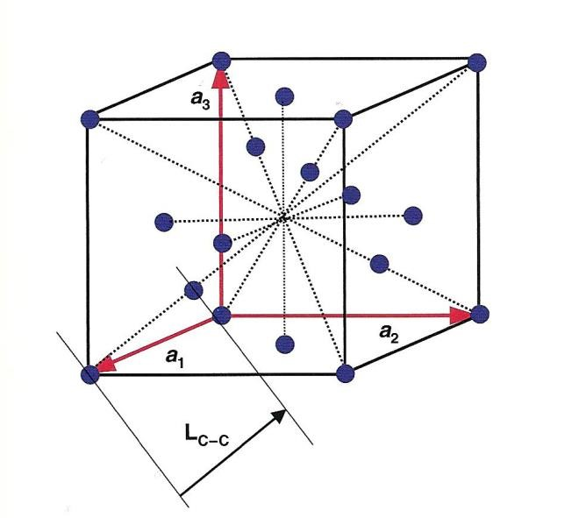
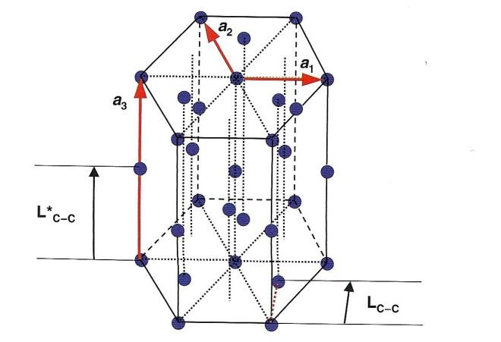
The bond
d=length calculation : Examples
Real Space
If all angles
between all translation vectors
equation (B) transforms to Equation (C)
are 90
:
°
(
C) for
(
C)
(
B)

Slide 16
Crystallographic Calculations
Reciprocal Space
Note
again that the result of calculations
also
depends on the relationship between vectors
b
₁
,b
b
.
₂
,
₃
Two planes are perpendicular when

Slide 17
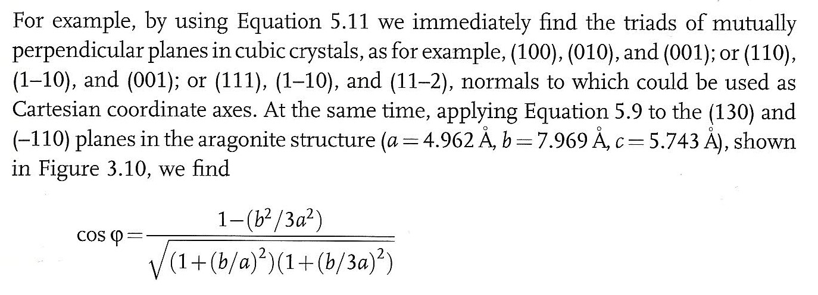
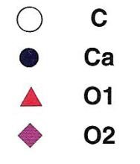
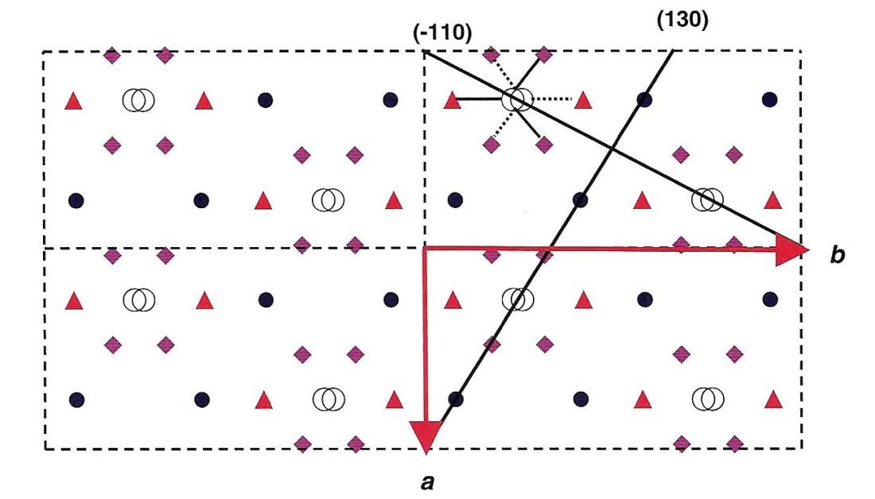
Angle between Crystallographic Planes
Reciprocal Space
(
A
)
(
B
)
(
B
)
(
A) to the (130) and

Slide 18
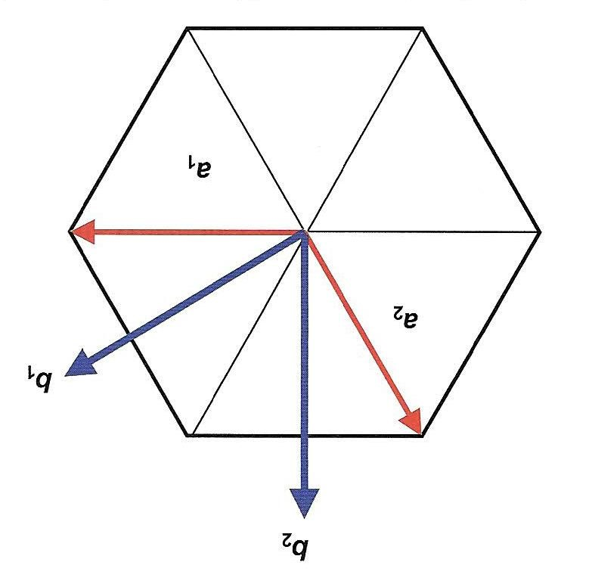
D
-
spacing
Reciprocal Space
Applying the equation to cubic crystal yields:
Applying the equation to tetragonal crystal yields:
Applying the equation for hexagonal crystal yields:

Slide 19
Both Space

