Slide 1
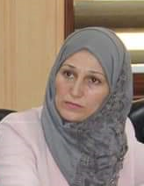
MARKETS AND COMPETITORS
Dr.DJOUDI Hanane
Faculty of ECMS/ University of Biskra
November 5, 2023
REF: Business vocabulary in use

Slide 2
A

Slide 3
B

Slide 4
C

Slide 5
EX 1

Slide 6
EX 2

Slide 7
EX 3

Slide 8
Thanks

