Slide 1
Lecture starting soon

Slide 2
STATISTICS Quantitative Data Analysis in Applied Linguistics
Moustafa Amrate
Department of English, University of Biskra
moustafa.amrate@univ-biskra.dz

Slide 3
Course description
This course focuses on the analysis of quantitative data in the fields of Applied Linguistics and TEFL.
The course introduce the main statistical tests used to determine the existence and strength of a relationship between two or more variables.

Slide 4
Course objectives
By the end of this course, you will be able to:
Choose the appropriate statistical test for your Master’s research project.
2. Use the relevant statistical test for your research manually or by using Excel, SPSS, and R studio.
3. Interpret the results generated through the different statistical tests.

Slide 5
Prerequisites
Before enrolling in this course, you should have:
A basic level in arithmetic.
A knowledge of basic concepts in Research Methods in Applied Linguistics.

Slide 6
Course outline
Lecture 1 Introduction to basic concepts in statistics
Lecture 2 Population and sampling
Lecture 3 Levels of measurement
Lecture 4 Introduction to descriptive statistics
Lecture 5 Applications of descriptive statistics
Lecture 6 Practice
Lecture 7 Introduction to inferential statistics and hypothesis testing
Lecture 8 Choosing advanced statistical tests (Practice)
Lecture 9 Correlation: Introduction
Lecture 10 Multiple regression
Lecture 11 Reporting results and data visualization
Lecture 12 Revision and Practice

Slide 7
Course card
Module | Statistics
Level | Master
Year of study | 2nd year
Term/ semester | 3rd semester
Unit | Discovery
Credit | 1
Coefficient | 1
Format | Lectures (ONLINE LECTURES)
Evaluation Format | End of term exam (100%)
Lecturer | Moustafa Amrate
Email | moustafa.amrate@univ-biskra.dz

Slide 8
ANY QUESTIONS?

Slide 9
LECTURE 1:
INTRODUCTION TO BASIC CONCEPTS IN STATISTICS

Slide 10
Outline
The notion of data and types of data
Introduction to statistics
Branches of statistics
A population vs. a sample
Variables
Hypotheses
Probability
Causation vs. correlation
Bias

Slide 11
Data
The term data (plural for datum) refers to facts, information, and observations about an object (or objects), a phenomenon (or phenomena), a person (or a group of people). Data can take either a qualitative or a quantitative form.

Slide 12
STATISTICS
RESEARCH METHODOLOGY
RESEARCH METHODOLOGY
+ ACADEMIC WRITING
Data collection
Analysis
Results
Experiments
Questionnaires
Interviews …

Slide 13
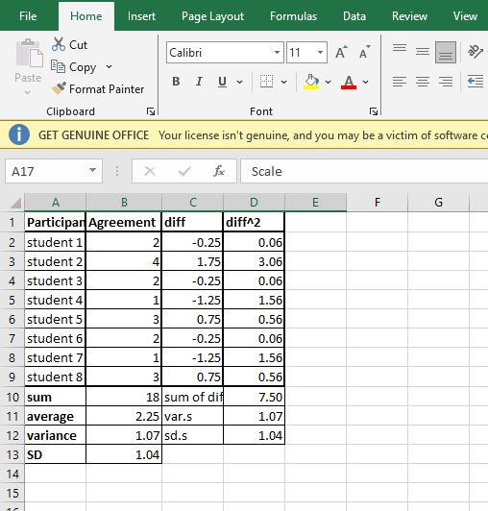

Slide 15
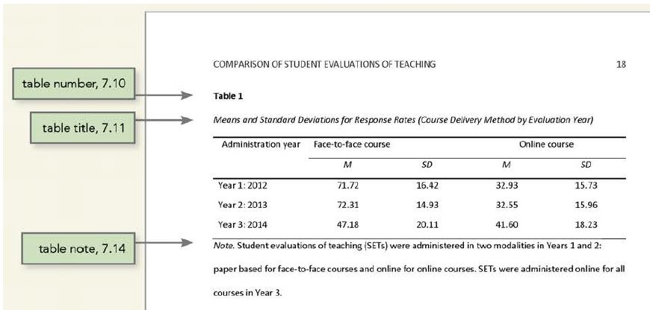

Slide 17
TYPES OF DATA
Quantitative data
Qualitative data

Slide 18
Qualitative data
Qualitative data refer to the type of descriptive information that does not make use of statistical procedures (Mackey & Gass, 2015, pp. 250-251).
Instead of quantification, the collection and analysis of qualitative data involves careful and detailed descriptions of objects, phenomena, or people’s narratives, perceptions, and beliefs about objects or phenomena.
Such data are often collected using observations, semi-structured and unstructured questionnaires, or interviews.

Slide 19
Quantitative data
Quantitative data consists of information that is, in some way or the other, quantifiable. In other words, we can put quantitative data into numbers, figures, and graphs, and process it using statistical procedures.
When using quantitative analysis, we are usually interested in how much and how many there is/are of whatever we are interested in.

Slide 20
What is statistics?
Statistics is the discipline that concerns the collection, organization, analysis, interpretation, and presentation of data (Romeijn, 2014).
In Statistics, the phenomena being studied should be quantified and therefore are reduced to numbers.

Slide 21
Statistics is comprised of two main branches, a) descriptive statistics and b) inferential statistics.
BRANCHES OF STATISTICS
Descriptive statistics
Inferential statistics

Slide 22
Descriptive statistics
“Descriptive statistics can help to provide a simple summary or overview of the data, thus allowing researchers to gain a better overall understanding of the data” (Mackey & Gass, 2015, pp. 250-251).
This summary of the data is done through measures of frequency, measures of central tendency (i.e., the mode, median, and mean), and measures of spread (i.e., variance and standard deviation).

Slide 23
Inferential statistics
Inferential statistics refer to statistical tests that allow the researchers to infer the results obtained with a sample to the general population (hence the name inferential).
Such tests are very important as they ensure the researcher that the difference found between tests or groups is not due to chance but rather to a real relationship (causal or correlational) between the variables being studied.

Slide 24
ANY QUESTIONS?

Slide 25
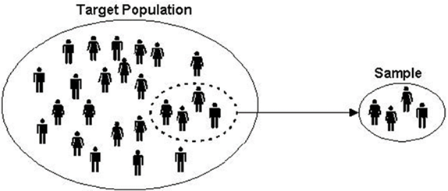
A population vs. a sample
A population is the entire group that the researcher wants to draw conclusions about. A sample is the specific group that the researcher will collect data from. The size of the sample is always less than the total size of the population.

Slide 26
Variables
In research, variables refer to the population, objects, or phenomena that the researcher is trying to measure.
Dependent variable: The variable that is influenced by the independent variable.
Independent variable: The factor that causes the dependent variable to change.
Example:
The influence of English media on EFL learners’ listening comprehension.

Slide 27
Variables
In research, variables refer to the population, objects, or phenomena that the researcher is trying to measure.
Dependent variable: The variable that is influenced by the independent variable.
Independent variable: The factor that causes the dependent variable to change.
Example:
The influence of English media on EFL learners’ listening comprehension.

Slide 28
Hypotheses
Research hypotheses can be used to express what the researcher expects the results of the investigation to be. The hypotheses are based on observations or on what the literature suggests the answers might be (Mackey & Gass, 2005: 19).
In research, we have three main types of hypotheses:
1)
2)
3)

Slide 29
Hypotheses
Research hypotheses can be used to express what the researcher expects the results of the investigation to be. The hypotheses are based on observations or on what the literature suggests the answers might be (Mackey & Gass, 2005: 19).
In research, we have three main types of hypotheses:
Null hypothesis (H0),
Non-directional hypothesis (two-tailed/ two-way hypothesis),
Directional hypothesis (one-tailed).

Slide 30
A) Null hypothesis (H0):
The null hypothesis is a neutral statement used as a basis for testing. The null hypothesis states that there is no relationship between items under investigation.
In advanced inferential statistical tests, the objective is often to reject the null hypothesis by providing a proof that there is a relationship between variables X and Y.
Examples:
•Text-to-speech technologies will not affect Algerian EFL learners’ pronunciation awareness.
There will be no relationship between family income and students’ academic performance.

Slide 31
B) Non-directional hypothesis (two-tailed/ two-way hypothesis):
In these types of hypotheses, a difference between variables under investigation is predicted, but the researcher is not interested in the direction of the difference/ relationship., but its direction is not specified.
Examples:
•Text-to-speech technologies will affect Algerian EFL learners’ pronunciation awareness.
•There will be a relationship between family income and students’ academic performance.

Slide 32
C) Directional hypothesis (one-tailed):
In these types of hypotheses, the researcher indicates the predicted direction of the relationship between two or more variables.
Examples:
•Older learners will prefer speaking more than younger learners.
•Novice teachers will give less instructions in the target language than experienced teachers.

Slide 33
Probability
In statistics, probability refers to the likelihood of an event taking place.
For example, the probability of getting heads or tails when tossing a coin is 50%.

Slide 34
Probability
In statistical tests, the probability value (or p-value) measures the probability that an observed relationship/ difference could have occurred due to random chance.
Low p-values (p < 0.05) indicate a great chance of real statistical significance (i.e., rejecting the null hypothesis);
meanwhile, high p-values (p > 0.051) indicate a low chance of statistical significance (i.e., accepting the null hypothesis).

Slide 35
Causation vs. correlation
Causal relationships are unveiled by determining the causes and effects of a particular phenomenon. Causation is usually determined through experiments.
On the other hand, “Correlational research attempts to determine the relationship between or among variables”. Correlation is usually determined through correlational studies.
(Mackey & Gass, 2005, p. 284).

Slide 36
Causation vs. correlation
In research, there is a general consensus that correlation does not equal causation. In other words, just because there a relationship between two variables, it does not mean they cause each other.

Slide 37
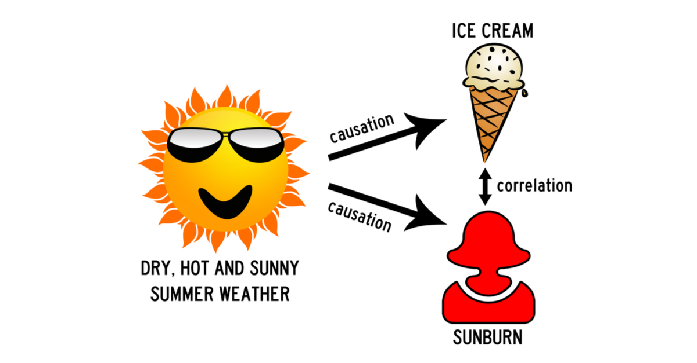
Example

Slide 38
Bias
“Bias takes place when a statistical model/ test over or underestimates a relationship between two or more variables.
There are two main types of bias,
a) Selection bias: Happens when a researcher tries to generalize findings that were collected in a non-random way.
b) Confirmation bias: Takes place when the researcher starts the data collection/ analysis with a predetermined assumption” (Vickery, 2021).

Slide 39
Thank you for attending!
Q& A

