Slide 1
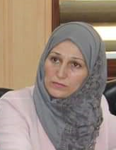
MARKETING MIX
Dr.DJOUDI Hanane
Faculty of ECMS/ University of Biskra
November 19, 2023
REF: Professional English in Use Marketing

Slide 2
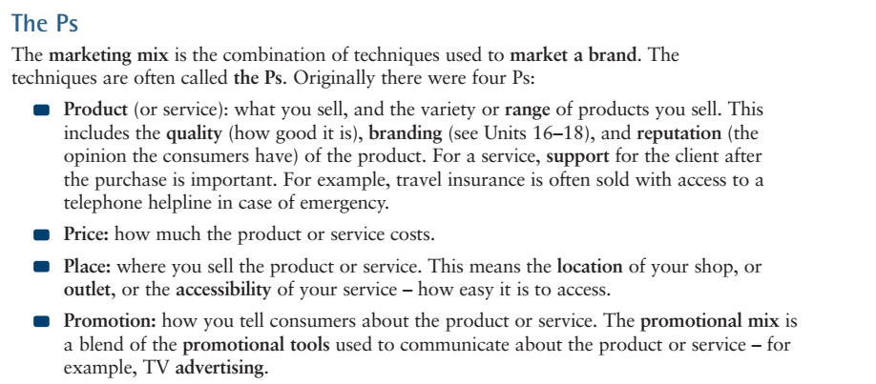
A

Slide 3
A

Slide 4
B

Slide 5
B

Slide 6
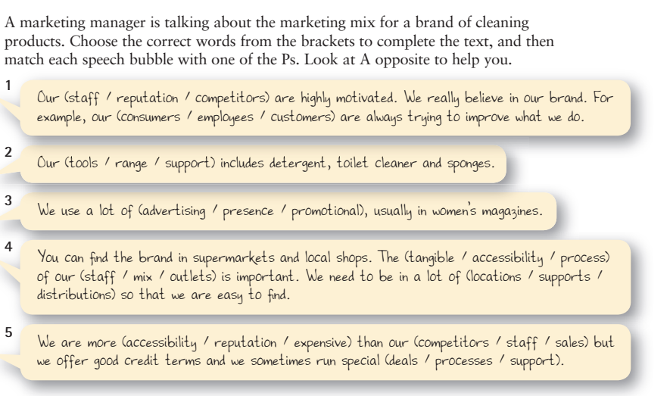
EX 1

Slide 7
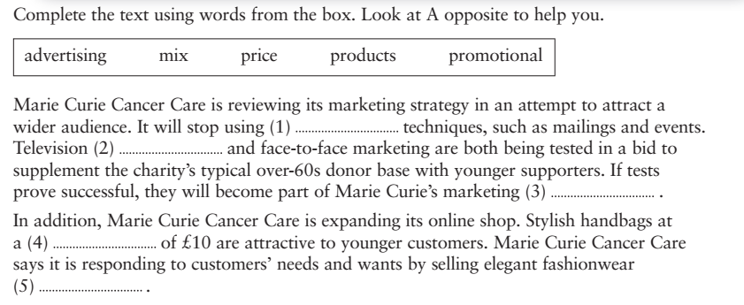
EX 2

Slide 8
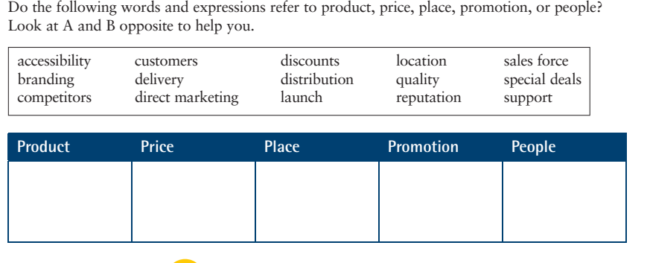
EX 3

Slide 9
Thanks

