Slide 1
Human resources slide 1
HUMAN RESOURCES PLANNING
ABDERRAOUF BENREBIAI
LACHI IMAD SALAH EDDINE
BOURAFAI ABDELDJALIL

Slide 2
Introduction
Globally Major issues in today’s organizations are skill shortages, competency gaps, redundancies, downsizing, rightsizing. and that’s what made manpower planning or what we call Human Resource planning to appear because it make sure that the right quantity and quality of manpower are available at exact time and place they are needed.

Slide 3
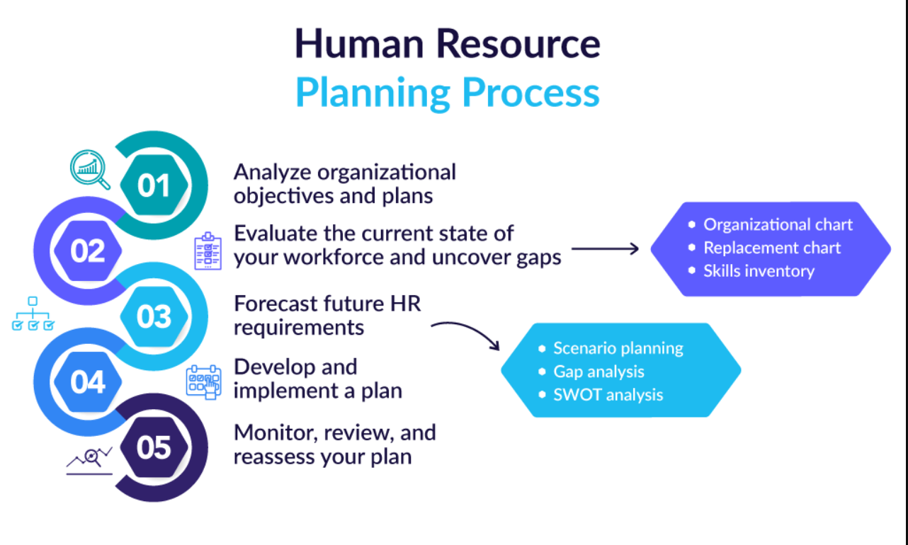
Consider an organization that is planning a large expansion into a new geographic region where it expects it will need to employ around 500 employees. The HR function for this organization would have a lot of planning to do. The HR team would need to:
Understand the employment laws and regulations of this new jurisdiction and work with department heads to identify staffing needs for the new location.
Get to know the local labor market and determine the most effective means of attracting talent.
Plan for large-scale on boarding of new hires.
Next, imagine a company that has an older workforce, a large proportion of whom are nearing retirement age. This organization’s HR team should be thinking about the looming large-scale attrition of workers and planning to both replace those employees and retain as much of their institutional knowledge as possible before they’re gone.
HRP is the process by which an organization ensures that it has the right number and kind of people, at the right places, at the right time. HR planning: Compares the present state of the organization with its goals for the future. Identifies what changes it must make in HR to meet these goals.
HRP is a process of forecasting a firm’s future demand for, and supply of, The right type of people In the right number.
HRP includes estimation of how many qualified people are necessary to carry out the assigned activities, how many people will be available, and what , if anything, must be done to ensure that personnel supply equals personnel demand at the appropriate time in the future.
HR planning results in reduced labour costs.
It serves as basis for planning of employee development for the optimum use of worker’s skills in the organization.
It enables identification of gaps of the existing personnel so that corrective training is imparted.
It leads to improvement in the overall business planning process.
It helps in formulating managerial succession plan as a part of the replacement planning process.
It helps to evaluate the effect of alternative human resource policies and actions taken.
STEPS OF HR PLANNING
To ensure optimum use of present human resource.
To avoid imbalances in the distribution and allocation of human resources in the different departments of the organization.
To assess or forecast the future skills requirements for the organization.
To provide control measure to ensure availability of necessary human resources when required.
To control the cost aspect of the human resource.
To provide data for taking transfer and promotion decisions.
F
CONTENTS
Lack of understanding of rationale for planning.
Insufficient support of top management.
Insufficient initial support.
Lack of co-ordination with the other functions.
Lack of integration with organizational plans.
Resistance from employees.
Expensive and time consuming.
Environmental uncertainties.
Insufficient Information.
E
D
*
Introduction
Organised Effort.
Support of top level management.
Integration with corporate plans.
Involvement of operative managers.
Environmental forecasting.
Human resource information system.
C
B
A
HR PLANNING DEFINITION
B
IMPORTANCE OF HR PLANNING
A
C
OBJECTIVES OF HR PLANNING
D
GUIDELINES FOR EFFECTIVE HR PLANNING
E
PROBLEMS OF HR PLANNING
F
STEPS OF HR PLANNING
*
Conclusion

Slide 4
Conclusion
HRP is required for an organisation to be effective.
HRP needs to be fully in integrated to the organisation plan.
Secret of success is the right type of people available in the
right number at time at right place.

Slide 5
THE END
Success is the sum of small efforts - repeated day in and day out.
Robert Collier
“Business opportunities are like buses. There’s always another one coming.”
Richard Branson

Slide 6
REFERENCES
‪Management of VA : Improved Human Resource Planning Needed to Achieve Str: Report to the Secretary of Veteran Affairsategic Goals‬‏. USA : ‪The Office‬‏, 1993.
‪Human Resource Issues in International Tourism‬‏. UK : ‪Elsevier Science‬‏, 2016.
‪Biles‬‏, ‪George E.‬‏., ‪Holmberg‬‏, ‪Stevan R.‬‏. ‪Strategic Human Resources Planning‬‏. USA: ‪T. Horton‬‏, 1980.
https://www.aihr.com/blog/human-resource-planning-process/
REFERENCES

