Slide 1
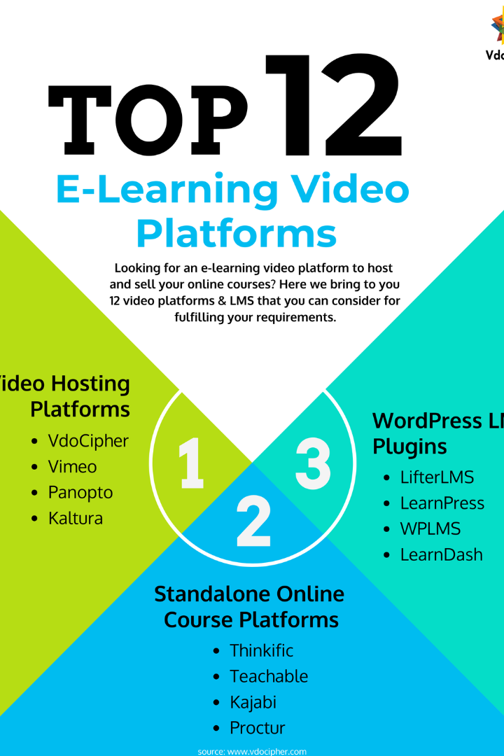
E-Learning: Unlocking the Future of Education
Welcome to the world of e-learning! As technology advances, education is evolving. Discover the definition, benefits, and potential challenges of e-learning, along with future trends.
By: Boussekar chahla

Slide 2
Definition of E-Learning
1
Flexible Learning
2
Online Education
3
Personalized Learning
E-learning refers to the delivery of educational content and training through digital platforms, enabling learners to access materials anytime, anywhere.
It encompasses online courses, virtual classrooms, webinars, and interactive learning tools that enhance engagement and knowledge retention.
E-learning empowers learners to tailor their educational experiences, choosing their pace of learning and focusing on areas that need improvement.

Slide 3
Benefits of E-Learning
Accessibility
Cost-Effectiveness
E-learning breaks down geographical barriers, making quality education accessible to individuals worldwide.
Eliminating the need for physical classrooms and resources, e-learning significantly reduces costs for both learners and institutions.
Flexibility
Engagement
Learners have the freedom to choose when and where to study, fitting education into their busy schedules.
Interactive multimedia elements such as videos, quizzes, and gamification enhance learner engagement and knowledge retention.

Slide 4
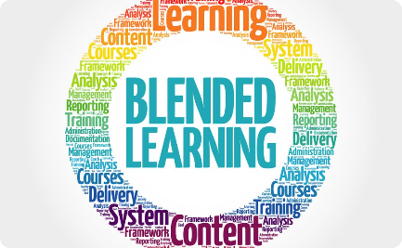
Different Types of E-Learning
Synchronous E-Learning
Asynchronous E-Learning
Blended Learning
Real-time learning where learners and instructors interact simultaneously, typically through video conferences and chat platforms.
Self-paced learning where learners access materials and complete activities at their own convenience, without direct real-time interaction.
A combination of online and traditional face-to-face instruction, offering a flexible and personalized learning experience.

Slide 5
Examples of Successful E-Learning Platforms
1
Coursera
Online platform providing access to courses from top universities and organizations worldwide, catering to diverse fields and interests.
2
LinkedIn Learning
Offers a vast library of video-based courses and learning paths, empowering professionals to acquire in-demand skills and advance their careers.
3
Khan Academy
A non-profit organization offering free educational resources and personalized learning tools for K-12 students and beyond.

Slide 6
Challenges in Implementing E-Learning
1
Technical Infrastructure
2
Digital Inclusion
3
Educator Training
Ensuring equitable access to e-learning for all individuals, regardless of socio-economic background or geographical location.
Providing comprehensive professional development for teachers to effectively facilitate e-learning and maximize student engagement.
Sufficient internet connectivity, reliable devices, and learning management systems are necessary to support seamless e-learning experiences.

Slide 7
Best Practices for E-Learning Design and Development
Engaging Multimedia
Clear Navigation
Collaborative Learning
Include videos, interactive quizzes, and visually compelling graphics to enhance learner engagement.
Organize content in a logical structure with intuitive navigation menus for easy learner exploration.
Foster a sense of community by incorporating discussion boards, group projects, and peer feedback opportunities.
Ensure clear instructions and easily accessible resources for a seamless learning experience.
Use audio narration to cater to different learning styles and reinforce key concepts.
Promote social learning and knowledge exchange among learners.

Slide 8
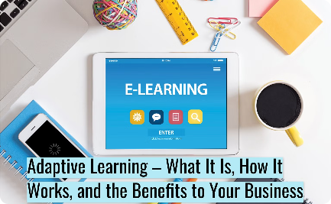
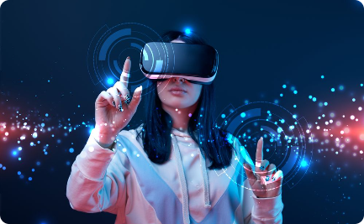
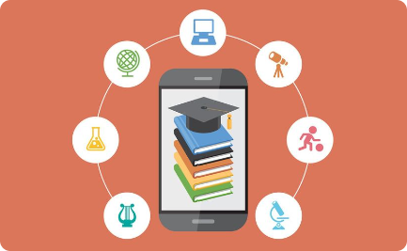
Future Trends in E-Learning
Adaptive E-Learning
Virtual Reality Integration
Mobile Learning
Intelligent systems leveraging Artificial Intelligence (AI) technology to personalize learning experiences based on individual learner's abilities and needs.
Immersive learning experiences using virtual reality (VR) technology, allowing learners to interact with realistic simulations and practice real-world skills.
Learning materials optimized for mobile devices, enabling learners to access content on-the-go and promote continuous learning.

